Slide 1
Chapter 10 C Structures, Unions, Bit Manipulation and Enumerations

Slide 2
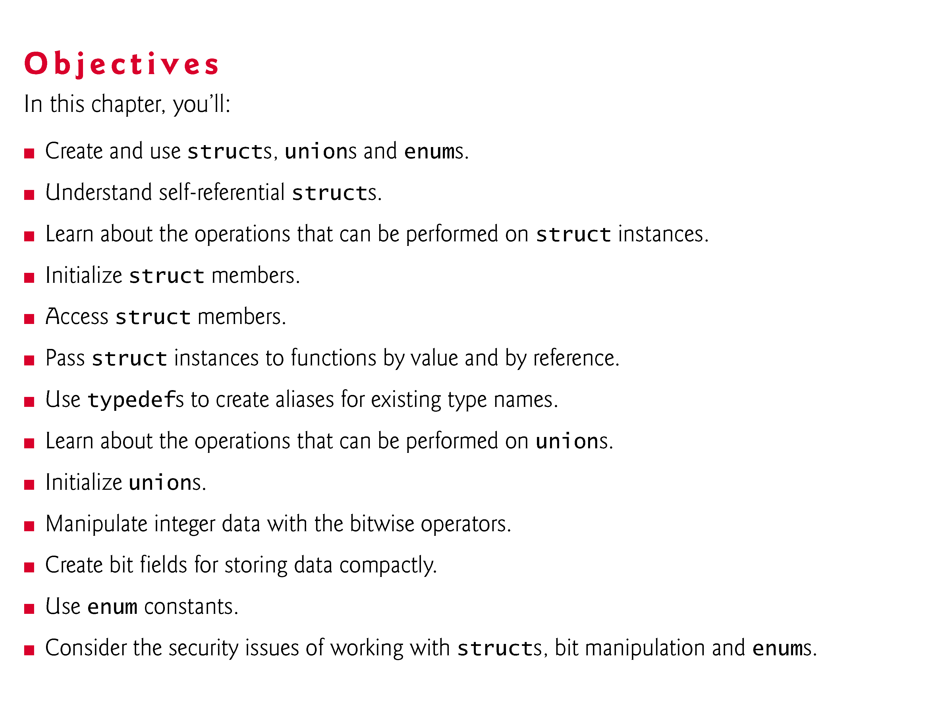

Slide 3
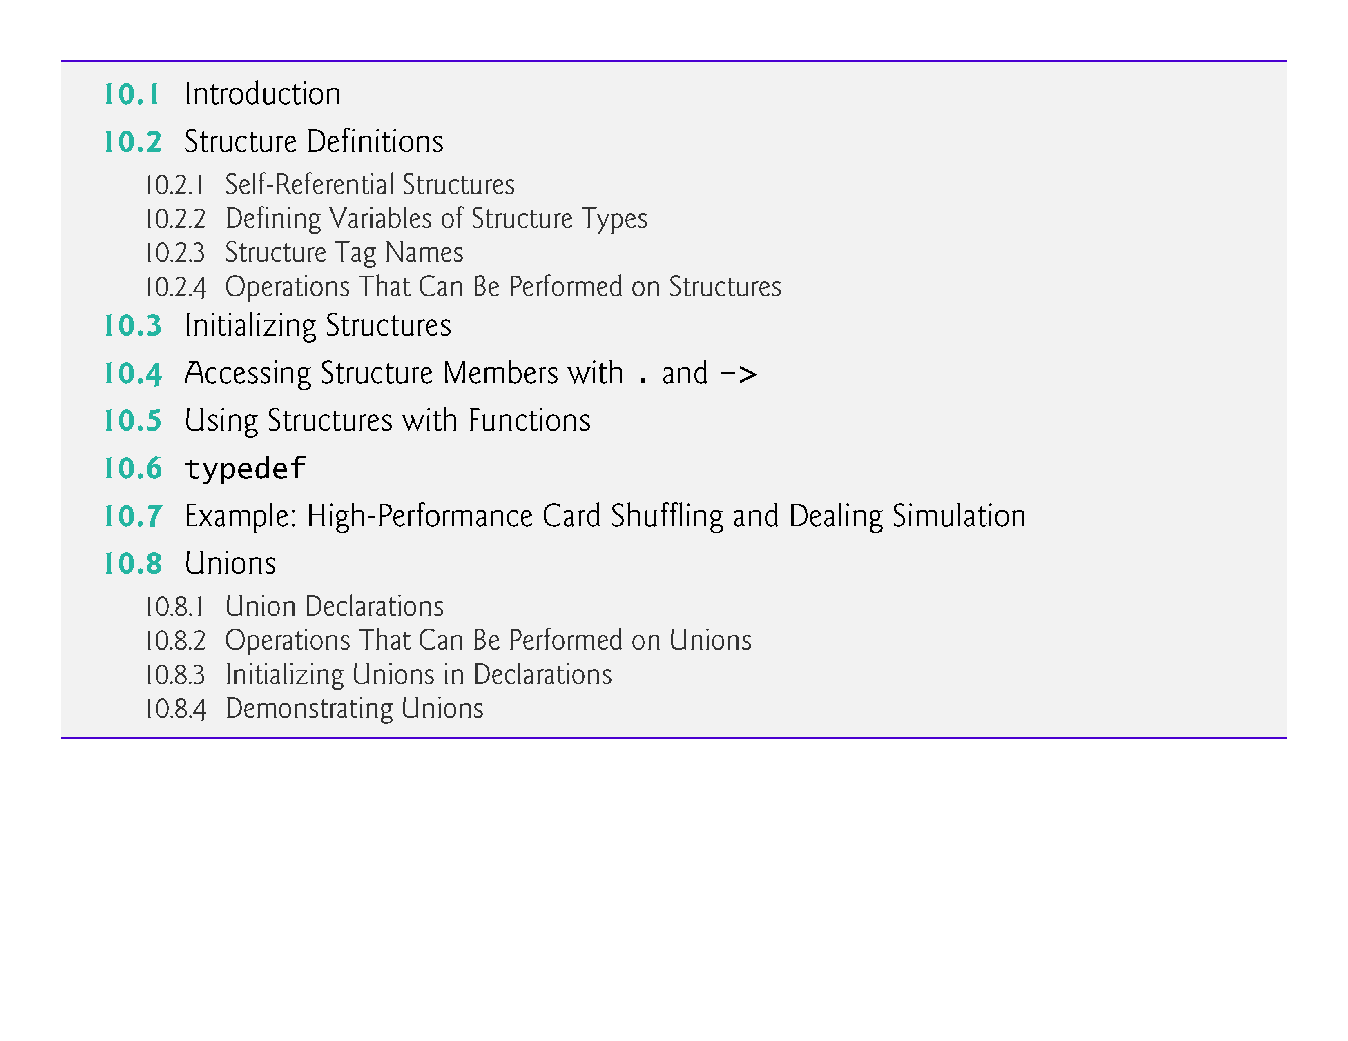

Slide 4
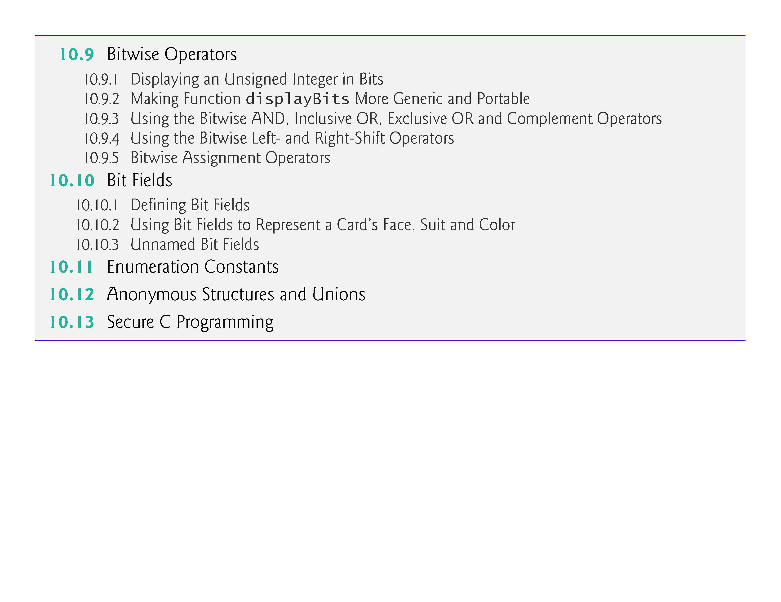

Slide 5
10.1 Introduction
Structures—sometimes referred to as aggregates—are collections of related variables under one name.
Structures may contain variables of many different data types—in contrast to arrays, which contain only elements of the same data type.
Structures are commonly used to define records to be stored in files (see Chapter 11, C File Processing).
Pointers and structures facilitate the formation of more complex data structures such as linked lists, queues, stacks and trees (see Chapter 12, C Data Structures).

Slide 6
10.1 Introduction (Cont.)
We’ll also discuss:
typedefs—for creating aliases for previously defined data types
unions—derived data types like structures, but with members that share the same storage space
bitwise operators—for manipulating the bits of integral operands
bit fields—unsigned int or int members of structures or unions for which you specify the number of bits in which the members are stored, helping you pack information tightly
enumerations—sets of integer constants represented by identifiers.

Slide 7
10.2 Structure Definitions
Structures are derived data types—they’re constructed using objects of other types.
Consider the following structure definition:
struct card { char *face; char *suit; };
Keyword struct introduces the structure definition.
The identifier card is the structure tag, which names the structure definition and is used with struct to declare variables of the structure type—e.g., struct card.

Slide 8
10.2 Structure Definitions (Cont.)
Variables declared within the braces of the structure definition are the structure’s members.
Members of the same structure type must have unique names, but two different structure types may contain members of the same name without conflict (we’ll soon see why).
Each structure definition must end with a semicolon.

Slide 9
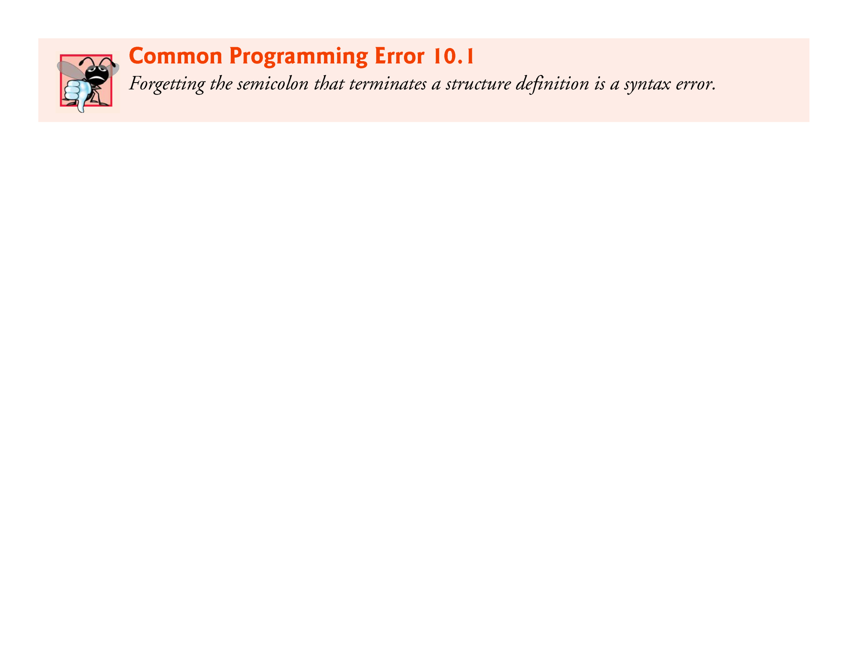

Slide 10
10.2 Structure Definitions (Cont.)
The definition of struct card contains members face and suit, each of type char *.
Structure members can be variables of the primitive data types (e.g., int, float, etc.), or aggregates, such as arrays and other structures.
Structure members can be of many types.

Slide 11
10.2 Structure Definitions (Cont.)
For example, the following struct contains character array members for an employee’s first and last names, an unsigned int member for the employee’s age, a char member that would contain 'M' or 'F' for the employee’s gender and a double member for the employee’s hourly salary:,
struct employee { char firstName[20]; char lastName[20]; unsigned int age; char gender; double hourlySalary; };

Slide 12
10.2.1 Self-Referential Structures
A structure cannot contain an instance of itself.
For example, a variable of type struct employee cannot be declared in the definition for struct employee.
A pointer to struct employee, however, may be included.
For example,
struct employee2 { char firstName[20]; char lastName[20]; unsigned int age; char gender; double hourlySalary; struct employee2 person; // ERROR struct employee2 *ePtr; // pointer };
struct employee2 contains an instance of itself (person), which is an error.

Slide 13
10.2 Structure Definitions (Cont.)
Because ePtr is a pointer (to type struct employee2), it’s permitted in the definition.
A structure containing a member that’s a pointer to the same structure type is referred to as a self-referential structure.
Self-referential structures are used in Chapter 12 to build linked data structures.

Slide 14
10.2.2 Defining Variables of Structure Types
Structure definitions do not reserve any space in memory; rather, each definition creates a new data type that’s used to define variables.
Structure variables are defined like variables of other types.
The definition
struct card aCard, deck[52], *cardPtr;
declares aCard to be a variable of type struct card, declares deck to be an array with 52 elements of type struct card and declares cardPtr to be a pointer to struct card.

Slide 15
10.2 Structure Definitions (Cont.)
Variables of a given structure type may also be declared by placing a comma-separated list of the variable names between the closing brace of the structure definition and the semicolon that ends the structure definition.
For example, the preceding definition could have been incorporated into the struct card definition as follows:
struct card { char *face; char *suit; } aCard, deck[52], *cardPtr;

Slide 16
10.2.3 Structure Tag Names
The structure tag name is optional.
If a structure definition does not contain a structure tag name, variables of the structure type may be declared only in the structure definition—not in a separate declaration.

Slide 17
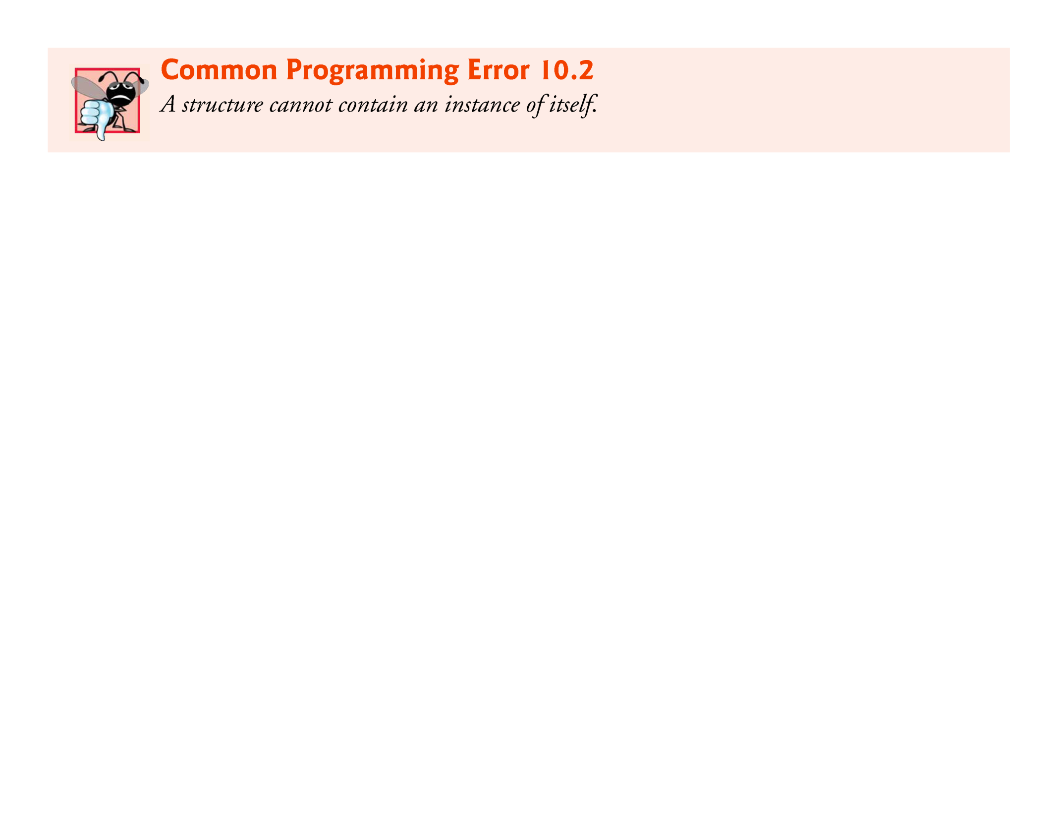

Slide 18
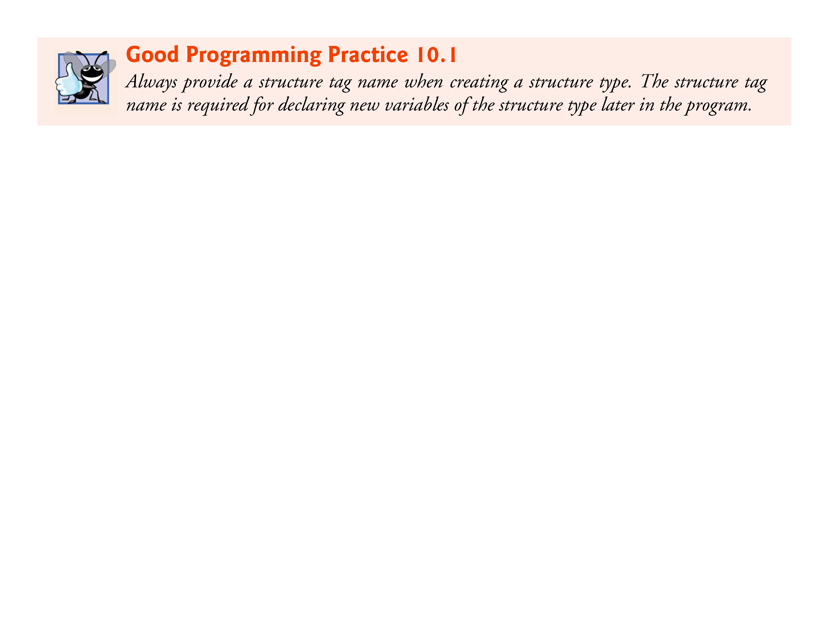

Slide 19
10.2.4 Operations That Can Be Performed on Structures
The only valid operations that may be performed on structures are:
assigning structure variables to structure variables of the same type,
taking the address (&) of a structure variable,
accessing the members of a structure variable (see Section 10.4) and
using the sizeof operator to determine the size of a structure variable.

Slide 20


Slide 21
10.2.4 Operations That Can Be Performed on Structures (Cont.)
Structures may not be compared using operators == and !=, because structure members are not necessarily stored in consecutive bytes of memory.
Sometimes there are “holes” in a structure, because computers may store specific data types only on certain memory boundaries such as half-word, word or double-word boundaries.
A word is a standard memory unit used to store data in a computer—usually 2 bytes or 4 bytes.

Slide 22
10.2 Structure Definitions (Cont.)
Consider the following structure definition, in which sample1 and sample2 of type struct example are declared:
struct example { char c; int i; } sample1, sample2;
A computer with 2-byte words may require that each member of struct example be aligned on a word boundary, i.e., at the beginning of a word (this is machine dependent).

Slide 23
10.2 Structure Definitions (Cont.)
Figure 10.1 shows a sample storage alignment for a variable of type struct example that has been assigned the character 'a' and the integer 97 (the bit representations of the values are shown).
If the members are stored beginning at word boundaries, there’s a 1-byte hole (byte 1 in the figure) in the storage for variables of type struct example.
The value in the 1-byte hole is undefined.
Even if the member values of sample1 and sample2 are in fact equal, the structures are not necessarily equal, because the undefined 1-byte holes are not likely to contain identical values.

Slide 24
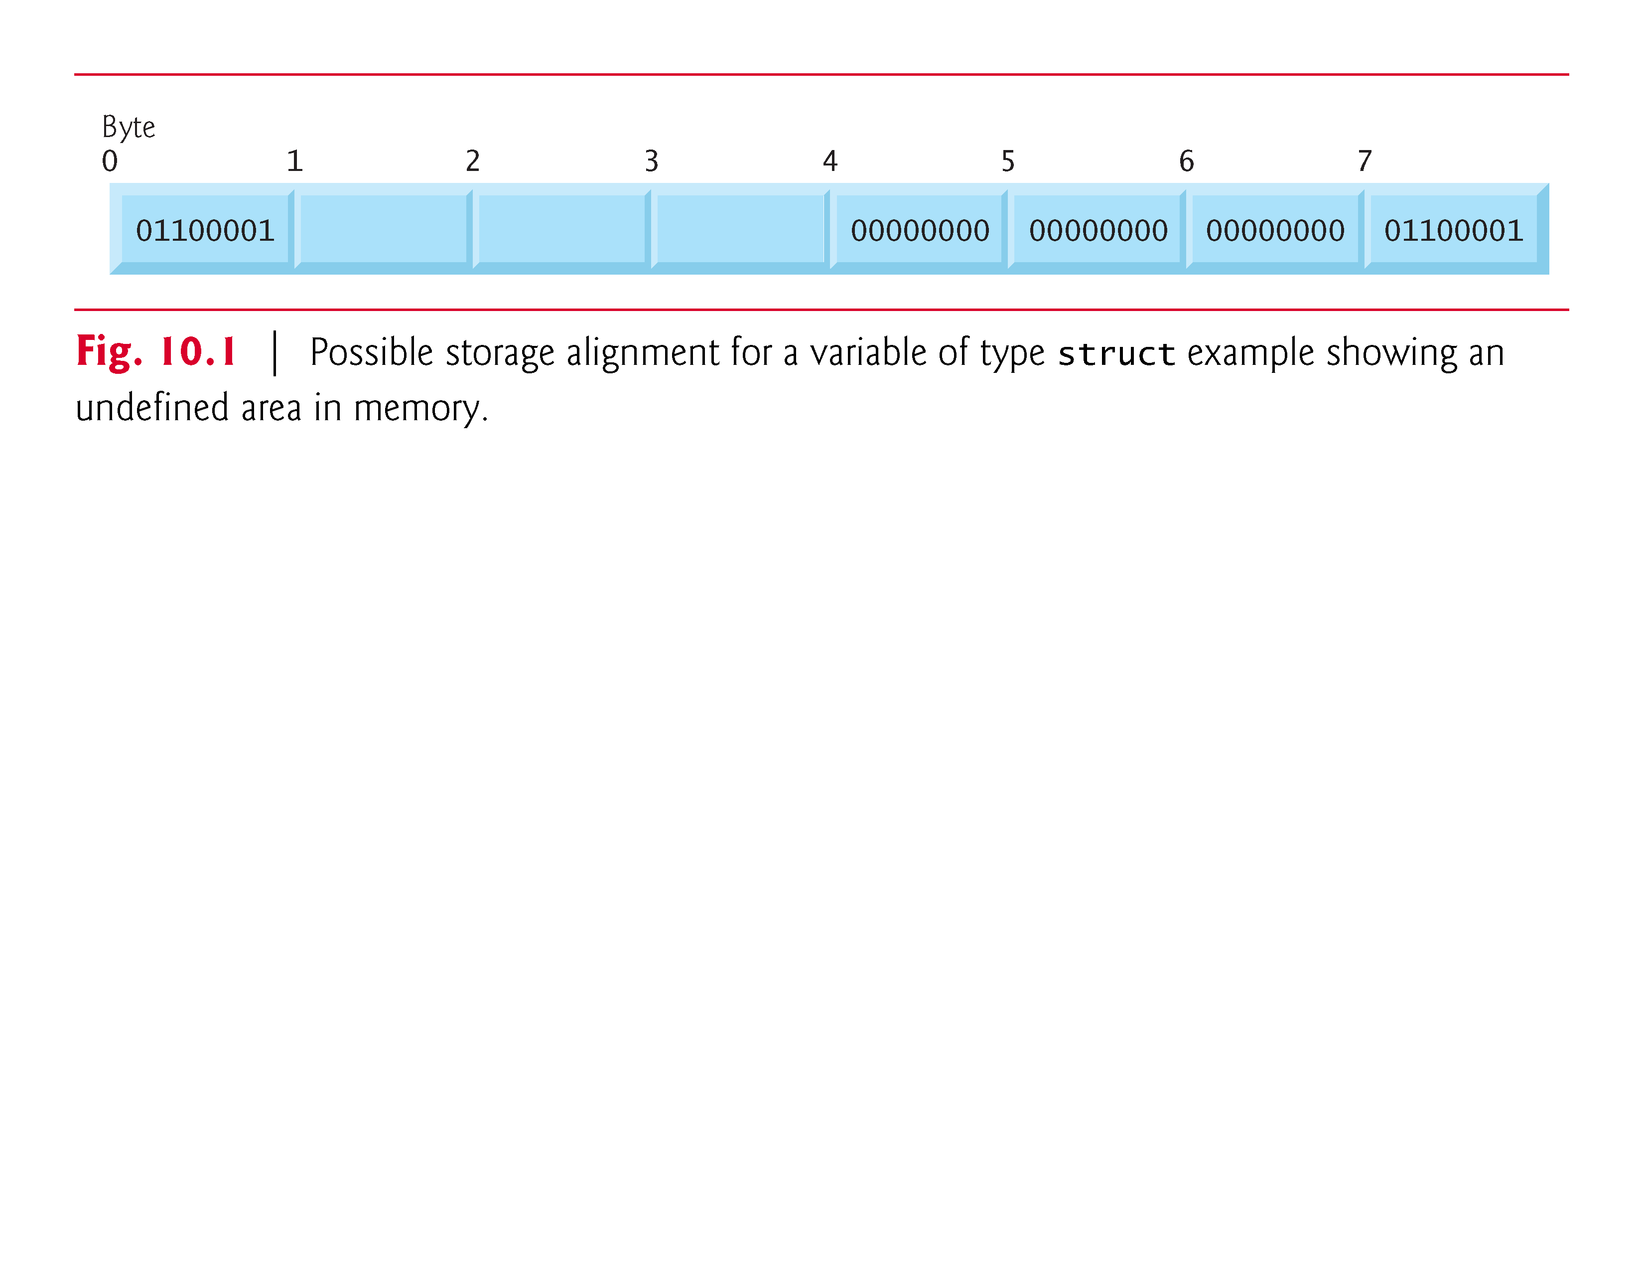

Slide 25
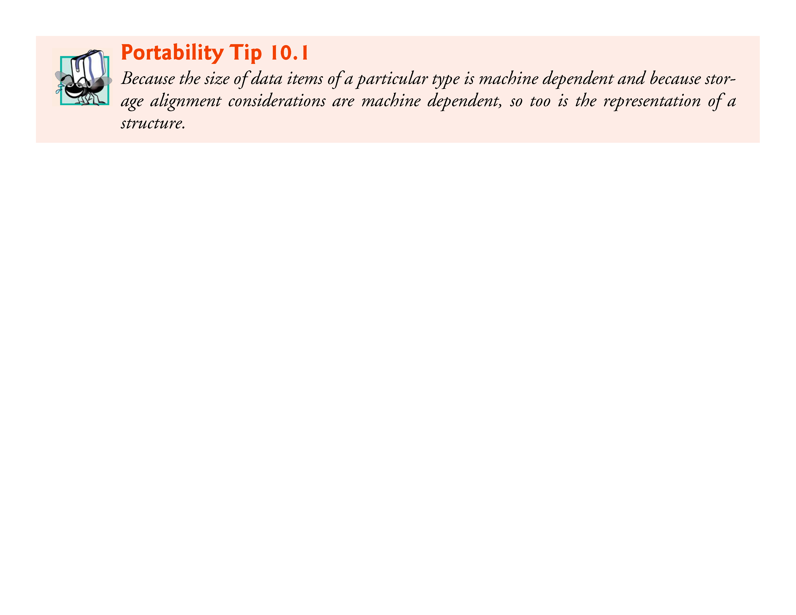

Slide 26
10.3 Initializing Structures
Structures can be initialized using initializer lists as with arrays.
To initialize a structure, follow the variable name in the definition with an equals sign and a brace-enclosed, comma-separated list of initializers.
For example, the declaration
struct card aCard = {"Three", "Hearts"};
creates variable aCard to be of type struct card (as defined in Section 10.2) and initializes member face to "Three" and member suit to "Hearts".

Slide 27
10.3 Initializing Structures (Cont.)
If there are fewer initializers in the list than members in the structure, the remaining members are automatically initialized to 0 (or NULL if the member is a pointer).
Structure variables defined outside a function definition (i.e., externally) are initialized to 0 or NULL if they’re not explicitly initialized in the external definition.
Structure variables may also be initialized in assignment statements by assigning a structure variable of the same type, or by assigning values to the individual members of the structure.

Slide 28
10.4 Accessing Structure Members
Two operators are used to access members of structures: the structure member operator (.)—also called the dot operator—and the structure pointer operator (->)—also called the arrow operator.
The structure member operator accesses a structure member via the structure variable name.
For example, to print member suit of structure variable aCard defined in Section 10.3, use the statement
printf("%s", aCard.suit); // displays Hearts

Slide 29
10.4 Accessing Structure Members (Cont.)
The structure pointer operator—consisting of a minus (-) sign and a greater than (>) sign with no intervening spaces—accesses a structure member via a pointer to the structure.
Assume that the pointer cardPtr has been declared to point to struct card and that the address of structure aCard has been assigned to cardPtr.
To print member suit of structure aCard with pointer cardPtr, use the statement
printf("%s", cardPtr->suit); // displays Hearts

Slide 30
10.4 Accessing Structure Members (Cont.)
The expression cardPtr->suit is equivalent to (*cardPtr).suit, which dereferences the pointer and accesses the member suit using the structure member operator.
The parentheses are needed here because the structure member operator (.) has a higher precedence than the pointer dereferencing operator (*).
The structure pointer operator and structure member operator, along with parentheses (for calling functions) and brackets ([]) used for array subscripting, have the highest operator precedence and associate from left to right.

Slide 31
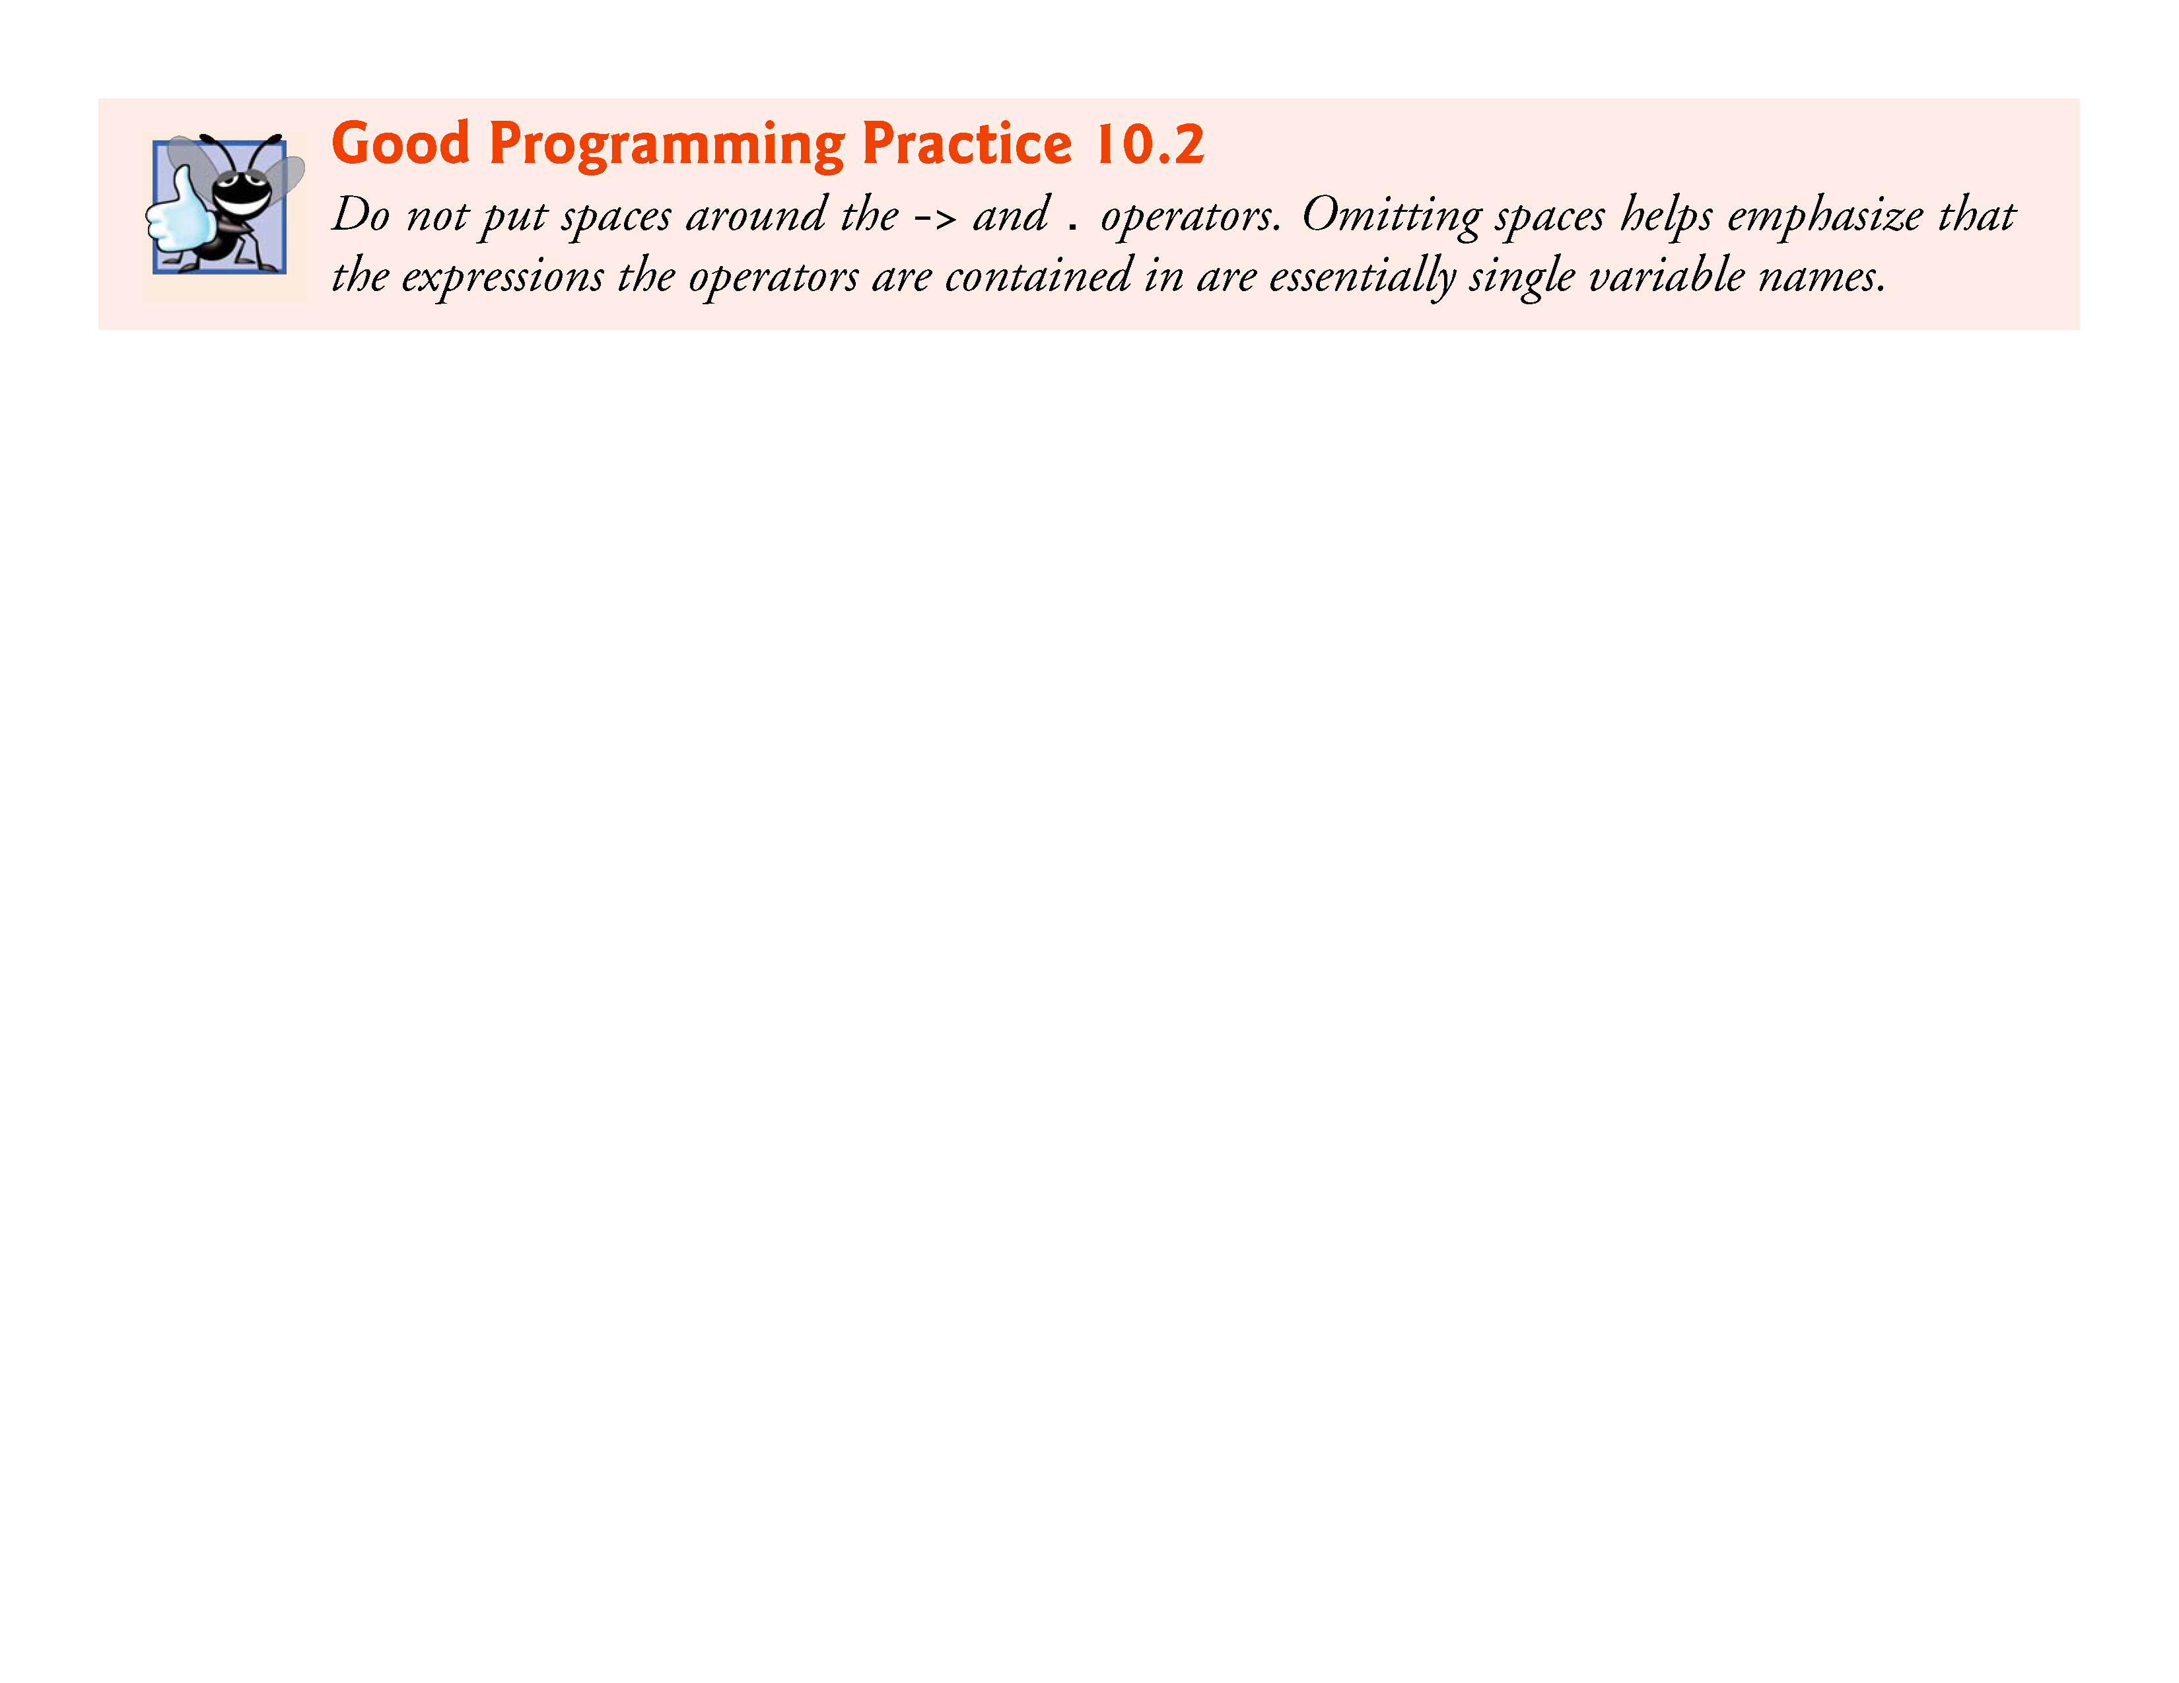

Slide 32
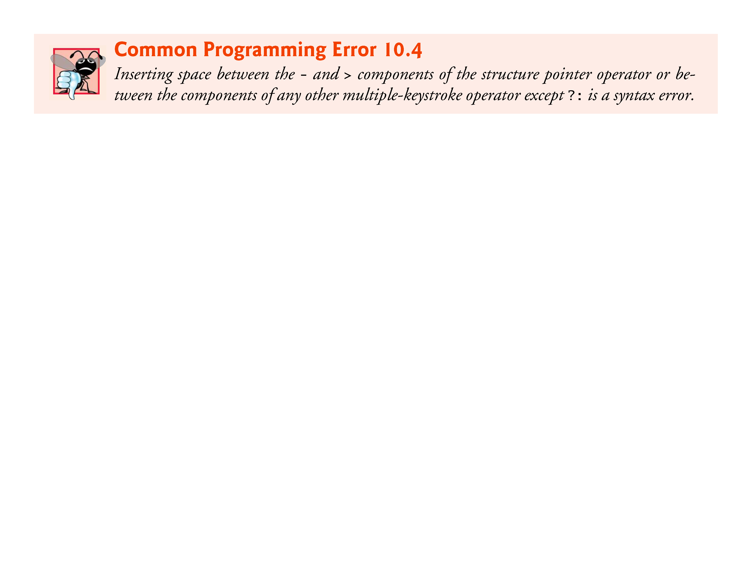

Slide 33


Slide 34
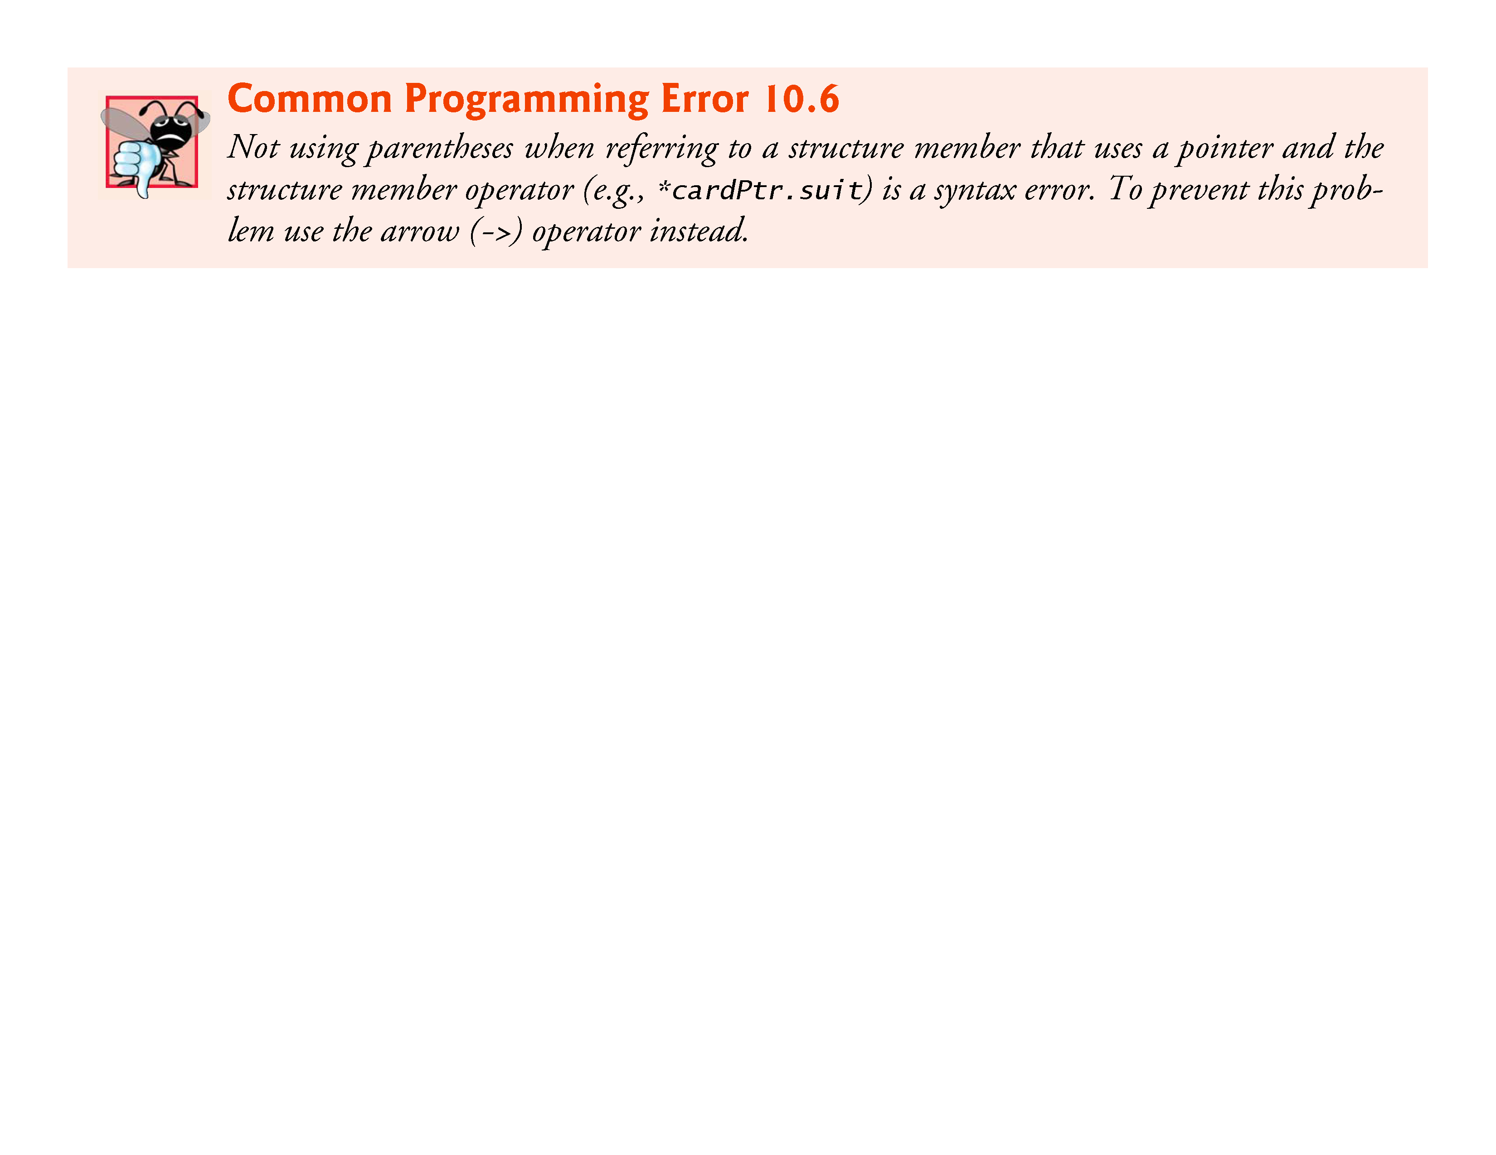

Slide 35
10.4 Accessing Structure Members (Cont.)
The program of Fig. 10.2 demonstrates the use of the structure member and structure pointer operators.
Using the structure member operator, the members of structure aCard are assigned the values "Ace" and "Spades", respectively
Pointer cardPtr is assigned the address of structure aCard
Function printf prints the members of structure variable aCard using the structure member operator with variable name aCard, the structure pointer operator with pointer cardPtr and the structure member operator with dereferenced pointer cardPtr

Slide 36
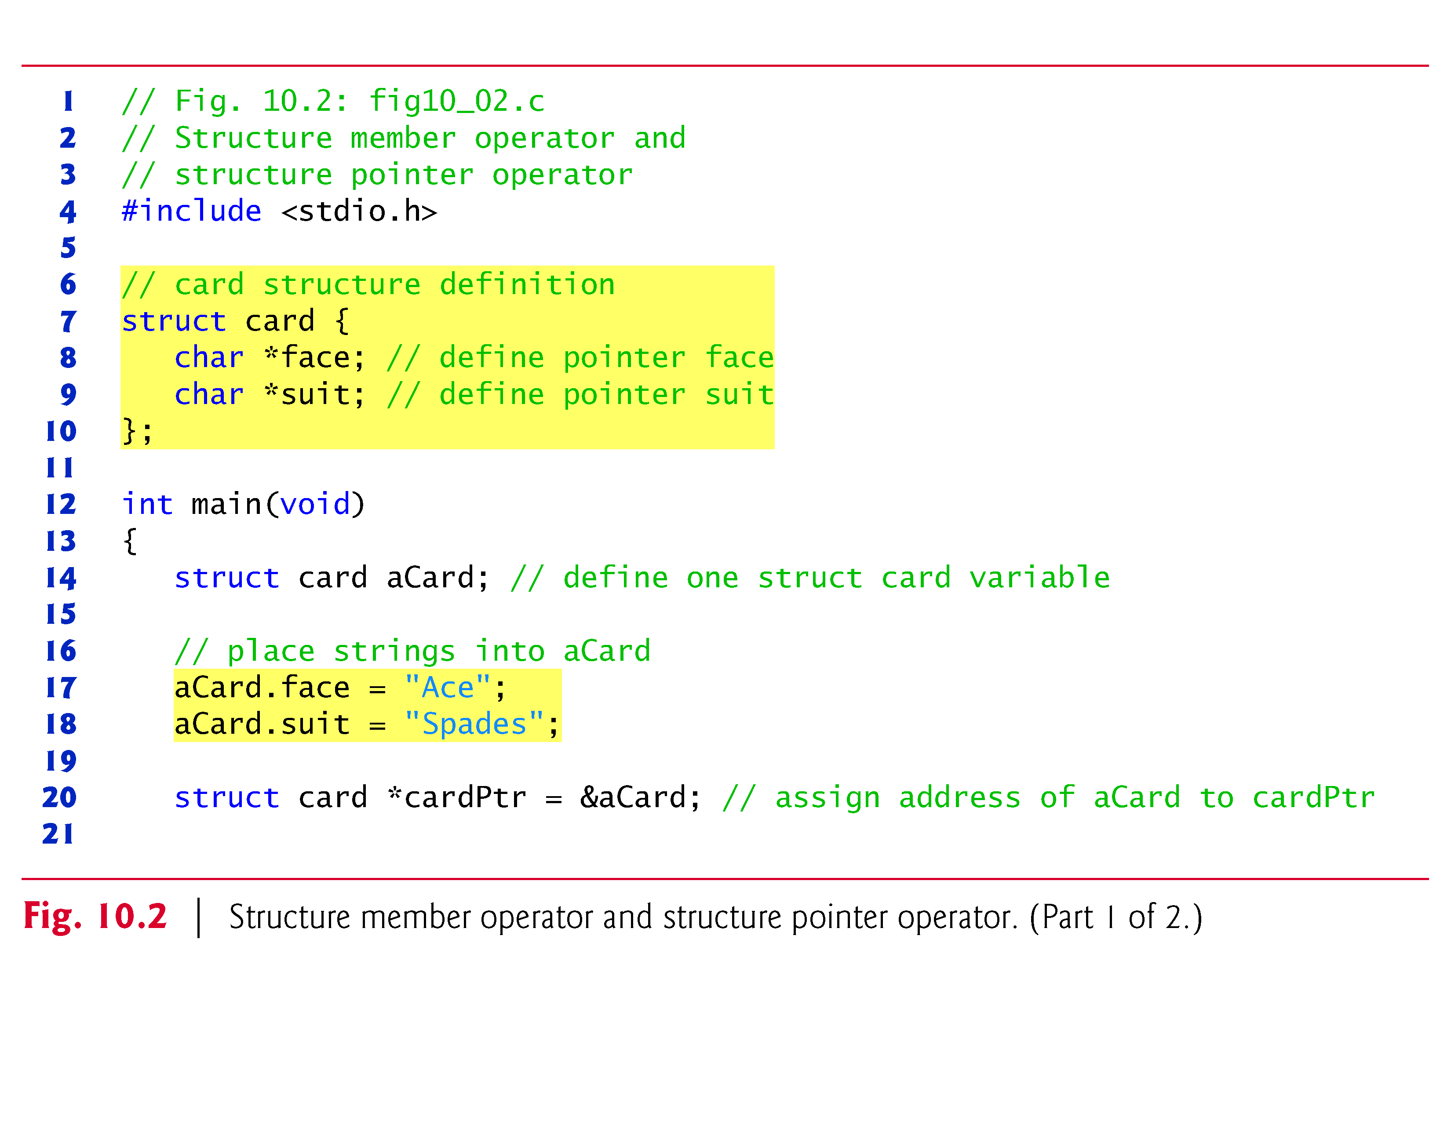

Slide 37
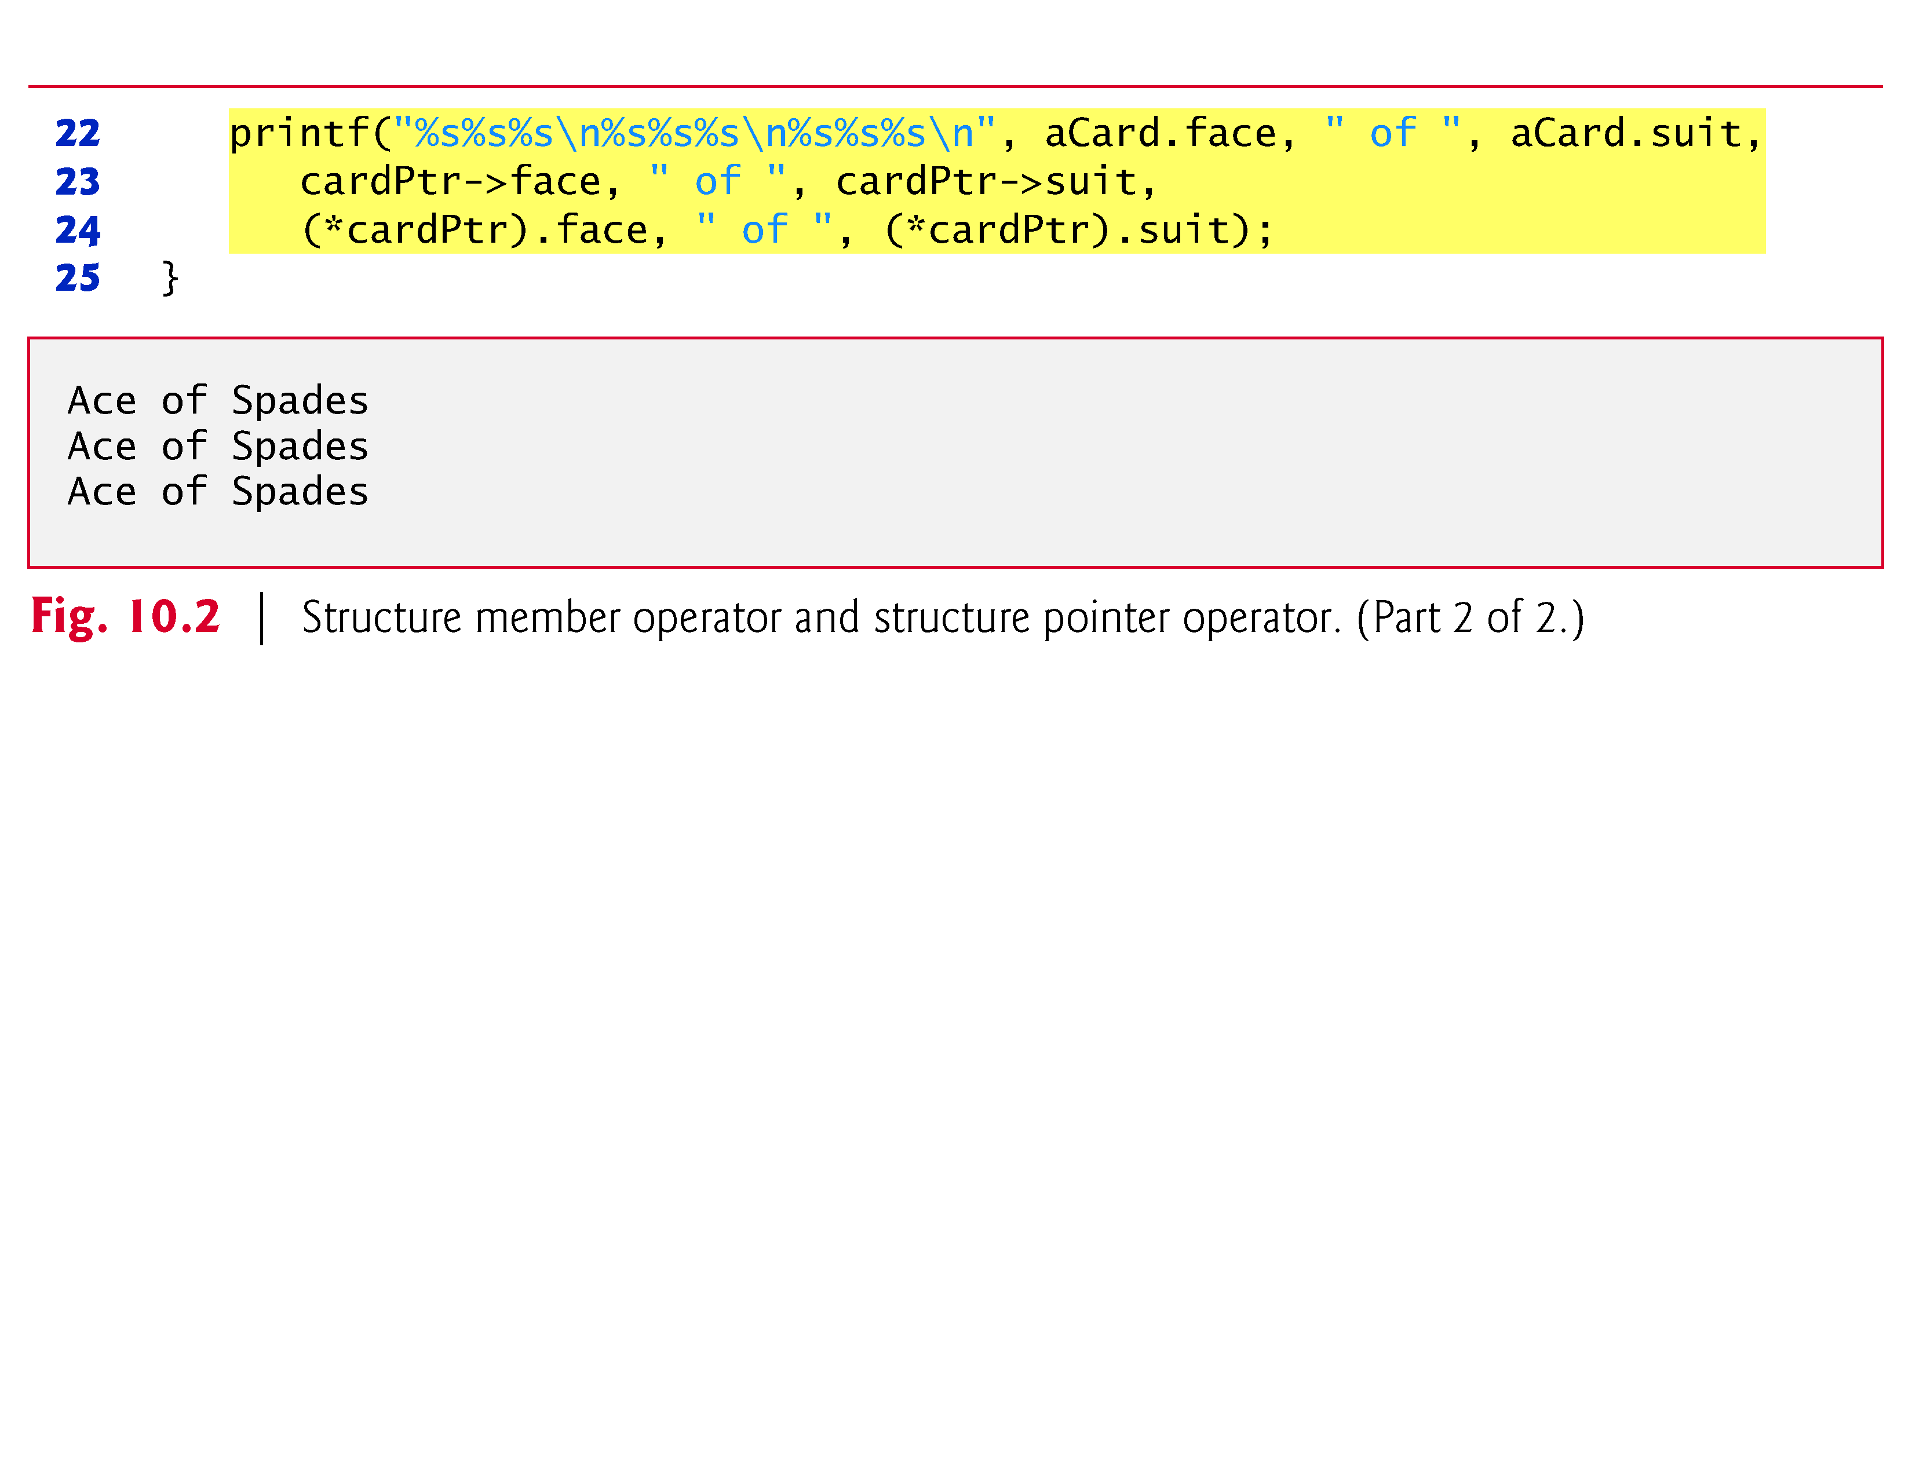

Slide 38
10.5 Using Structures with Functions
Structures may be passed to functions by passing individual structure members, by passing an entire structure or by passing a pointer to a structure.
When structures or individual structure members are passed to a function, they’re passed by value.
Therefore, the members of a caller’s structure cannot be modified by the called function.
To pass a structure by reference, pass the address of the structure variable.

Slide 39
10.5 Using Structures with Functions (Cont.)
Arrays of structures—like all other arrays—are automatically passed by reference.
To pass an array by value, create a structure with the array as a member.
Structures are passed by value, so the array is passed by value.

Slide 40
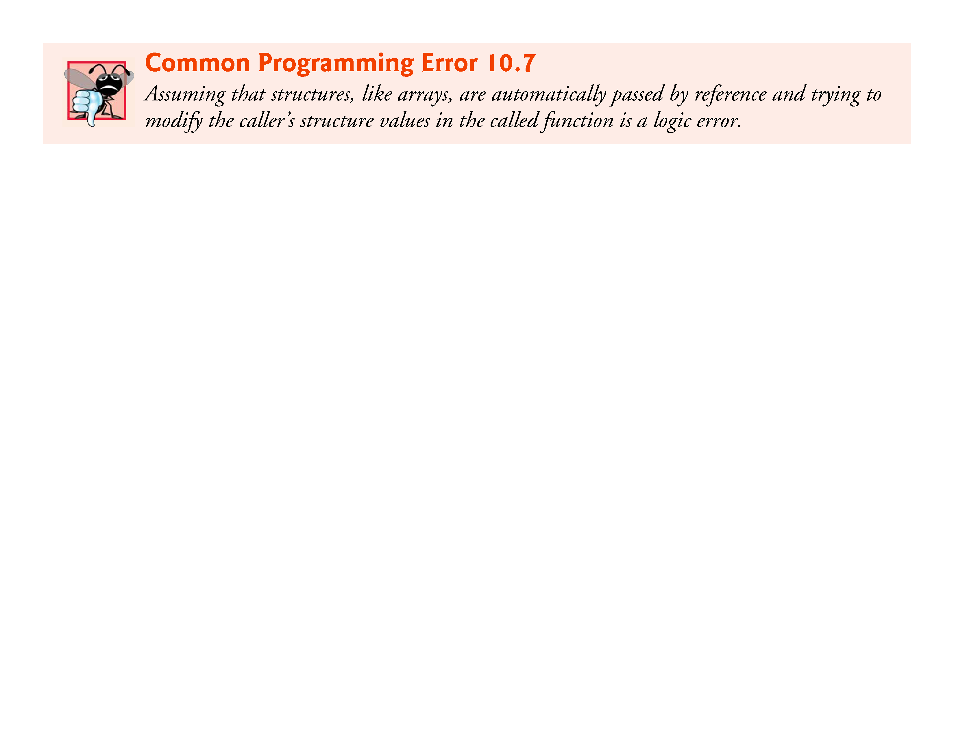

Slide 41
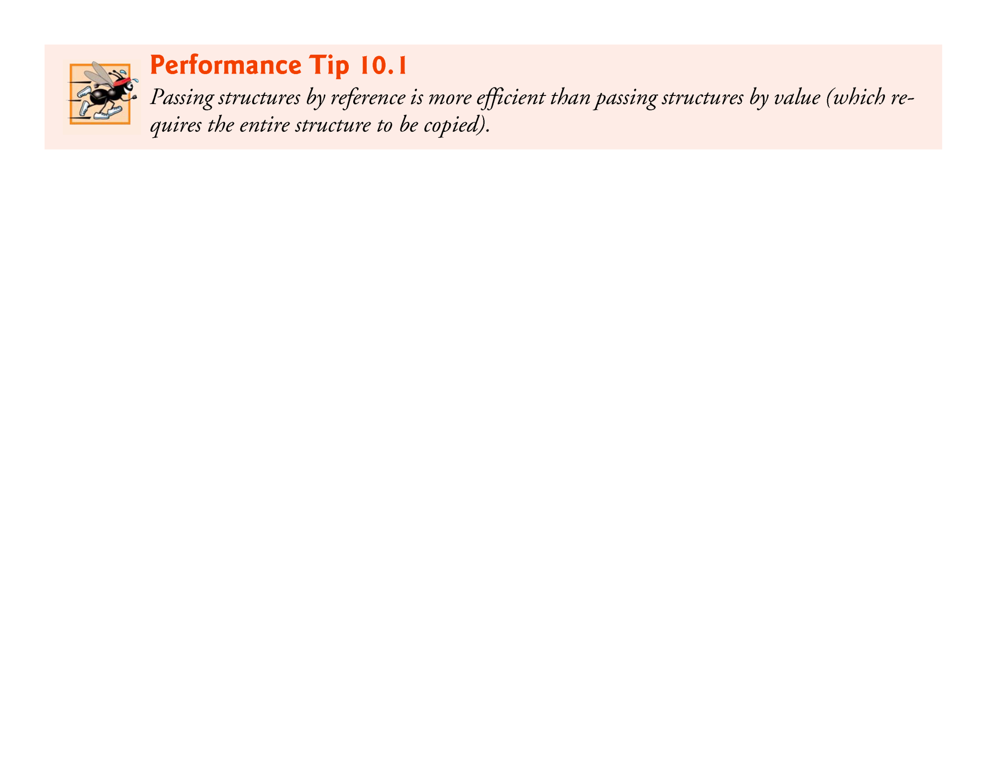

Slide 42
10.6 typedef
The keyword typedef provides a mechanism for creating synonyms (or aliases) for previously defined data types.
Names for structure types are often defined with typedef to create shorter type names.
For example, the statement
typedef struct card Card;
defines the new type name Card as a synonym for type struct card.
C programmers often use typedef to define a structure type, so a structure tag is not required.

Slide 43
10.6 typedef (Cont.)
For example, the following definition
typedef struct { char *face; char *suit; } Card;
creates the structure type Card without the need for a separate typedef statement.

Slide 44
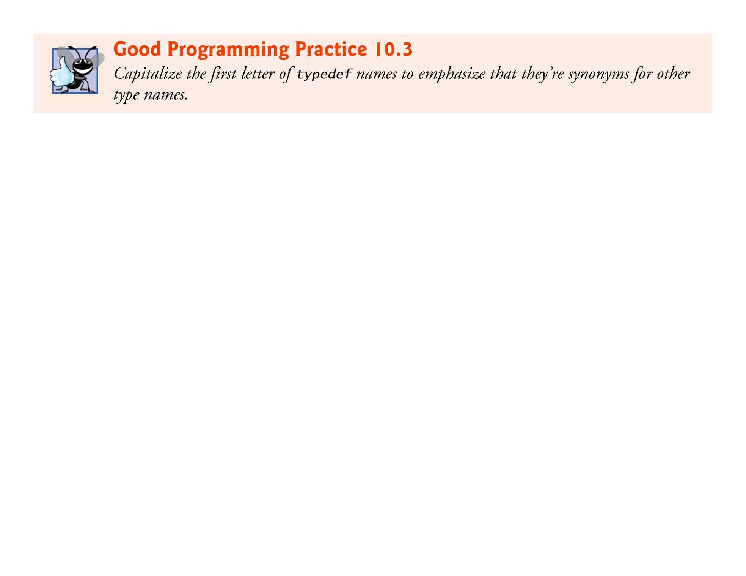

Slide 45
10.6 typedef (Cont.)
Card can now be used to declare variables of type struct card.
The declaration
Card deck[52];
declares an array of 52 Card structures (i.e., variables of type struct card).
Creating a new name with typedef does not create a new type; typedef simply creates a new type name, which may be used as an alias for an existing type name.

Slide 46
10.6 typedef (Cont.)
A meaningful name helps make the program self-documenting.
For example, when we read the previous declaration, we know “deck is an array of 52 Cards.”
Often, typedef is used to create synonyms for the basic data types.
For example, a program requiring four-byte integers may use type int on one system and type long on another.
Programs designed for portability often use typedef to create an alias for four-byte integers, such as Integer.
The alias Integer can be changed once in the program to make the program work on both systems.

Slide 47
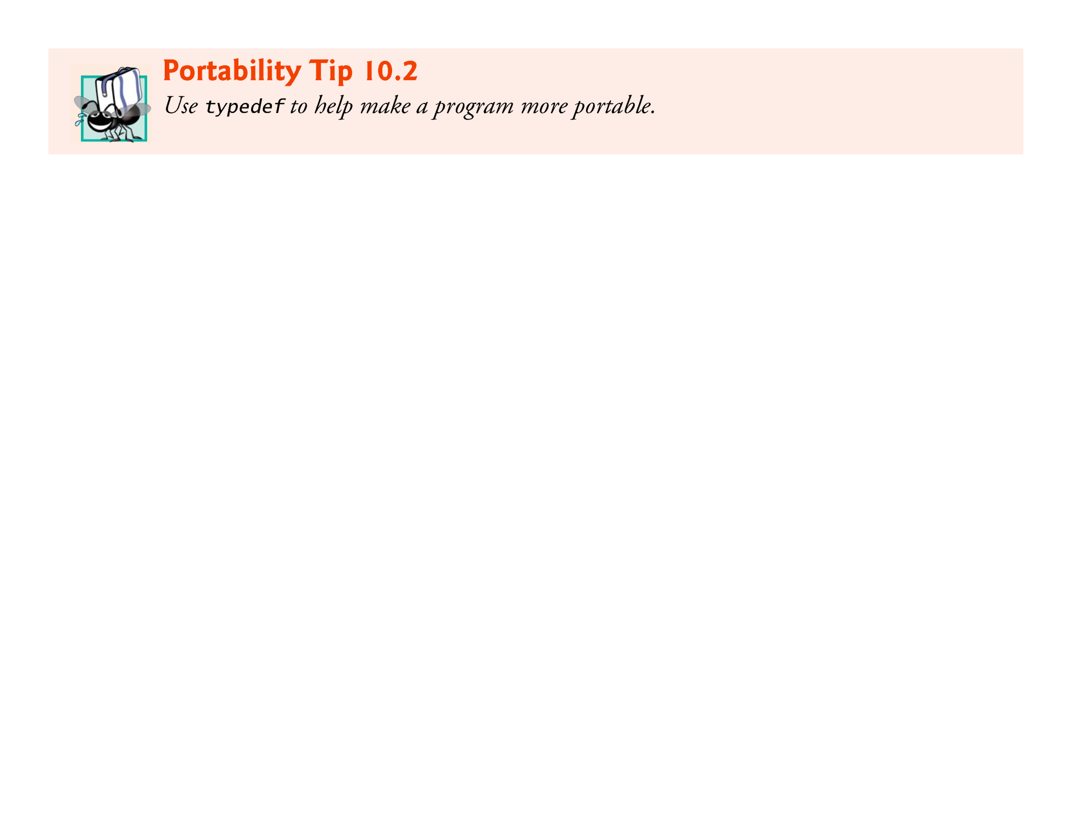

Slide 48


Slide 49
10.7 Example: High-Performance Card Shuffling and Dealing Simulation
The program in Fig. 10.3 is based on the card shuffling and dealing simulation discussed in Chapter 7.
The program represents the deck of cards as an array of structures and uses high-performance shuffling and dealing algorithms.
The program output is shown in Fig. 10.4.

Slide 50
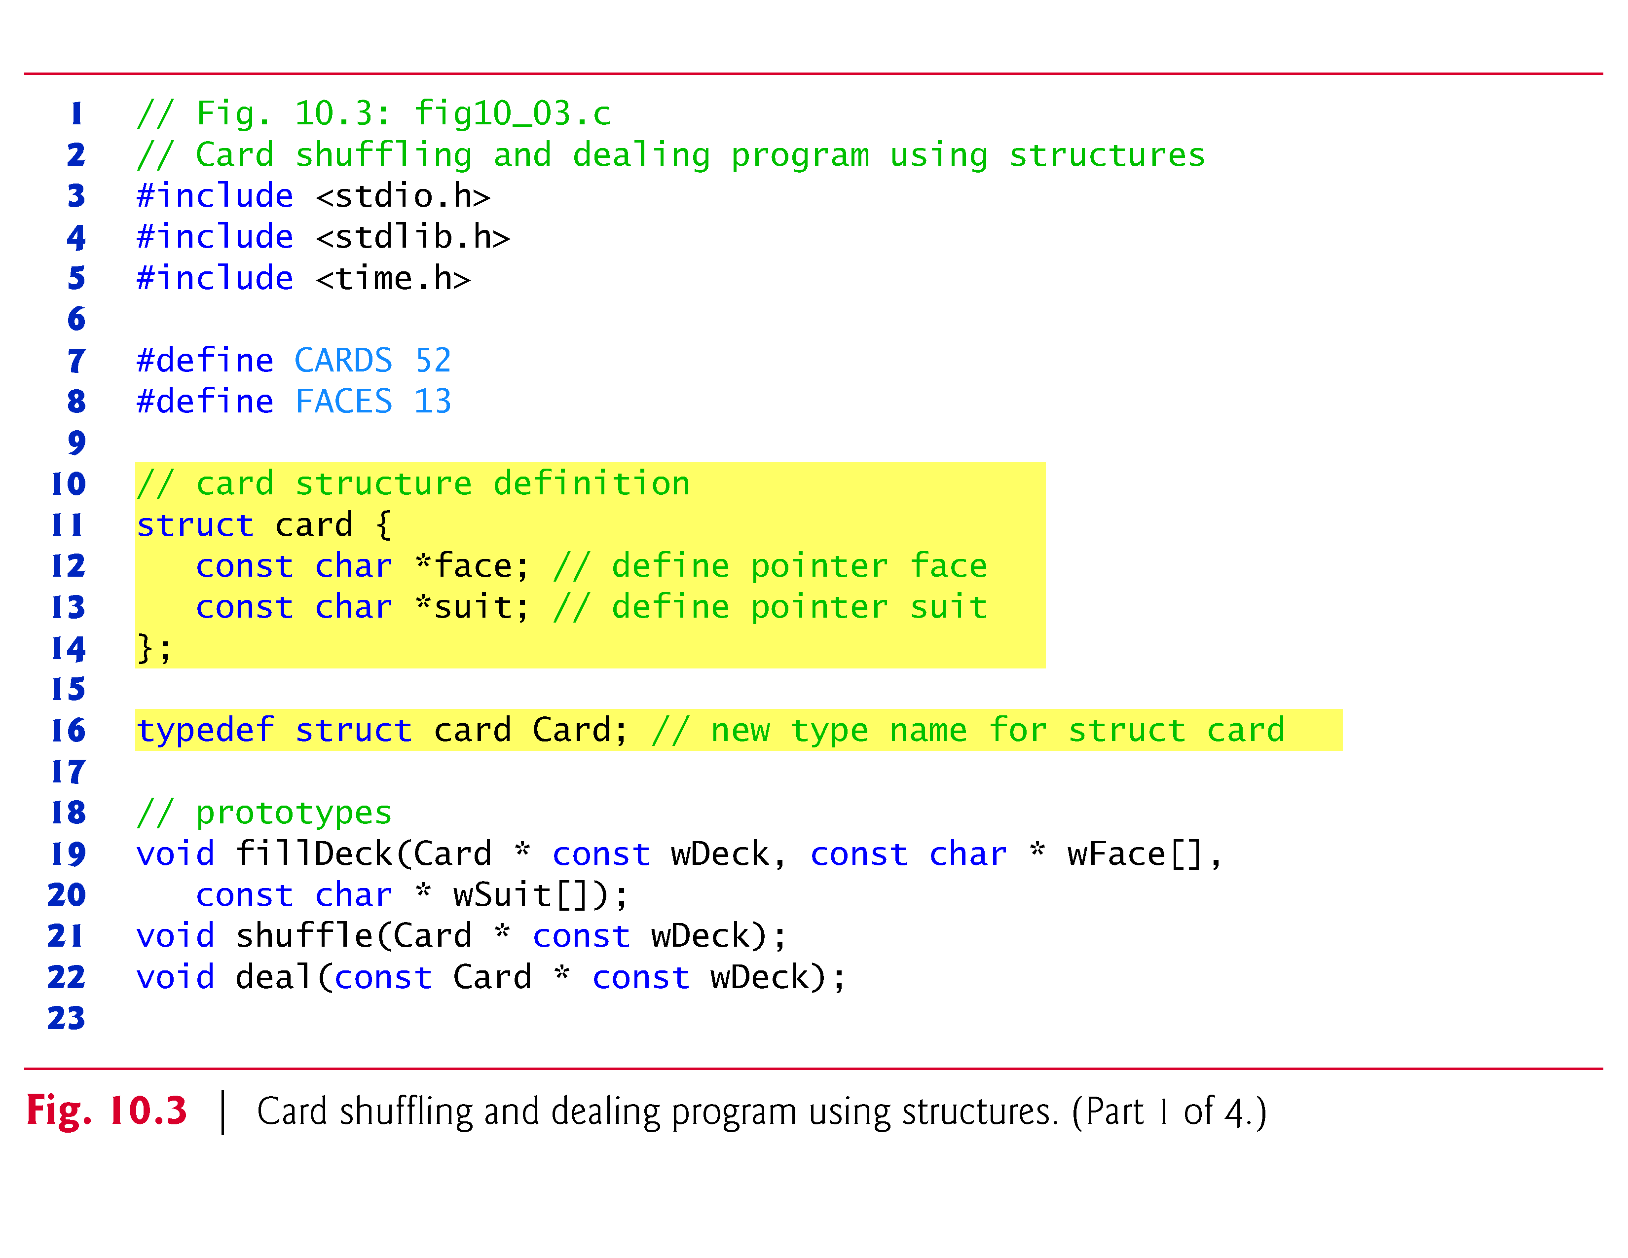

Slide 51
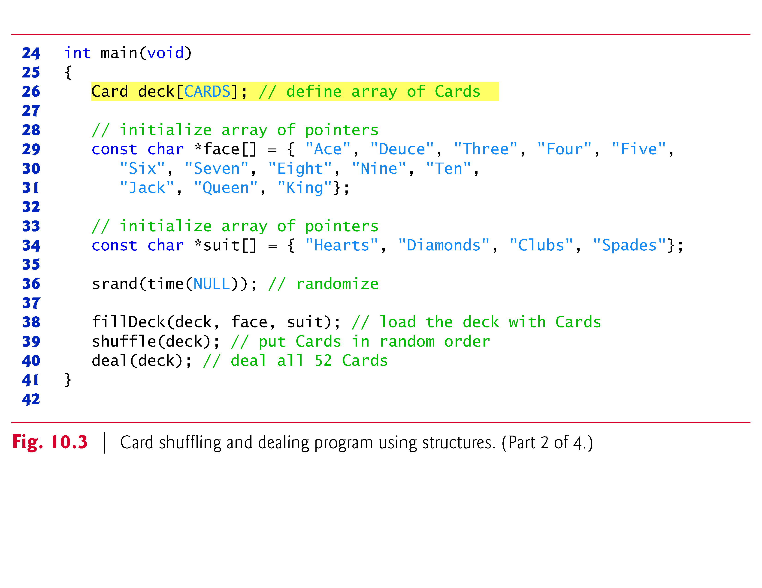

Slide 52
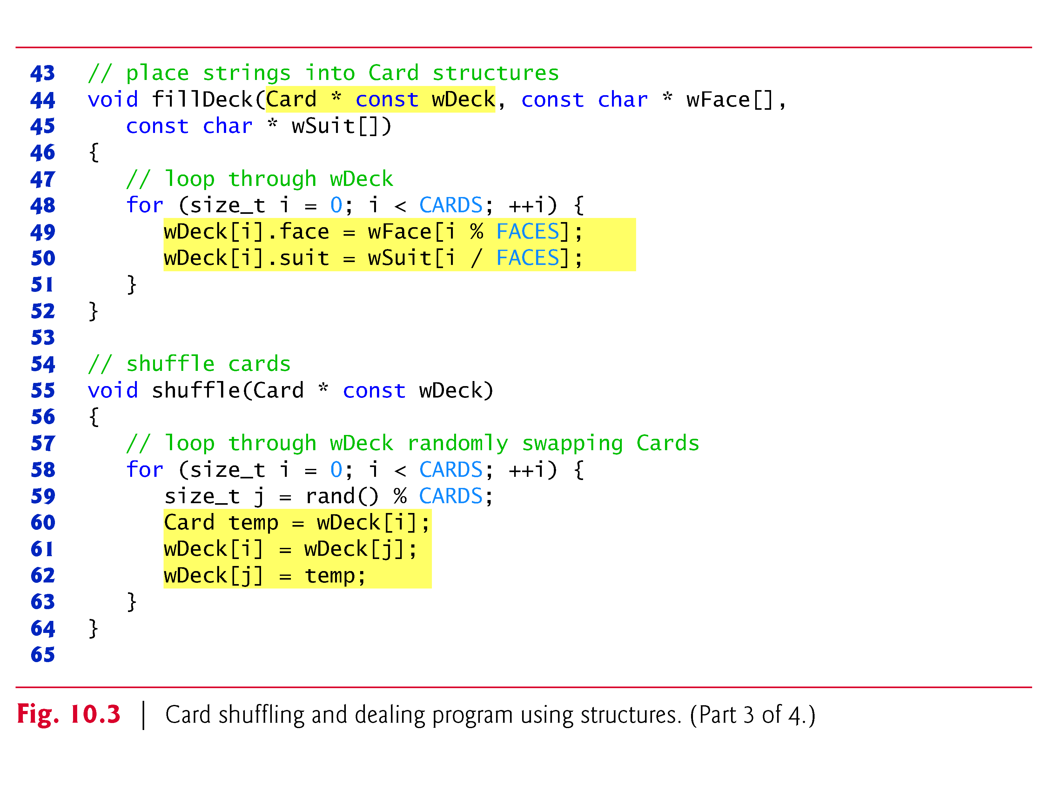

Slide 53
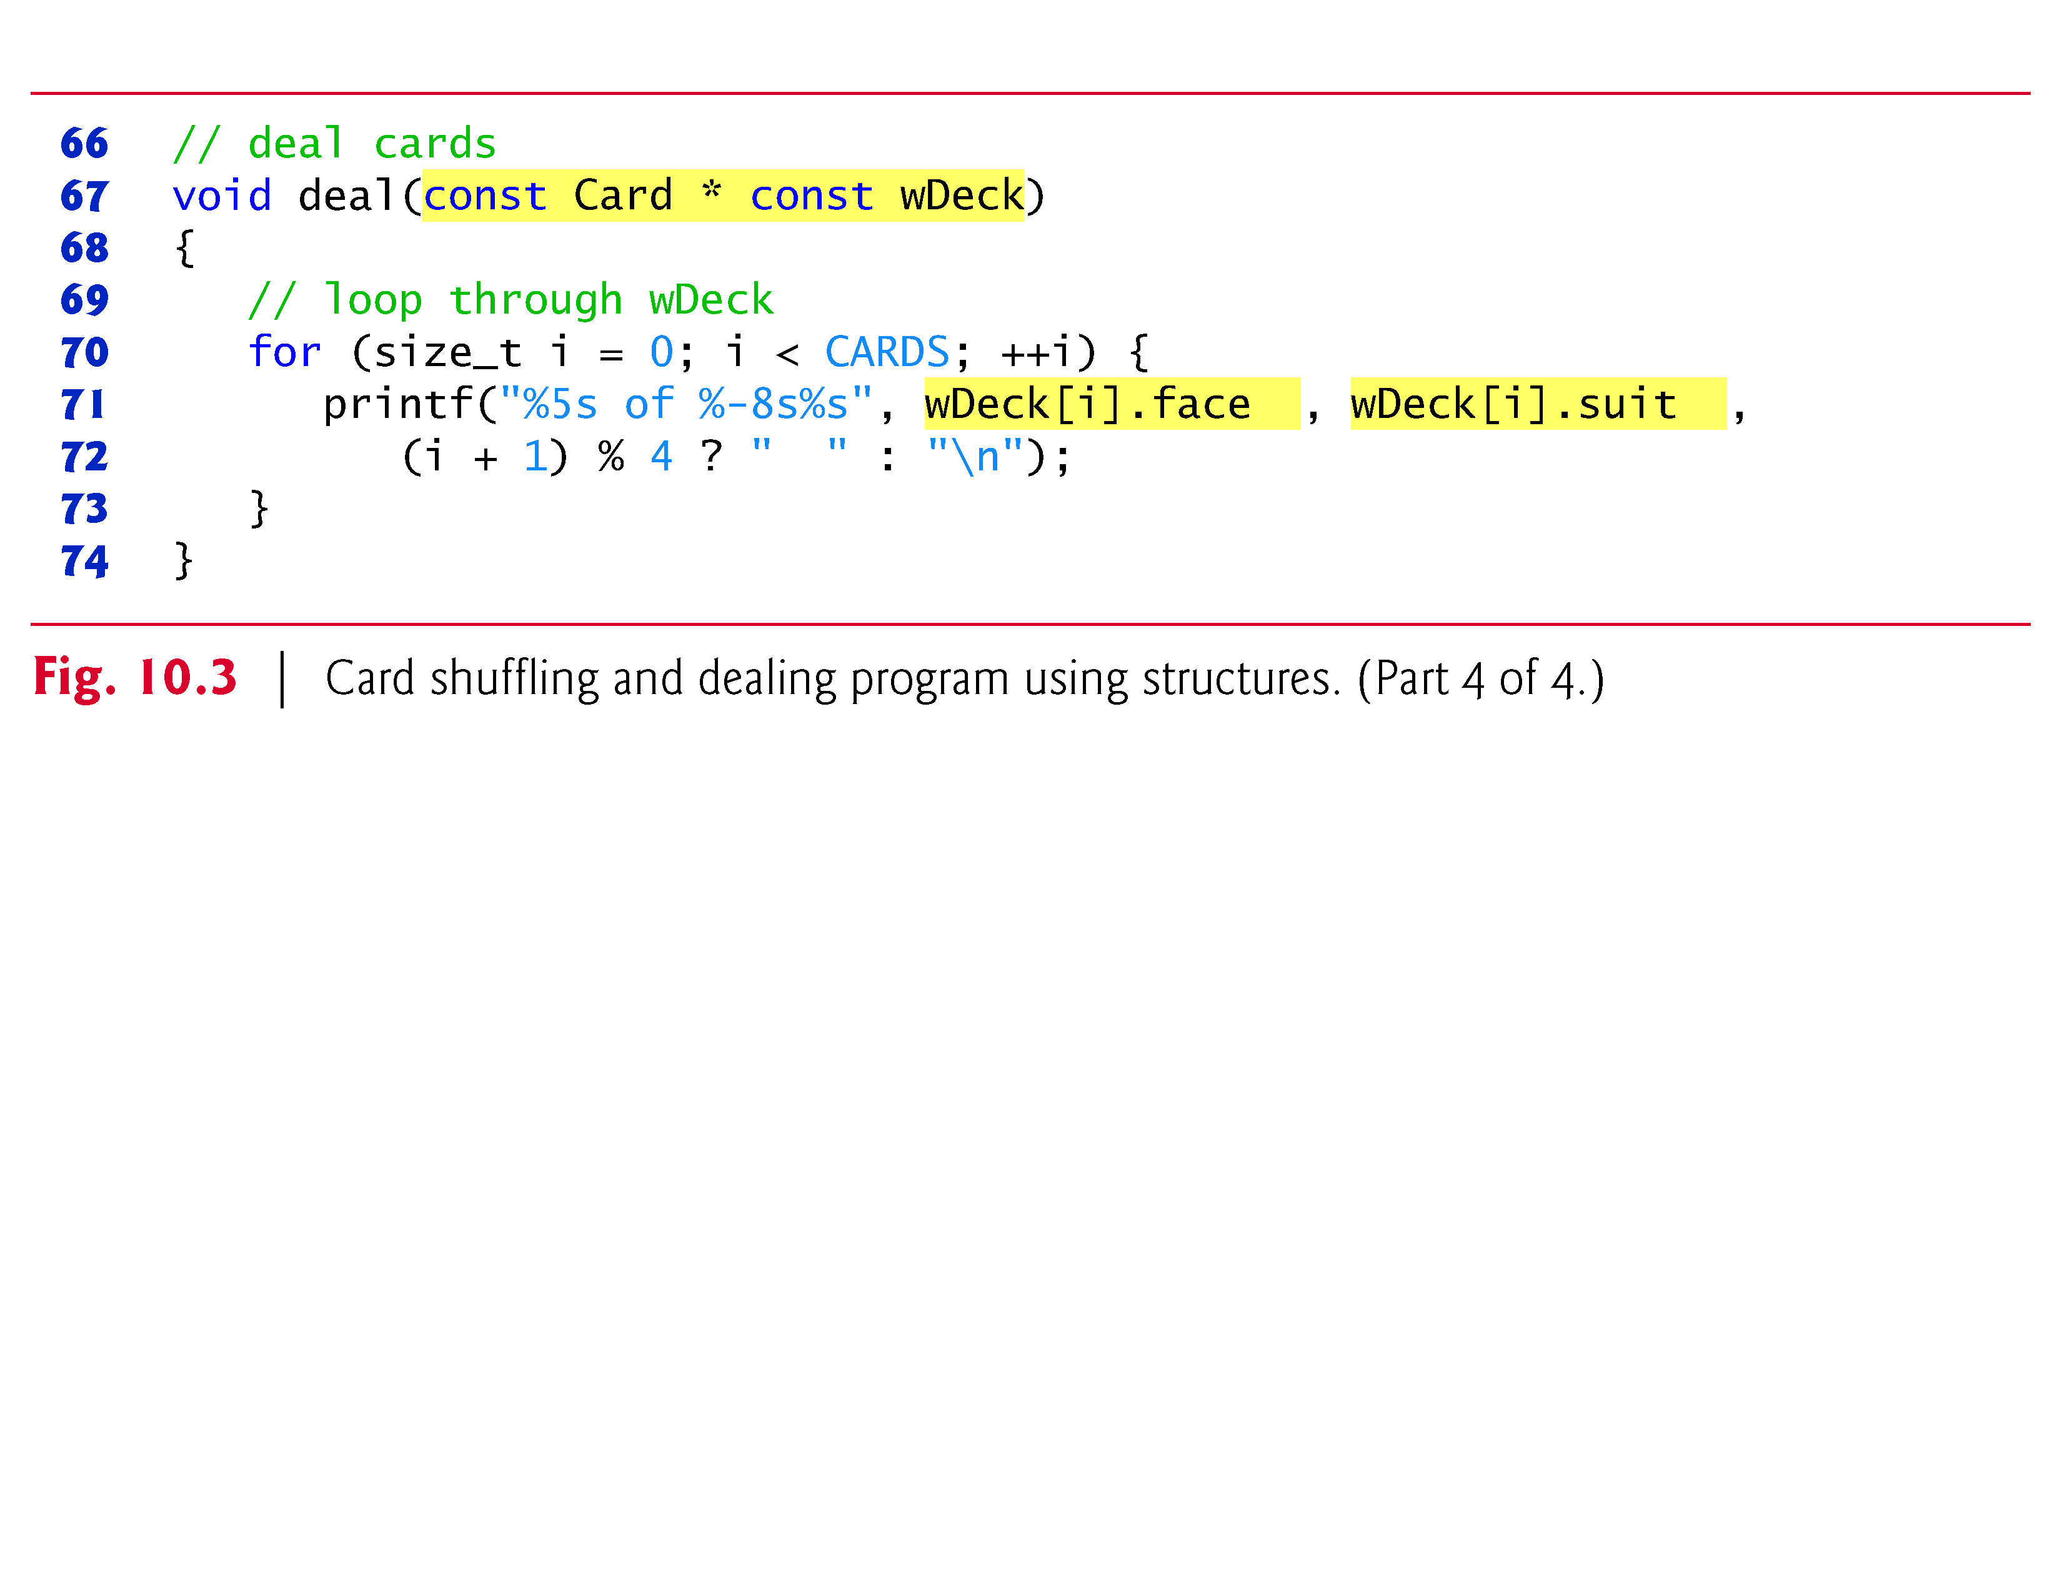

Slide 54
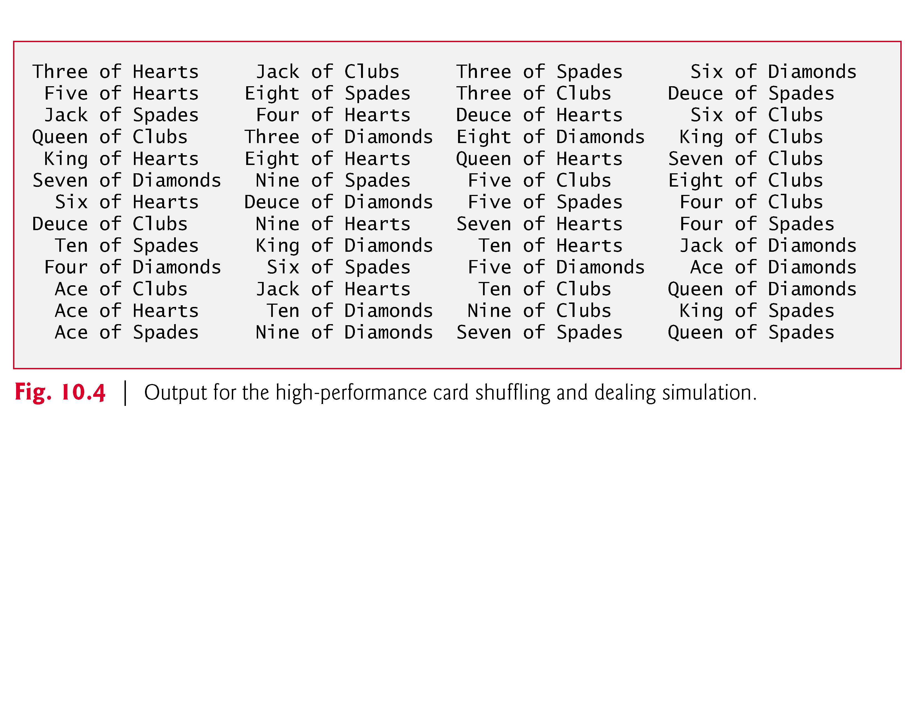

Slide 55
10.7 Example: High-Performance Card Shuffling and Dealing Simulation (Cont.)
In the program, function fillDeck initializes the Card array in order with “Ace” through “King” of each suit.
The Card array is passed to function shuffle, where the high-performance shuffling algorithm is implemented.
Function shuffle takes an array of 52 Cards as an argument.
The function loops through the 52 Cards

Slide 56
10.7 Example: High-Performance Card Shuffling and Dealing Simulation (Cont.)
For each card, a number between 0 and 51 is picked randomly.
Next, the current Card and the randomly selected Card are swapped in the array
A total of 52 swaps are made in a single pass of the entire array, and the array of Cards is shuffled!
This algorithm cannot suffer from indefinite postponement like the shuffling algorithm presented in Chapter 7.
Because the Cards were swapped in place in the array, the high-performance dealing algorithm implemented in function deal requires only one pass of the array to deal the shuffled Cards .

Slide 57
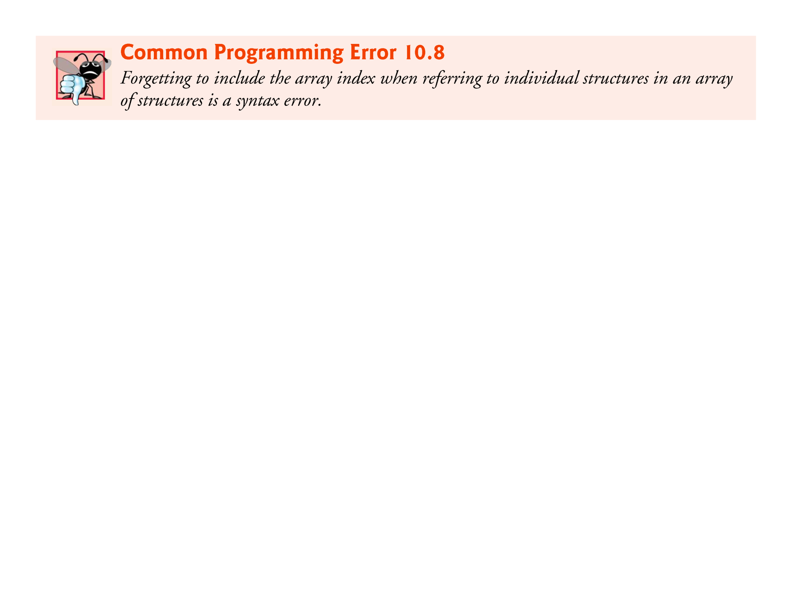

Slide 58
10.8 Unions
A union is a derived data type—like a structure—with members that share the same storage space.
For different situations in a program, some variables may not be relevant, but other variables are—so a union shares the space instead of wasting storage on variables that are not being used.
The members of a union can be of any data type.

Slide 59
10.8 Unions (Cont.)
The number of bytes used to store a union must be at least enough to hold the largest member.
In most cases, unions contain two or more data types.
Only one member, and thus one data type, can be referenced at a time.
It’s your responsibility to ensure that the data in a union is referenced with the proper data type.

Slide 60
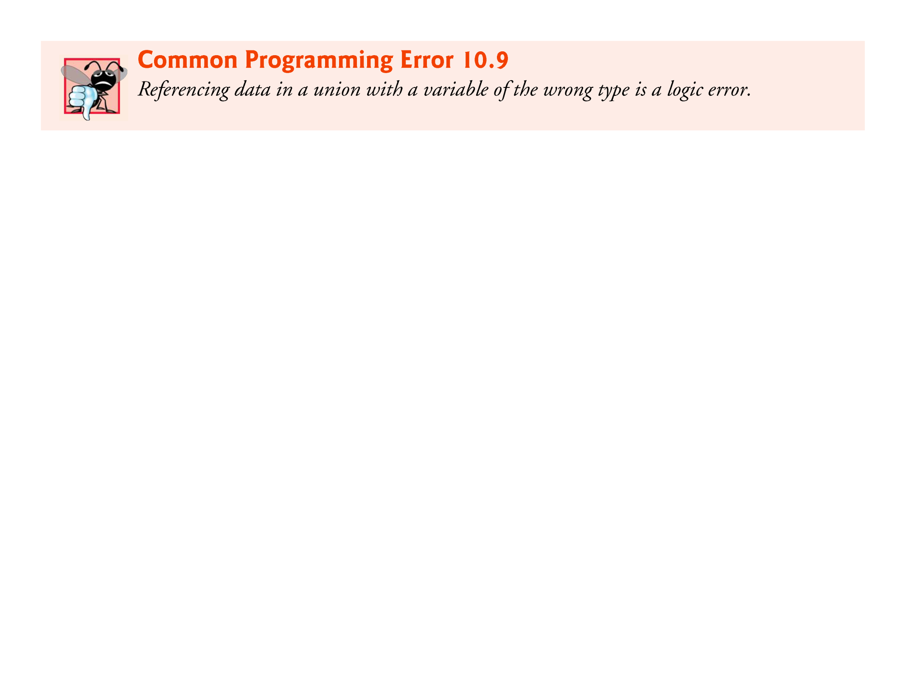

Slide 61
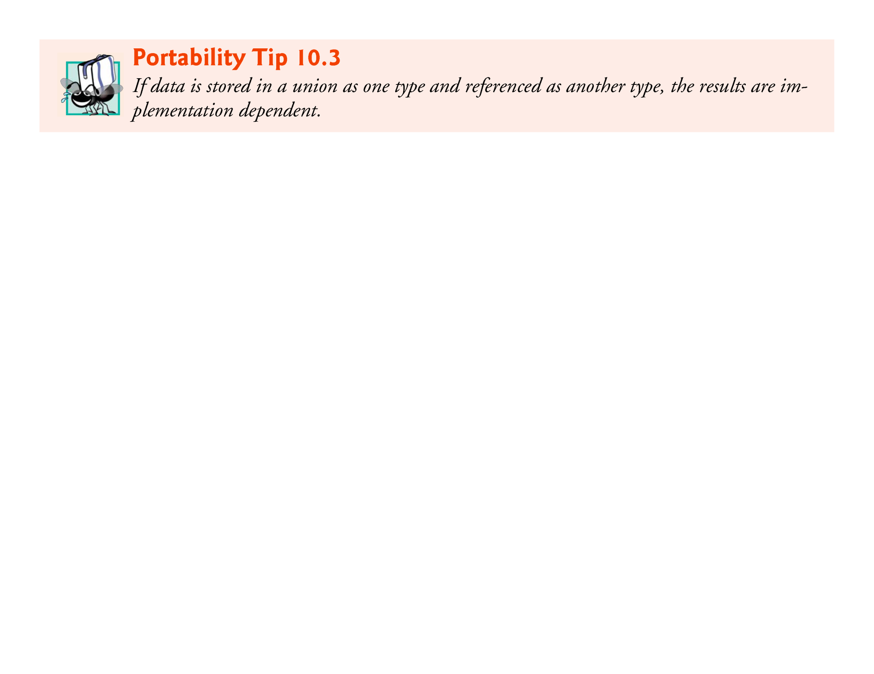

Slide 62
10.8.1 Union Declarations
A union definition has the same format as a structure definition.
The union definition
union number { int x; double y; };
indicates that number is a union type with members int x and double y.
The union definition is normally placed in a header and included in all source files that use the union type.

Slide 63
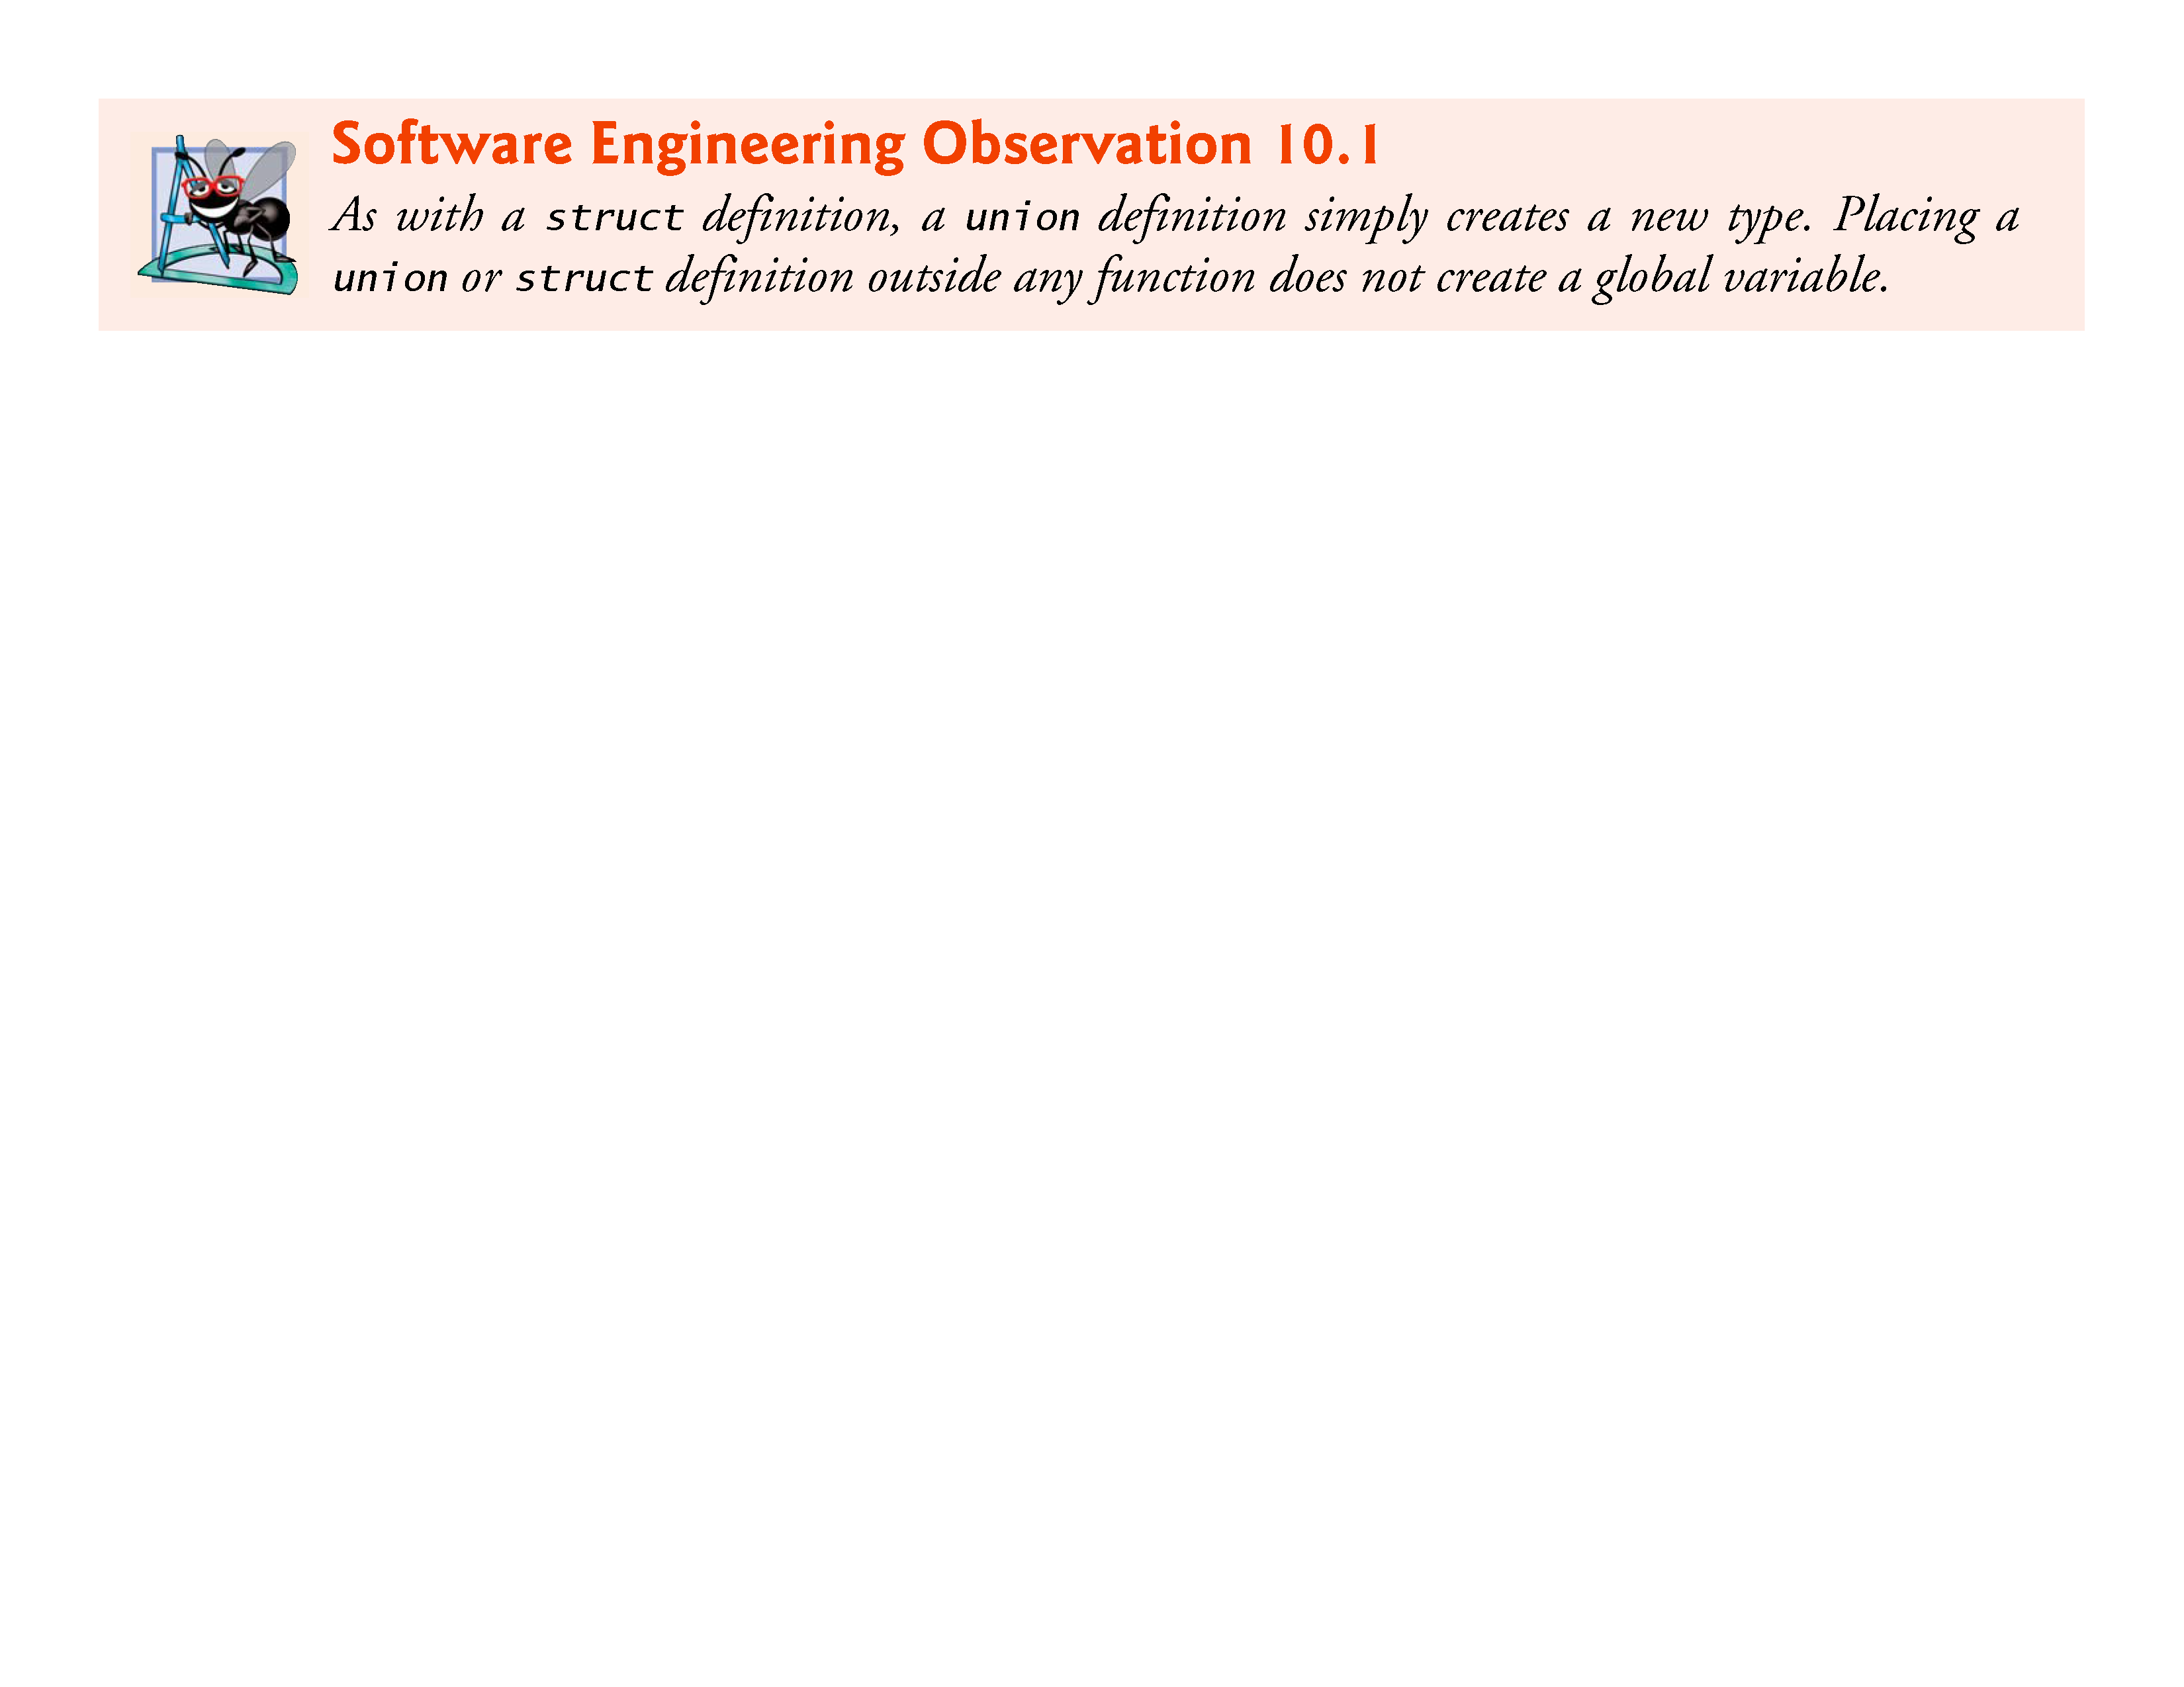

Slide 64
10.8.2 Operations That Can Be Performed on Unions
The operations that can be performed on a union are:
assigning a union to another union of the same type,
taking the address (&) of a union variable,
and accessing union members using the structure member operator and the structure pointer operator.
Unions may not be compared using operators == and != for the same reasons that structures cannot be compared.

Slide 65
10.8.3 Initializing Unions in Declarations
In a declaration, a union may be initialized with a value of the same type as the first union member.
For example, with the union in Section 10.8.1, the statement
union number value = {10};
is a valid initialization of union variable value because the union is initialized with an int, but the following declaration would truncate the floating-point part of the initializer value and normally would produce a warning from the compiler:
union number value = {1.43};

Slide 66
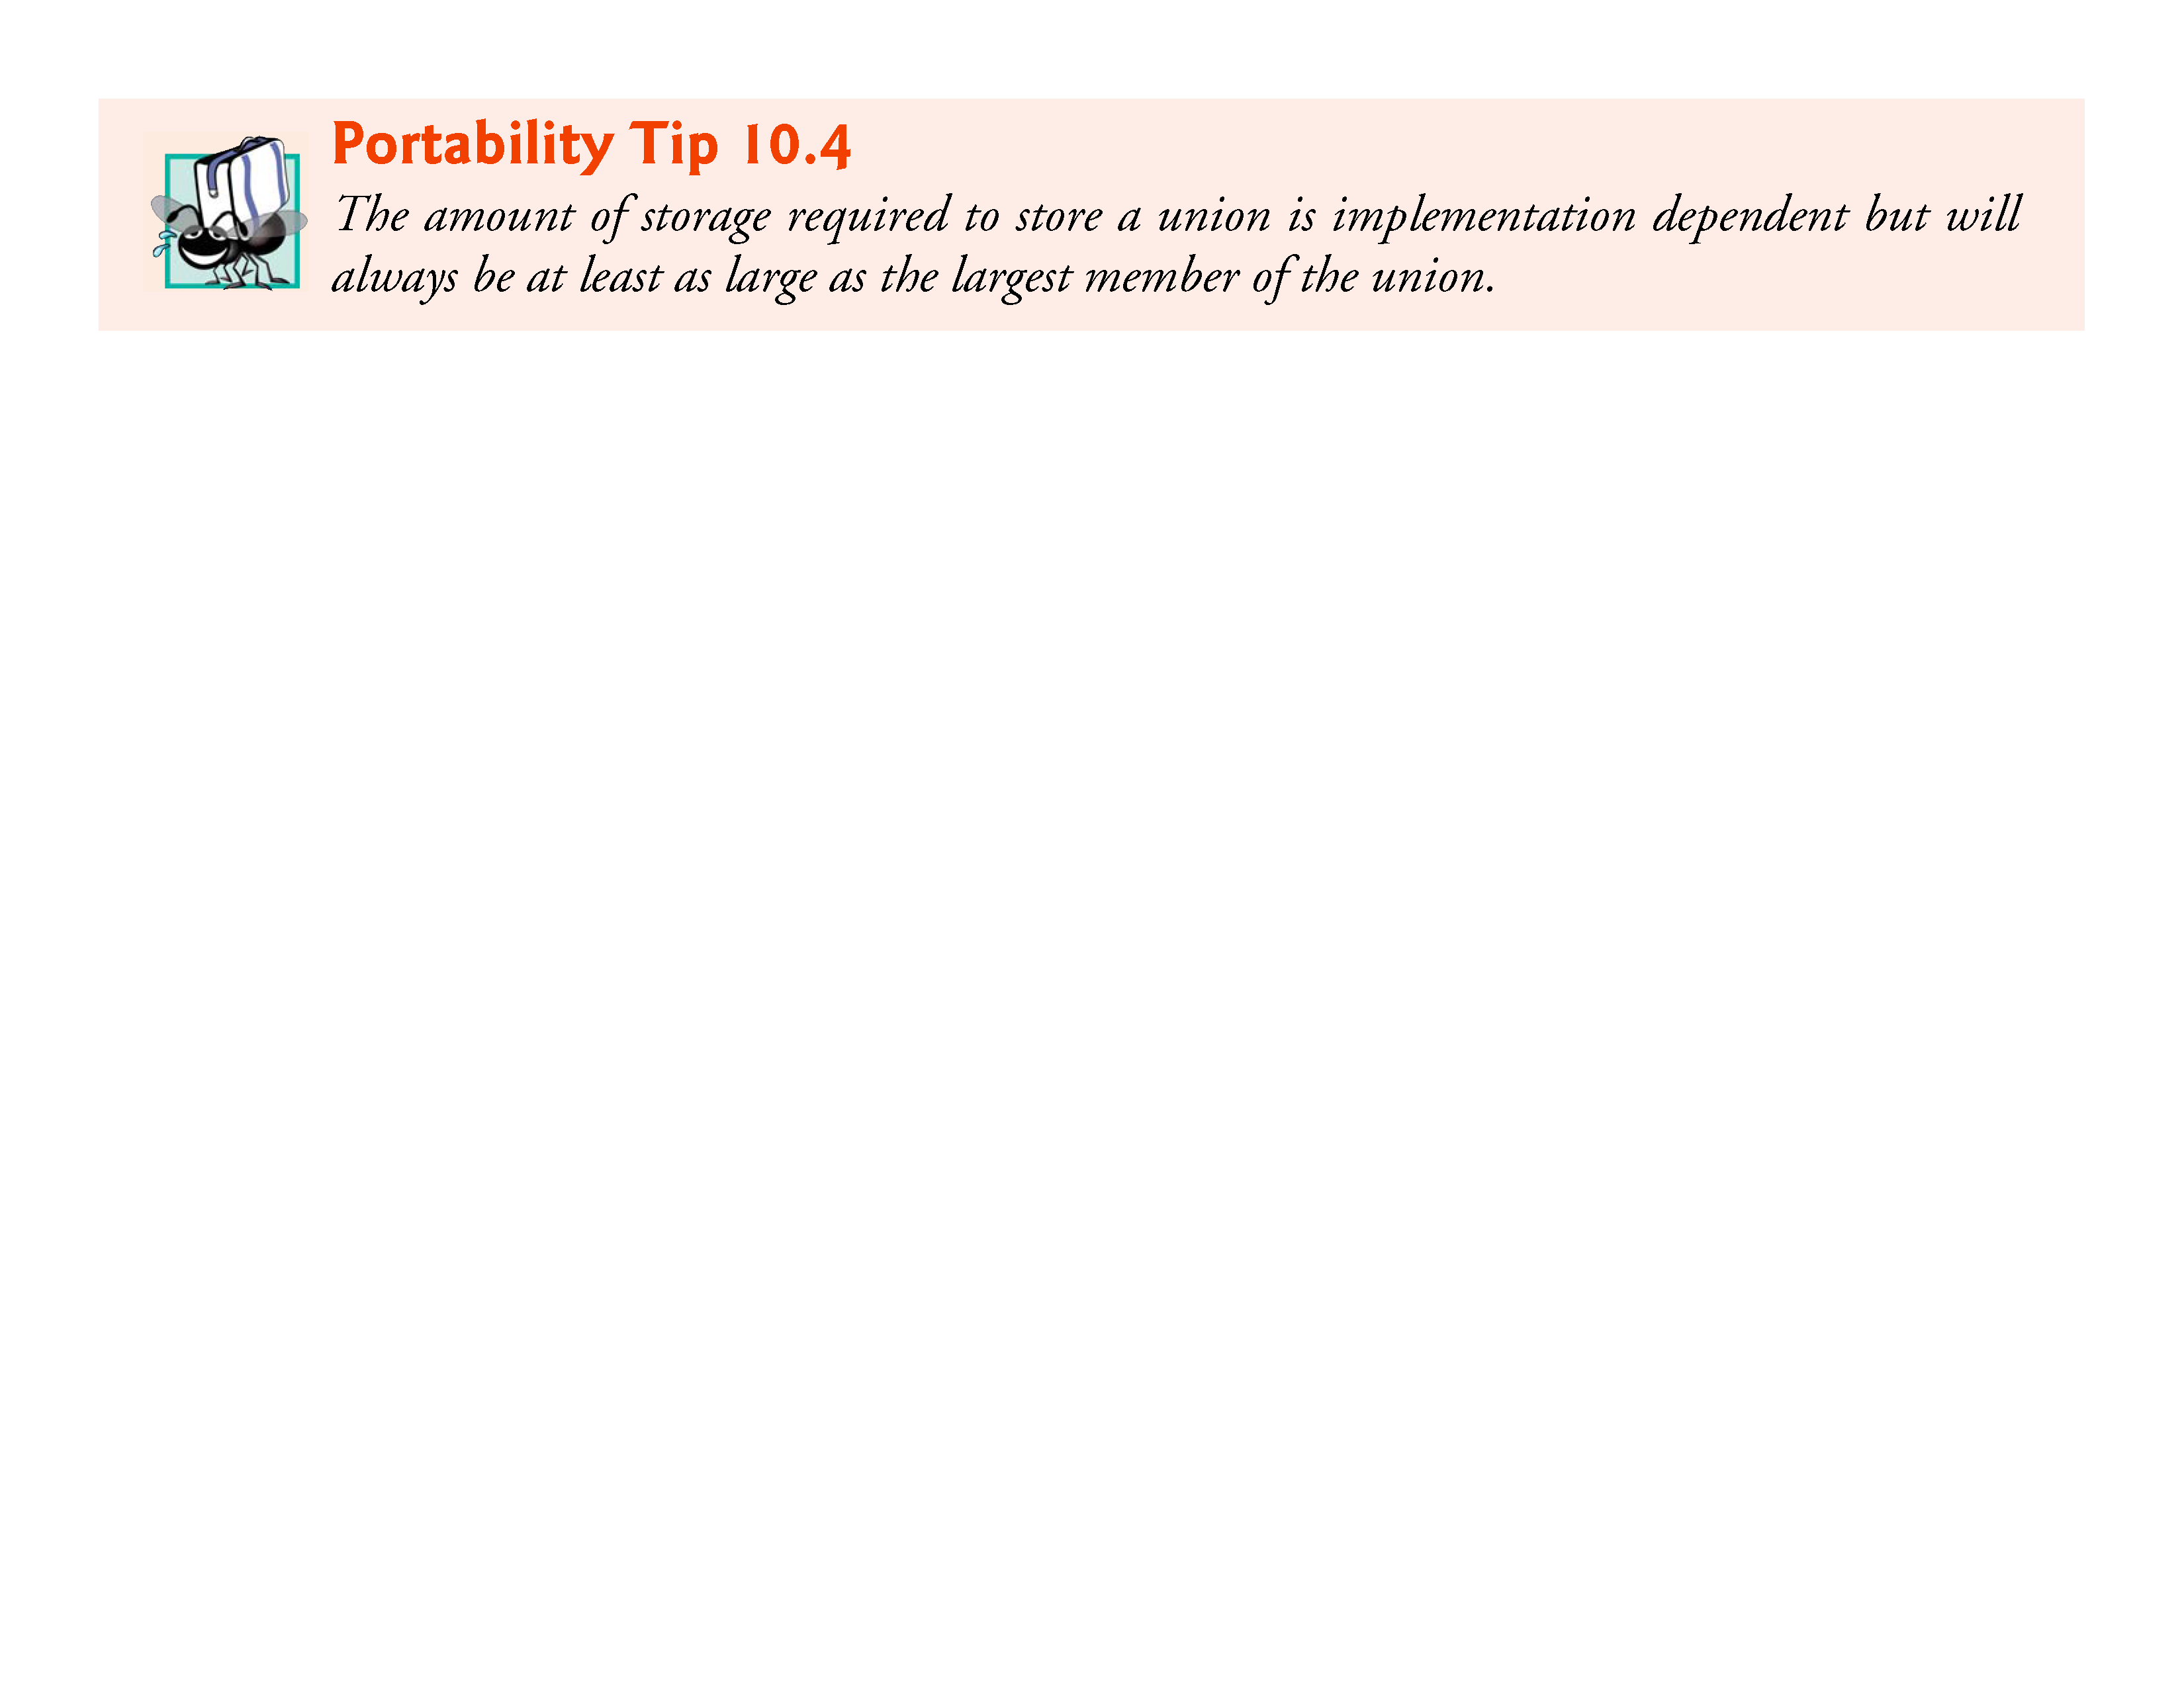

Slide 67
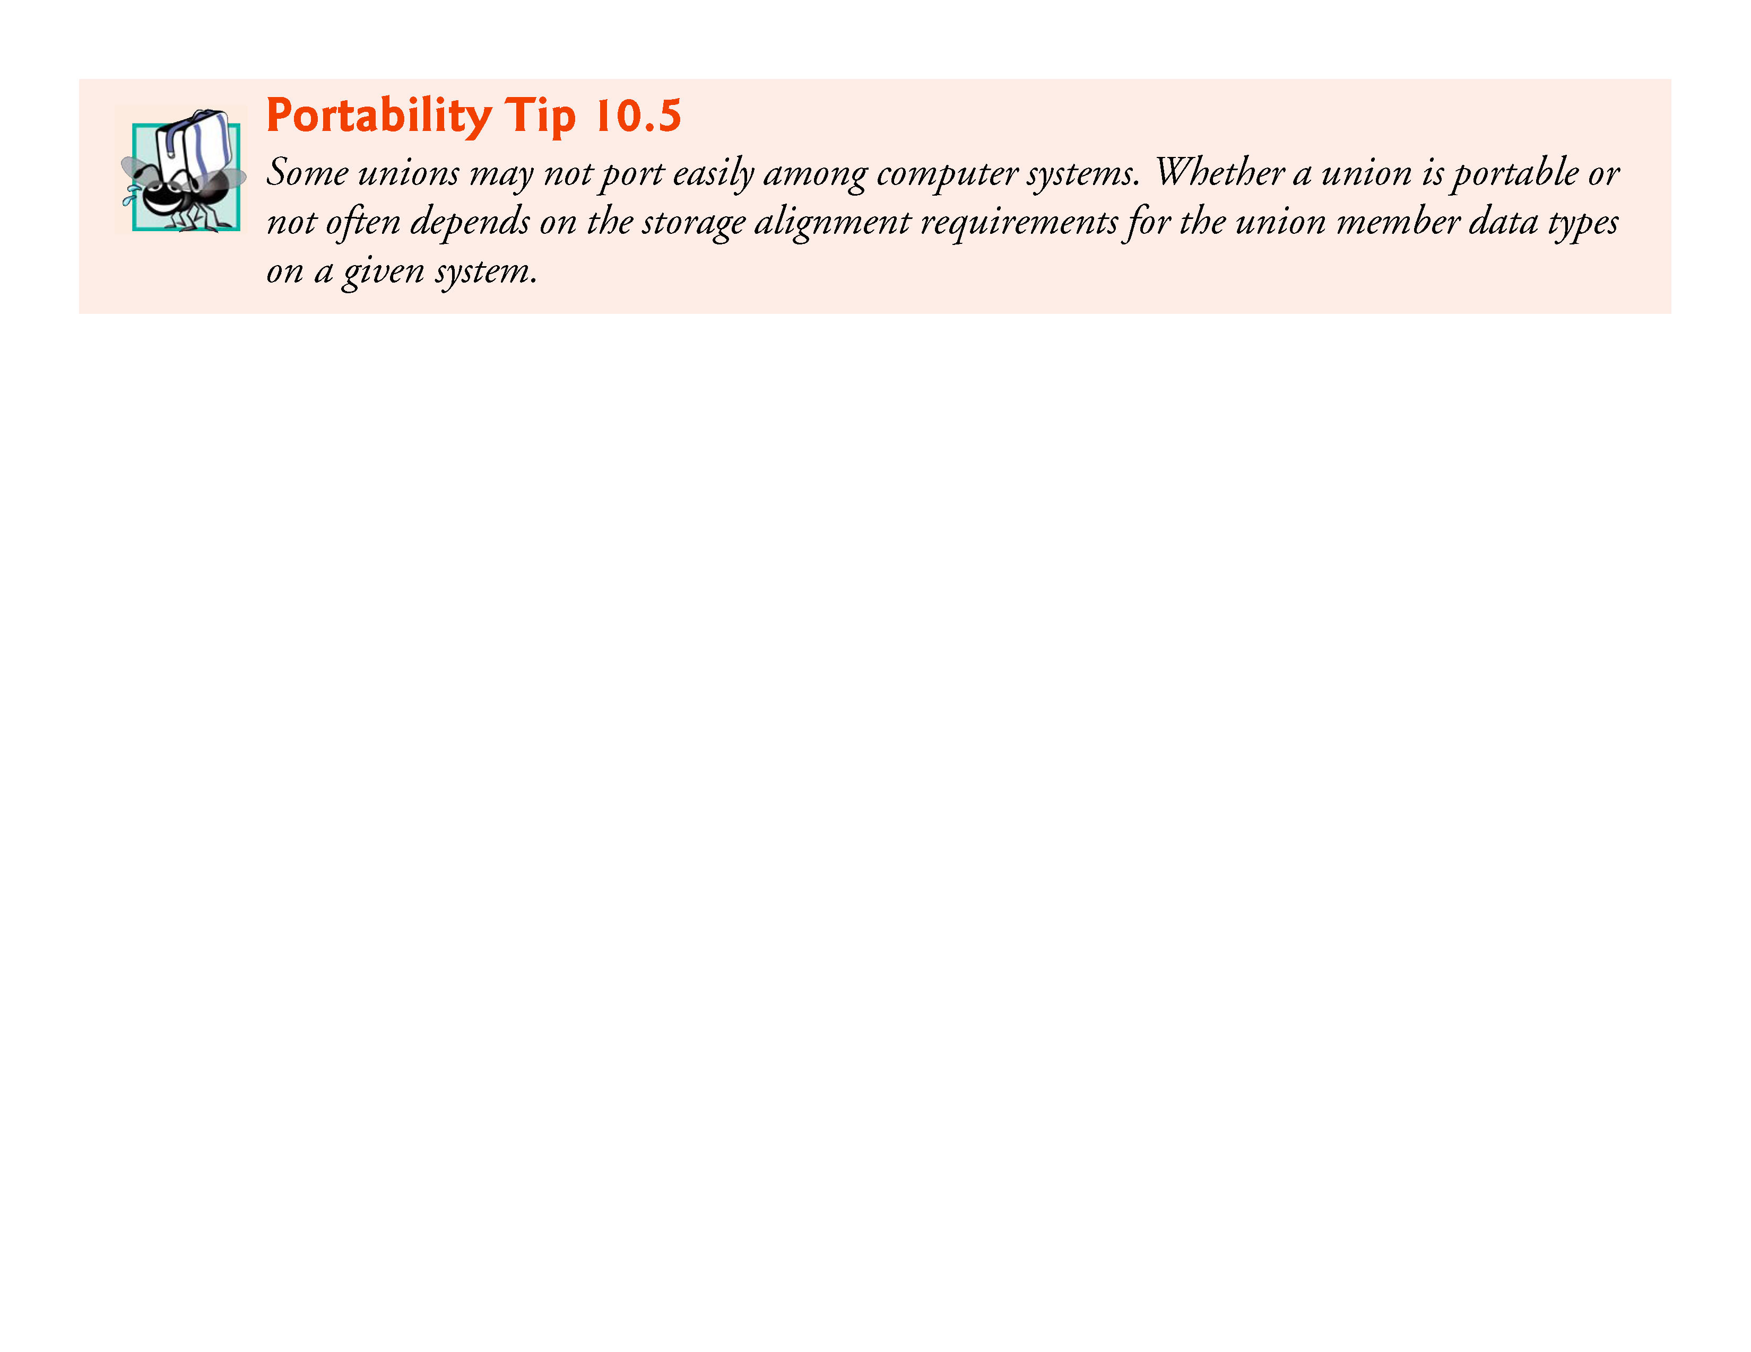

Slide 68
10.8.4 Demonstrating Unions
The program in Fig. 10.5 uses the variable value of type union number to display the value stored in the union as both an int and a double.
The program output is implementation dependent.
The program output shows that the internal representation of a double value can be quite different from the representation of int.

Slide 69
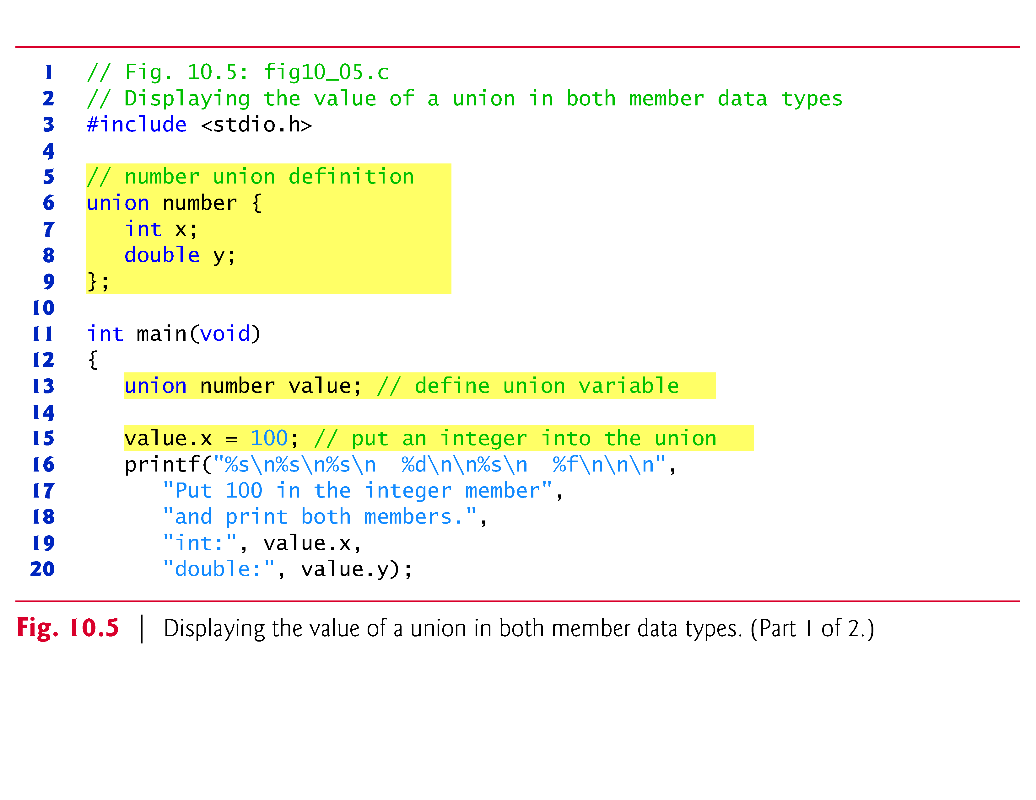

Slide 70
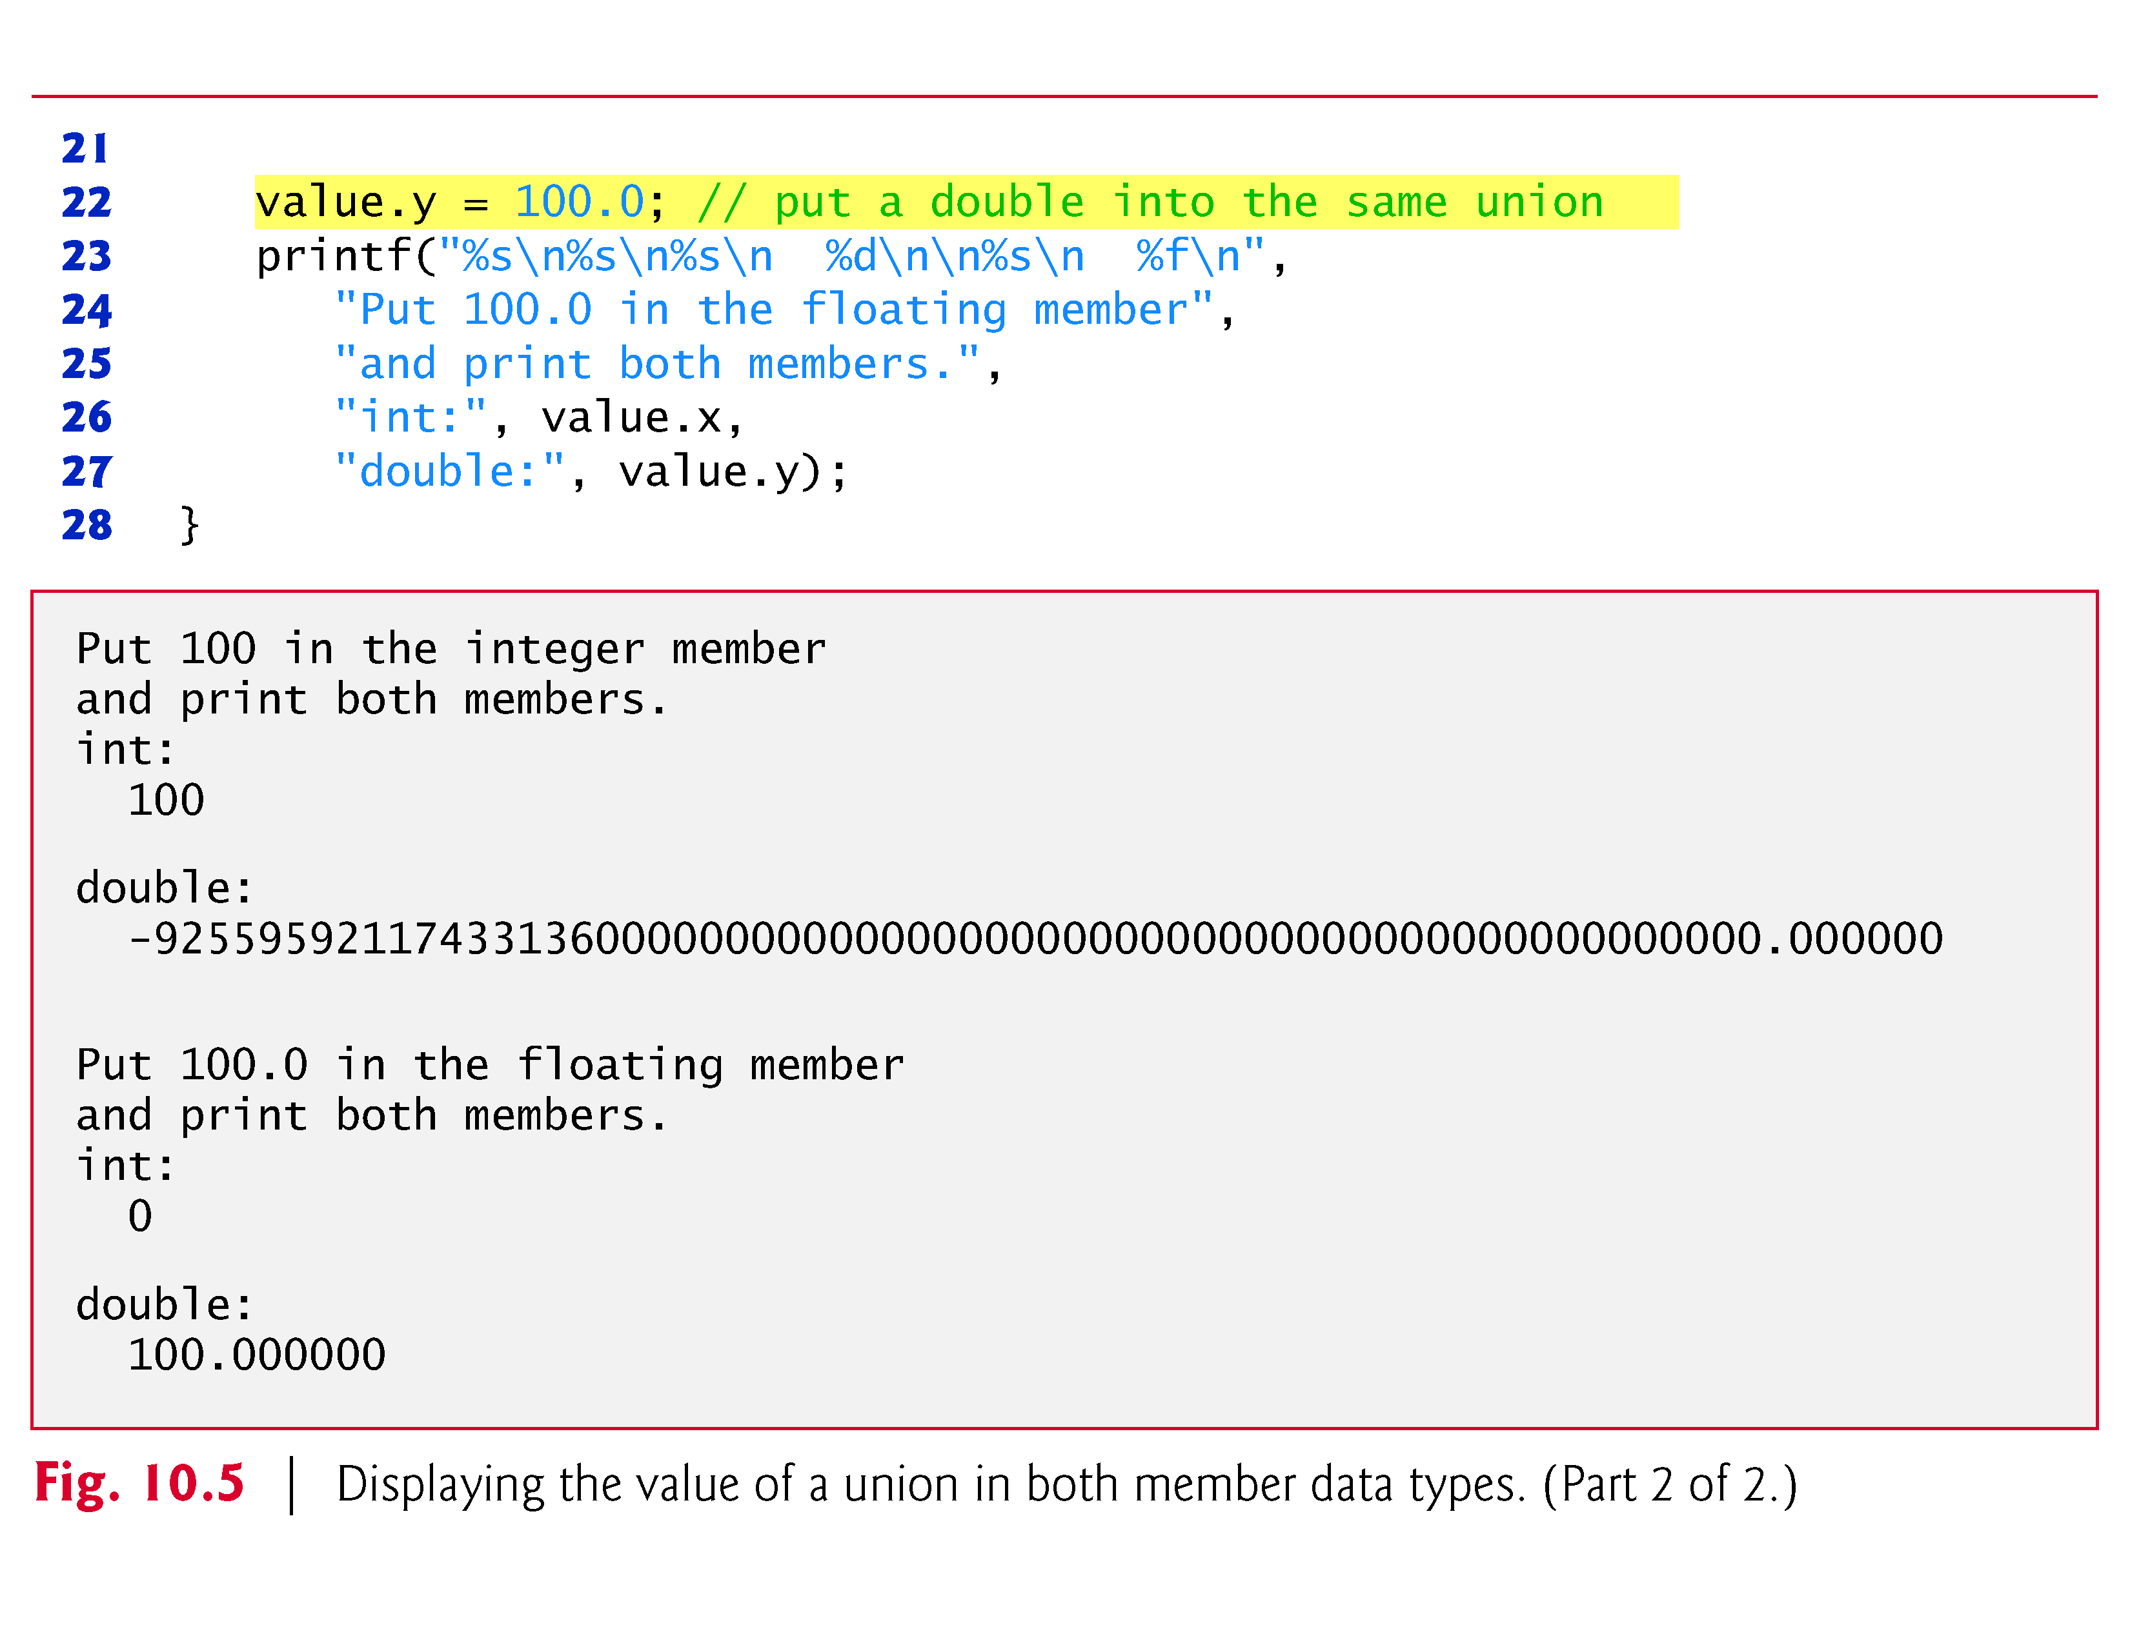

Slide 71
10.9 Bitwise Operators
Computers represent all data internally as sequences of bits.
Each bit can assume the value 0 or the value 1.
On most systems, a sequence of 8 bits forms a byte—the typical storage unit for a variable of type char.
Other data types are stored in larger numbers of bytes.
The bitwise operators are used to manipulate the bits of integral operands both signed and unsigned.
Unsigned integers are normally used with the bitwise operators.

Slide 72


Slide 73
10.9 Bitwise Operators (Cont.)
The bitwise operator discussions in this section show the binary representations of the integer operands.
For a detailed explanation of the binary (also called base-2) number system see Appendix C.
Because of the machine-dependent nature of bitwise manipulations, these programs may not work correctly on your system.
The bitwise operators are bitwise AND (&), bitwise inclusive OR (|), bitwise exclusive OR (^; also known as bitwise XOR), left shift (<<), right shift (>>) and complement (~).

Slide 74
10.9 Bitwise Operators (Cont.)
The bitwise AND, bitwise inclusive OR and bitwise exclusive OR operators compare their two operands bit by bit.
The bitwise AND operator sets each bit in the result to 1 if the corresponding bit in both operands is 1.
The bitwise inclusive OR operator sets each bit in the result to 1 if the corresponding bit in either (or both) operand(s) is 1.
The bitwise exclusive OR operator sets each bit in the result to 1 if the corresponding bit in exactly one operand is 1.

Slide 75
10.9 Bitwise Operators (Cont.)
The left-shift operator shifts the bits of its left operand to the left by the number of bits specified in its right operand.
The right-shift operator shifts the bits in its left operand to the right by the number of bits specified in its right operand.
The bitwise complement operator sets all 0 bits in its operand to 1 in the result and sets all 1 bits to 0 in the result.
Detailed discussions of each bitwise operator appear in the examples that follow.
The bitwise operators are summarized in Fig. 10.6.

Slide 76
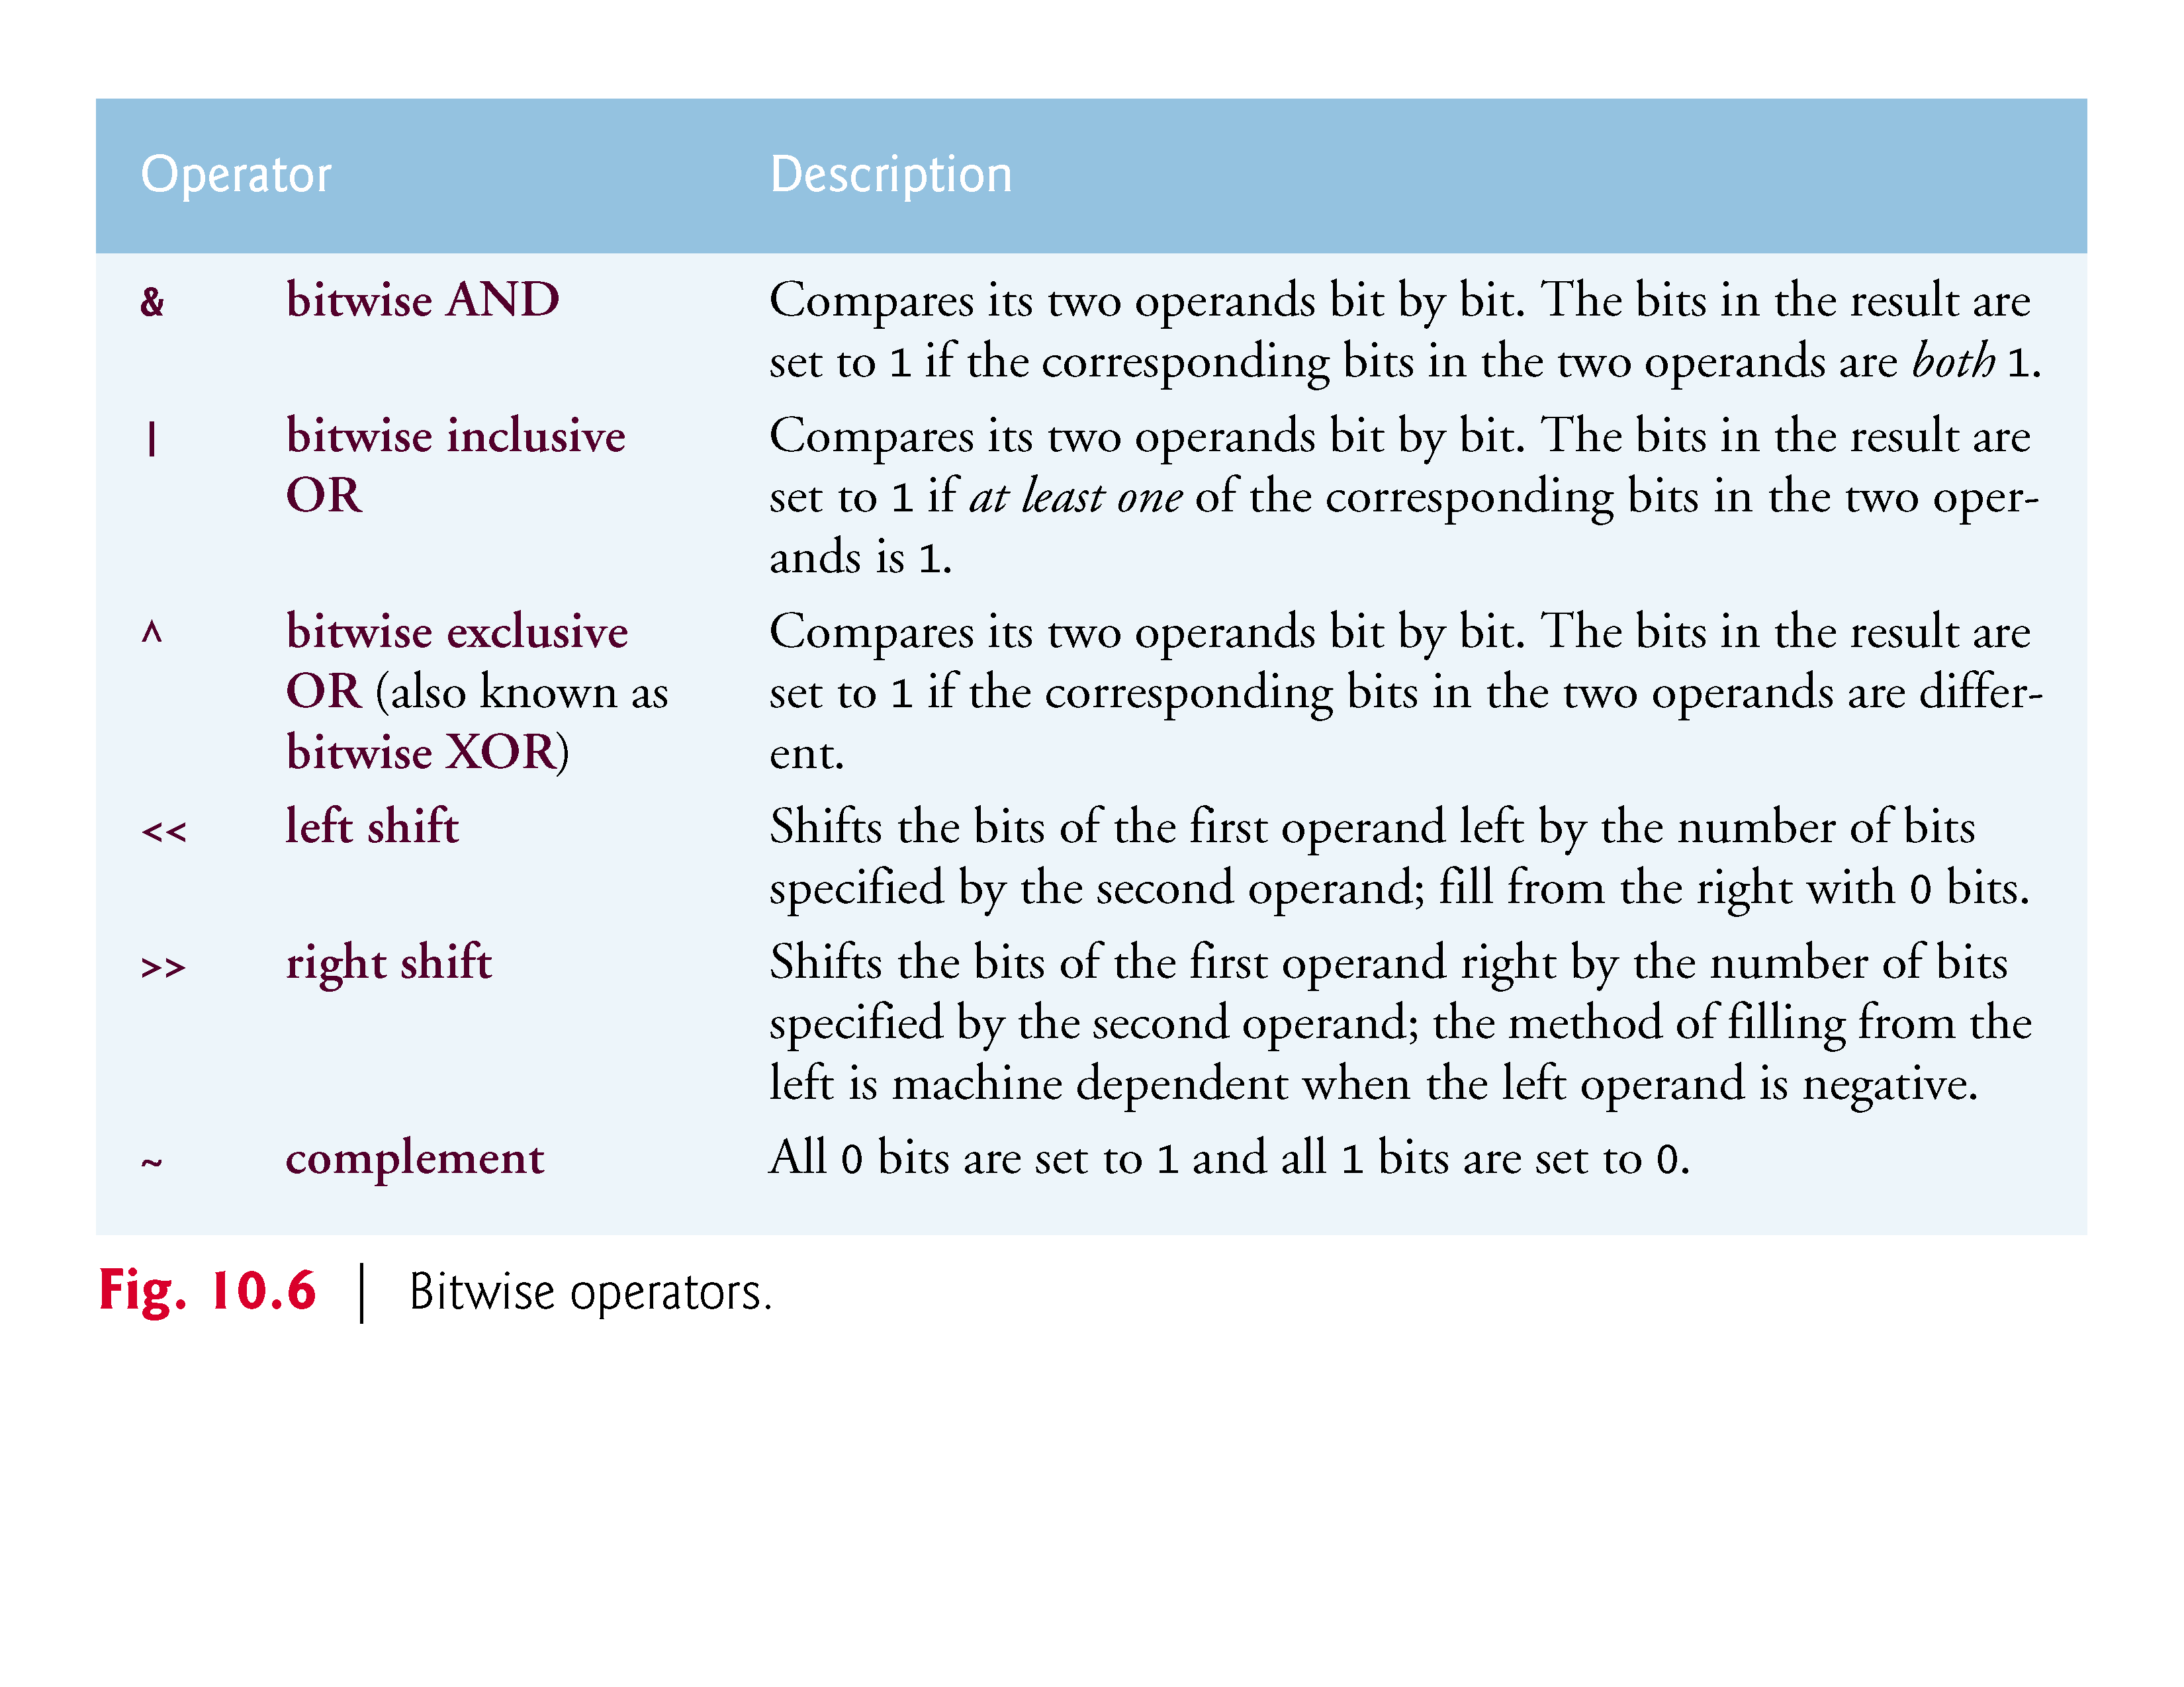

Slide 77
10.9.1 Displaying an Unsigned Integer in Bits
When using the bitwise operators, it’s useful to display values in binary to show the precise effects of these operators.
The program of Fig. 10.7 prints an unsigned int in its binary representation in groups of eight bits each for readability.
For the examples in this section, we assume an implementation where unsigned ints are stored in 4 bytes (32 bits) of memory.

Slide 78
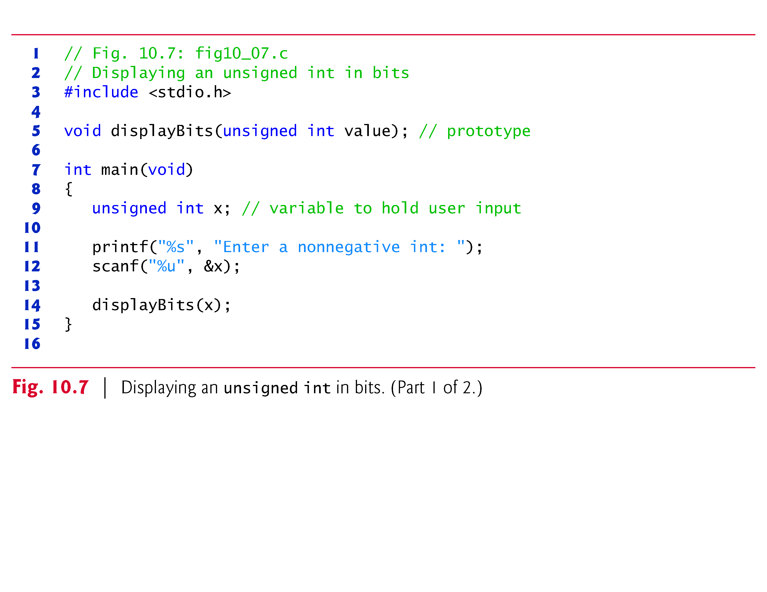

Slide 79
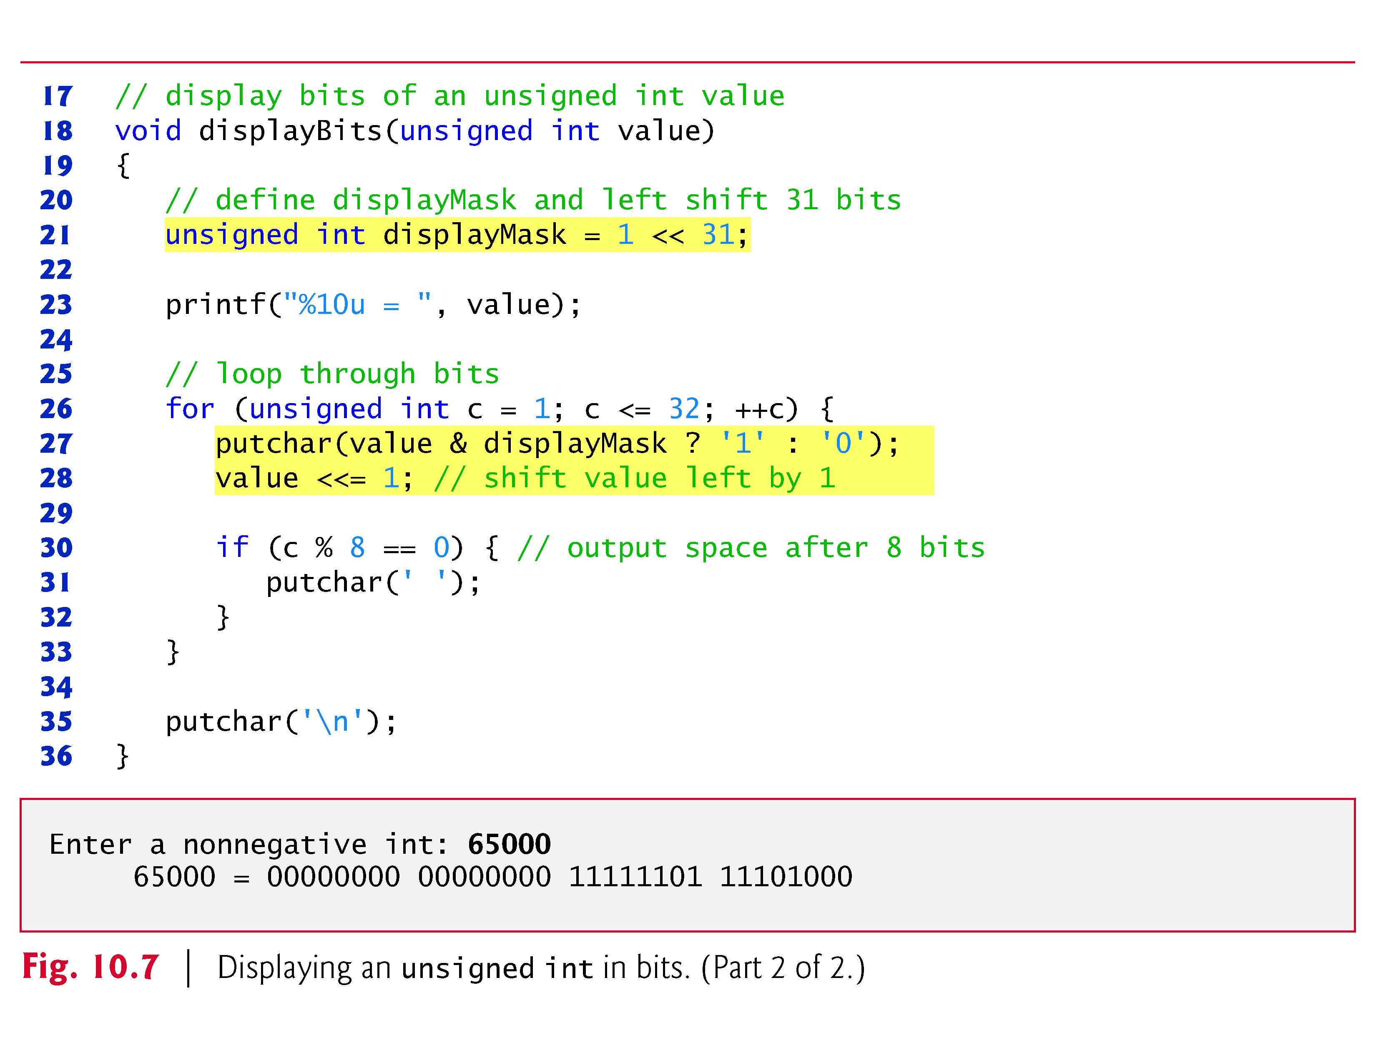

Slide 80
10.9.1 Displaying an Unsigned Integer in Bits (Cont.)
Function displayBits uses the bitwise AND operator to combine variable value with variable displayMask
Often, the bitwise AND operator is used with an operand called a mask—an integer value with specific bits set to 1.
Masks are used to hide some bits in a value while selecting other bits.
In function displayBits, mask variable displayMask is assigned the value
1 << 31 (10000000 00000000 00000000 00000000)

Slide 81
10.9.1 Displaying an Unsigned Integer in Bits (Cont.)
The left-shift operator shifts the value 1 from the low-order (rightmost) bit to the high-order (leftmost) bit in displayMask and fills in 0 bits from the right.
putchar(value & displayMask ? '1' : '0');
determines whether a 1 or a 0 should be printed for the current leftmost bit of variable value.
When value and displayMask are combined using &, all the bits except the high-order bit in variable value are “masked off” (hidden), because any bit “ANDed” with 0 yields 0.

Slide 82
10.9.1 Displaying an Unsigned Integer in Bits (Cont.)
If the leftmost bit is 1, value & displayMask evaluates to a nonzero (true) value and 1 is printed—otherwise, 0 is printed.
Variable value is then left shifted one bit by the expression value <<= 1 (this is equivalent to value = value << 1).
These steps are repeated for each bit in unsigned variable value.
Figure 10.8 summarizes the results of combining two bits with the bitwise AND operator.

Slide 83
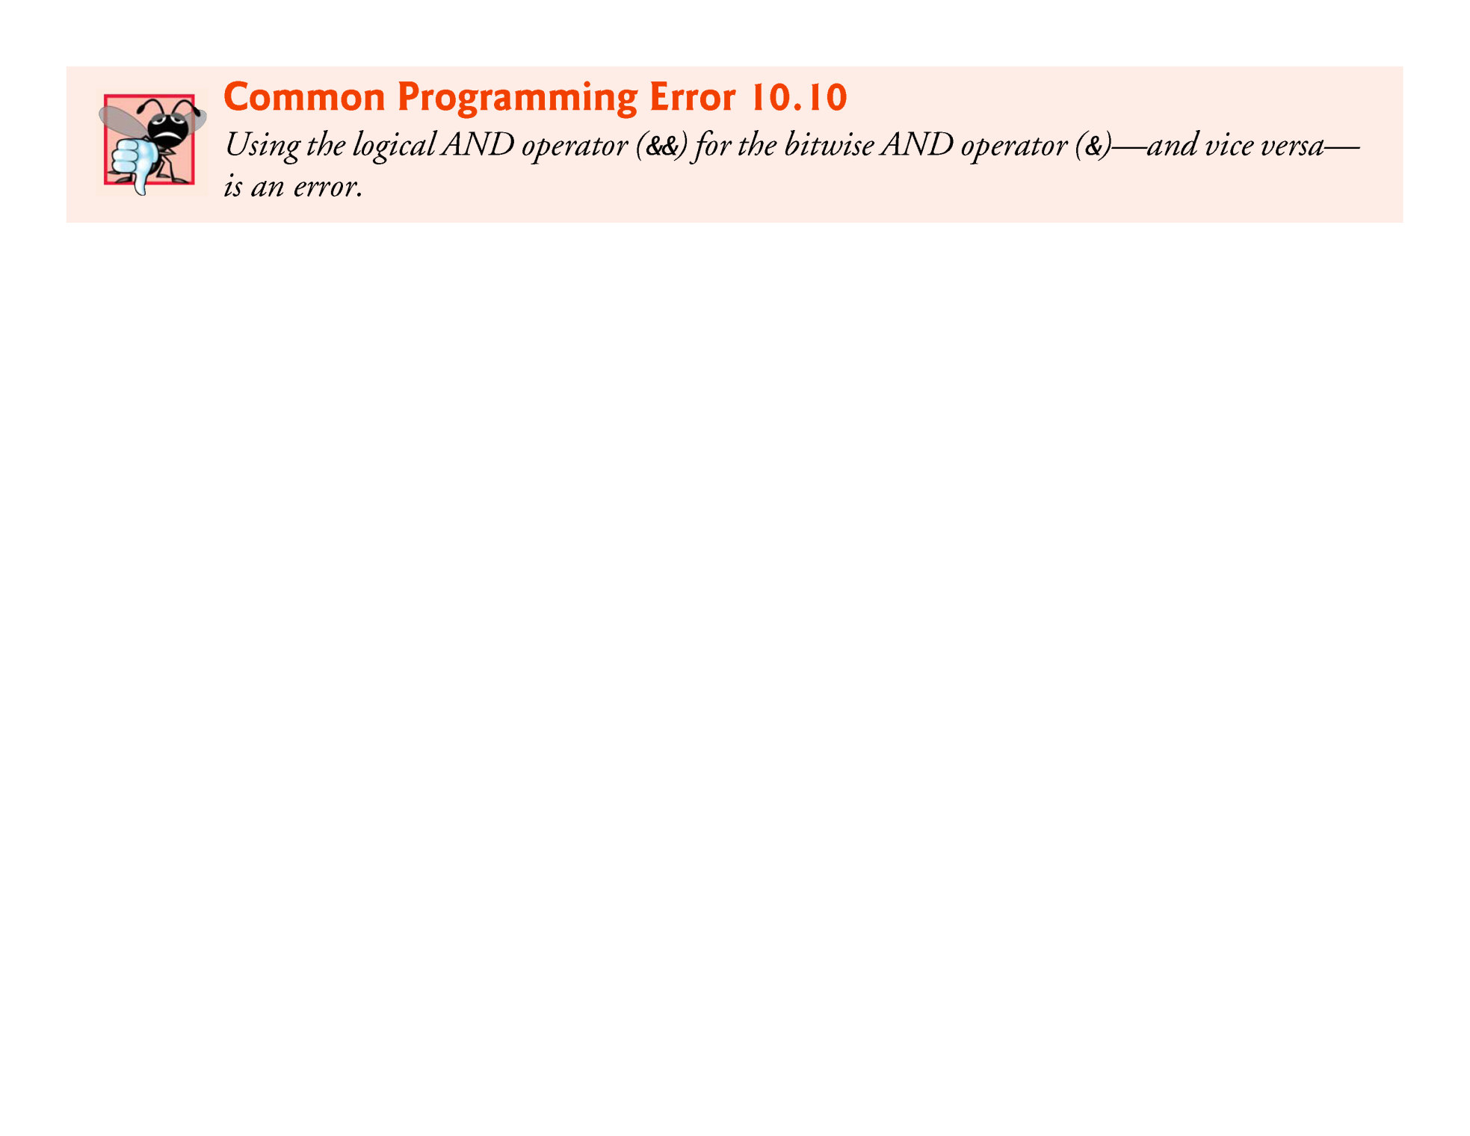

Slide 84
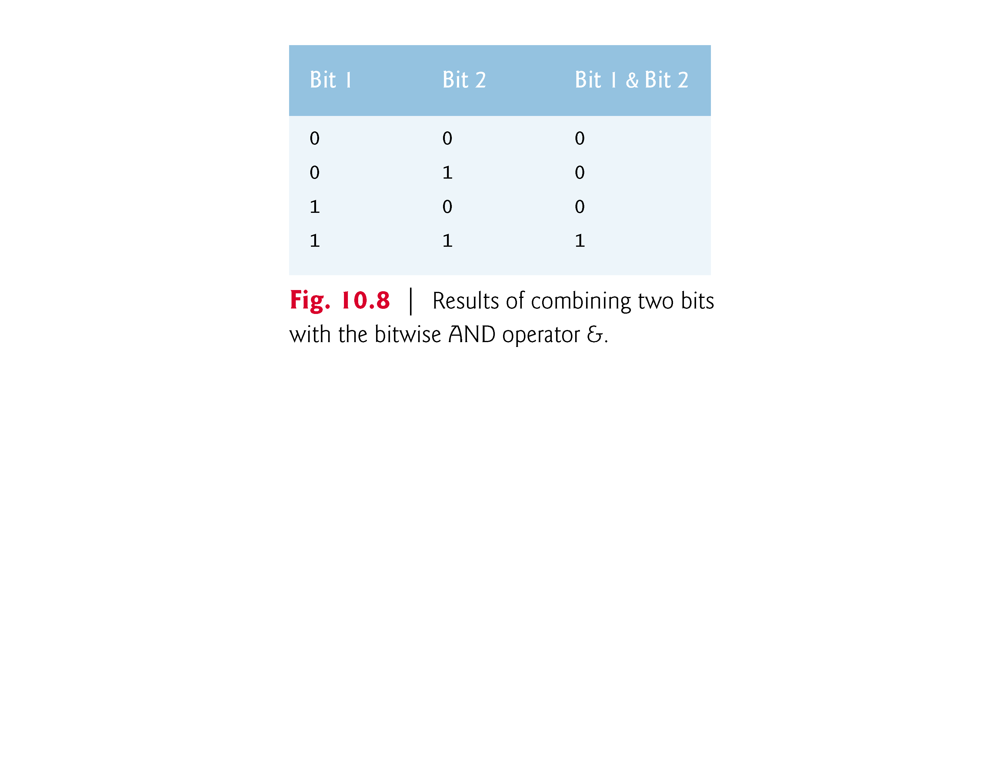

Slide 85
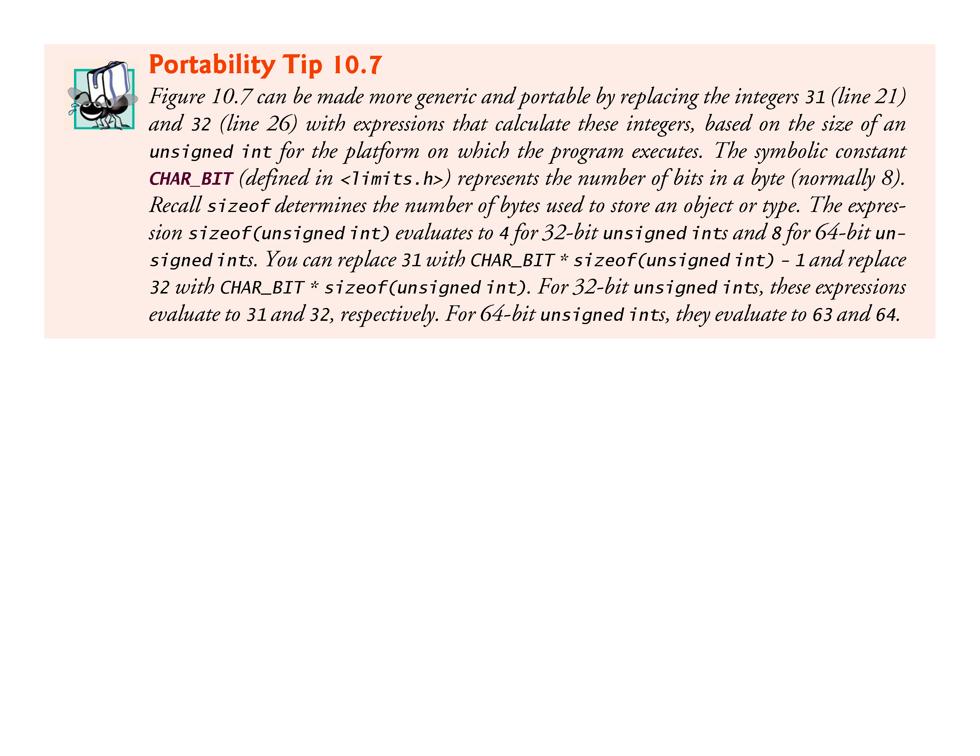

Slide 86
10.9.2 Making Function displayBits More Scalable and Portable
In Fig. 10.7, we hard coded the integer 31 to indicate that the value 1 should be shifted to the leftmost bit in the variable displayMask.
Similarly, we hard coded the integer 32 to indicate that the loop should iterate 32 times—once for each bit in variable value.
We assumed that unsigned ints are always stored in 32 bits (4 bytes) of memory.
Many of today’s popular computers use 32-bit or 64-bit word hardware architectures.

Slide 87
10.9.2 Making Function displayBits More Scalable and Portable (Cont.)
As a C programmer, you’ll tend to work across many hardware architectures, and sometimes unsigned ints will be stored in smaller or larger numbers of bits.
We can make the program in Fig. 10.7 more scalable and more portable by replacing the integer 31 with the expression
CHAR_BIT * sizeof(unsigned int) - 1
and by replacing the integer 32 with the expression
CHAR_BIT * sizeof(unsigned int)

Slide 88
10.9.2 Making Function displayBits More Scalable and Portable (Cont.)
The symbolic constant CHAR_BIT (defined in <limits.h>) represents the number of bits in a byte (normally 8).
On a computer that uses 32-bit words, the expression sizeof(unsigned int) evaluates to 4, so the two preceding expressions evaluate to 31 and 32, respectively.
On a computer that uses 16-bit words, the sizeof expression evaluates to 2 and the two preceding expressions evaluate to 15 and 16, respectively.

Slide 89
10.9.3 Using the Bitwise AND, Inclusive OR, Exclusive OR and Complement Operators
Figure 10.9 demonstrates the use of the bitwise AND operator, the bitwise inclusive OR operator, the bitwise exclusive OR operator and the bitwise complement operator.
The program uses function displayBits to print the unsigned int values.
The output is shown in Fig. 10.10.

Slide 90
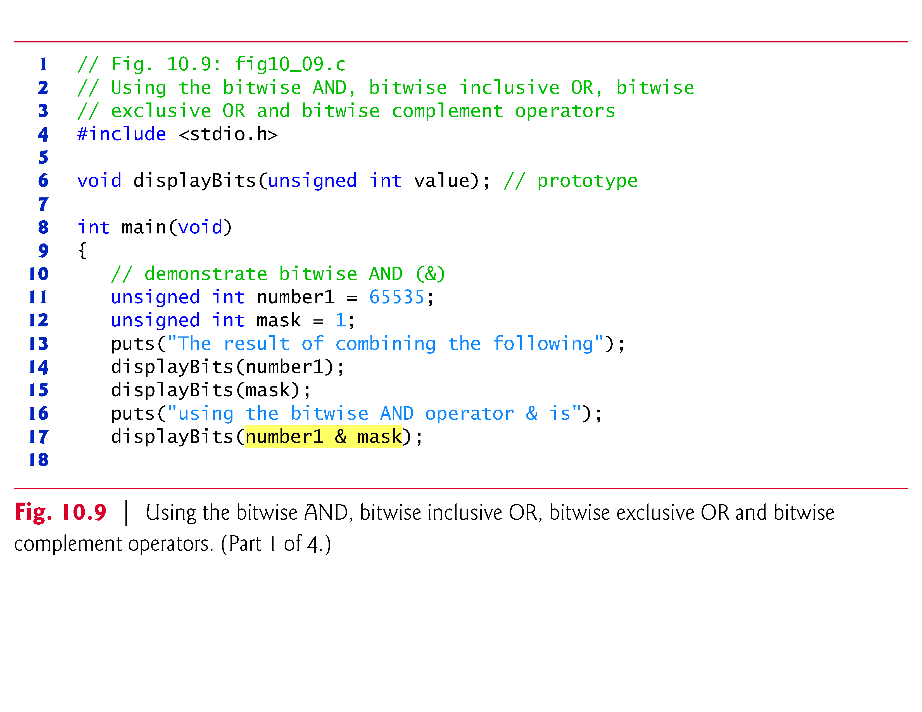

Slide 91
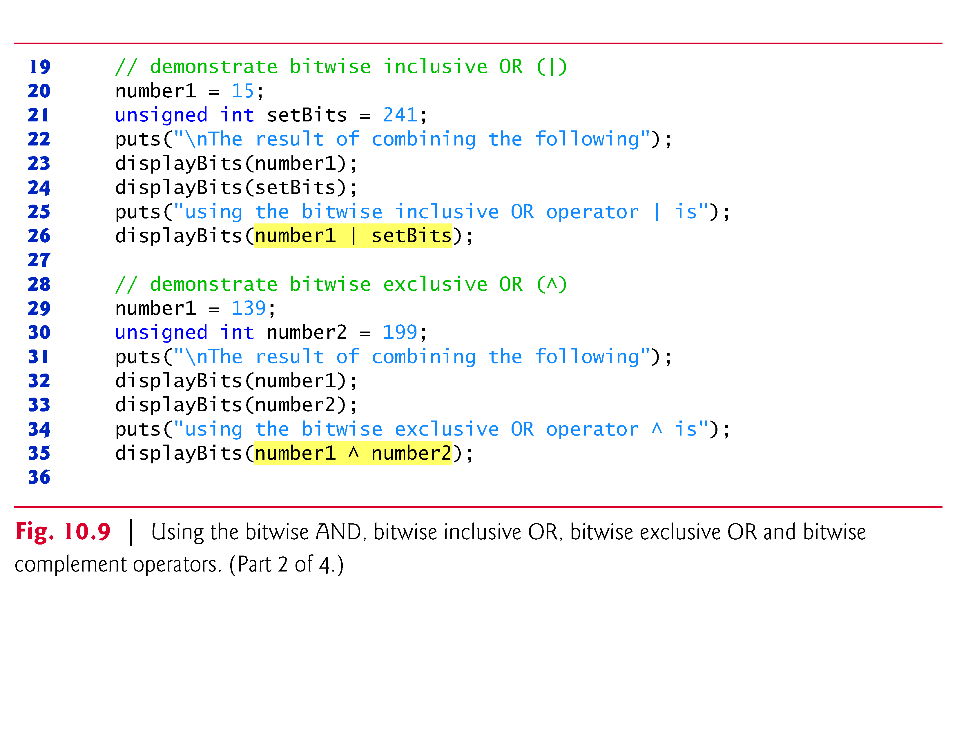

Slide 92
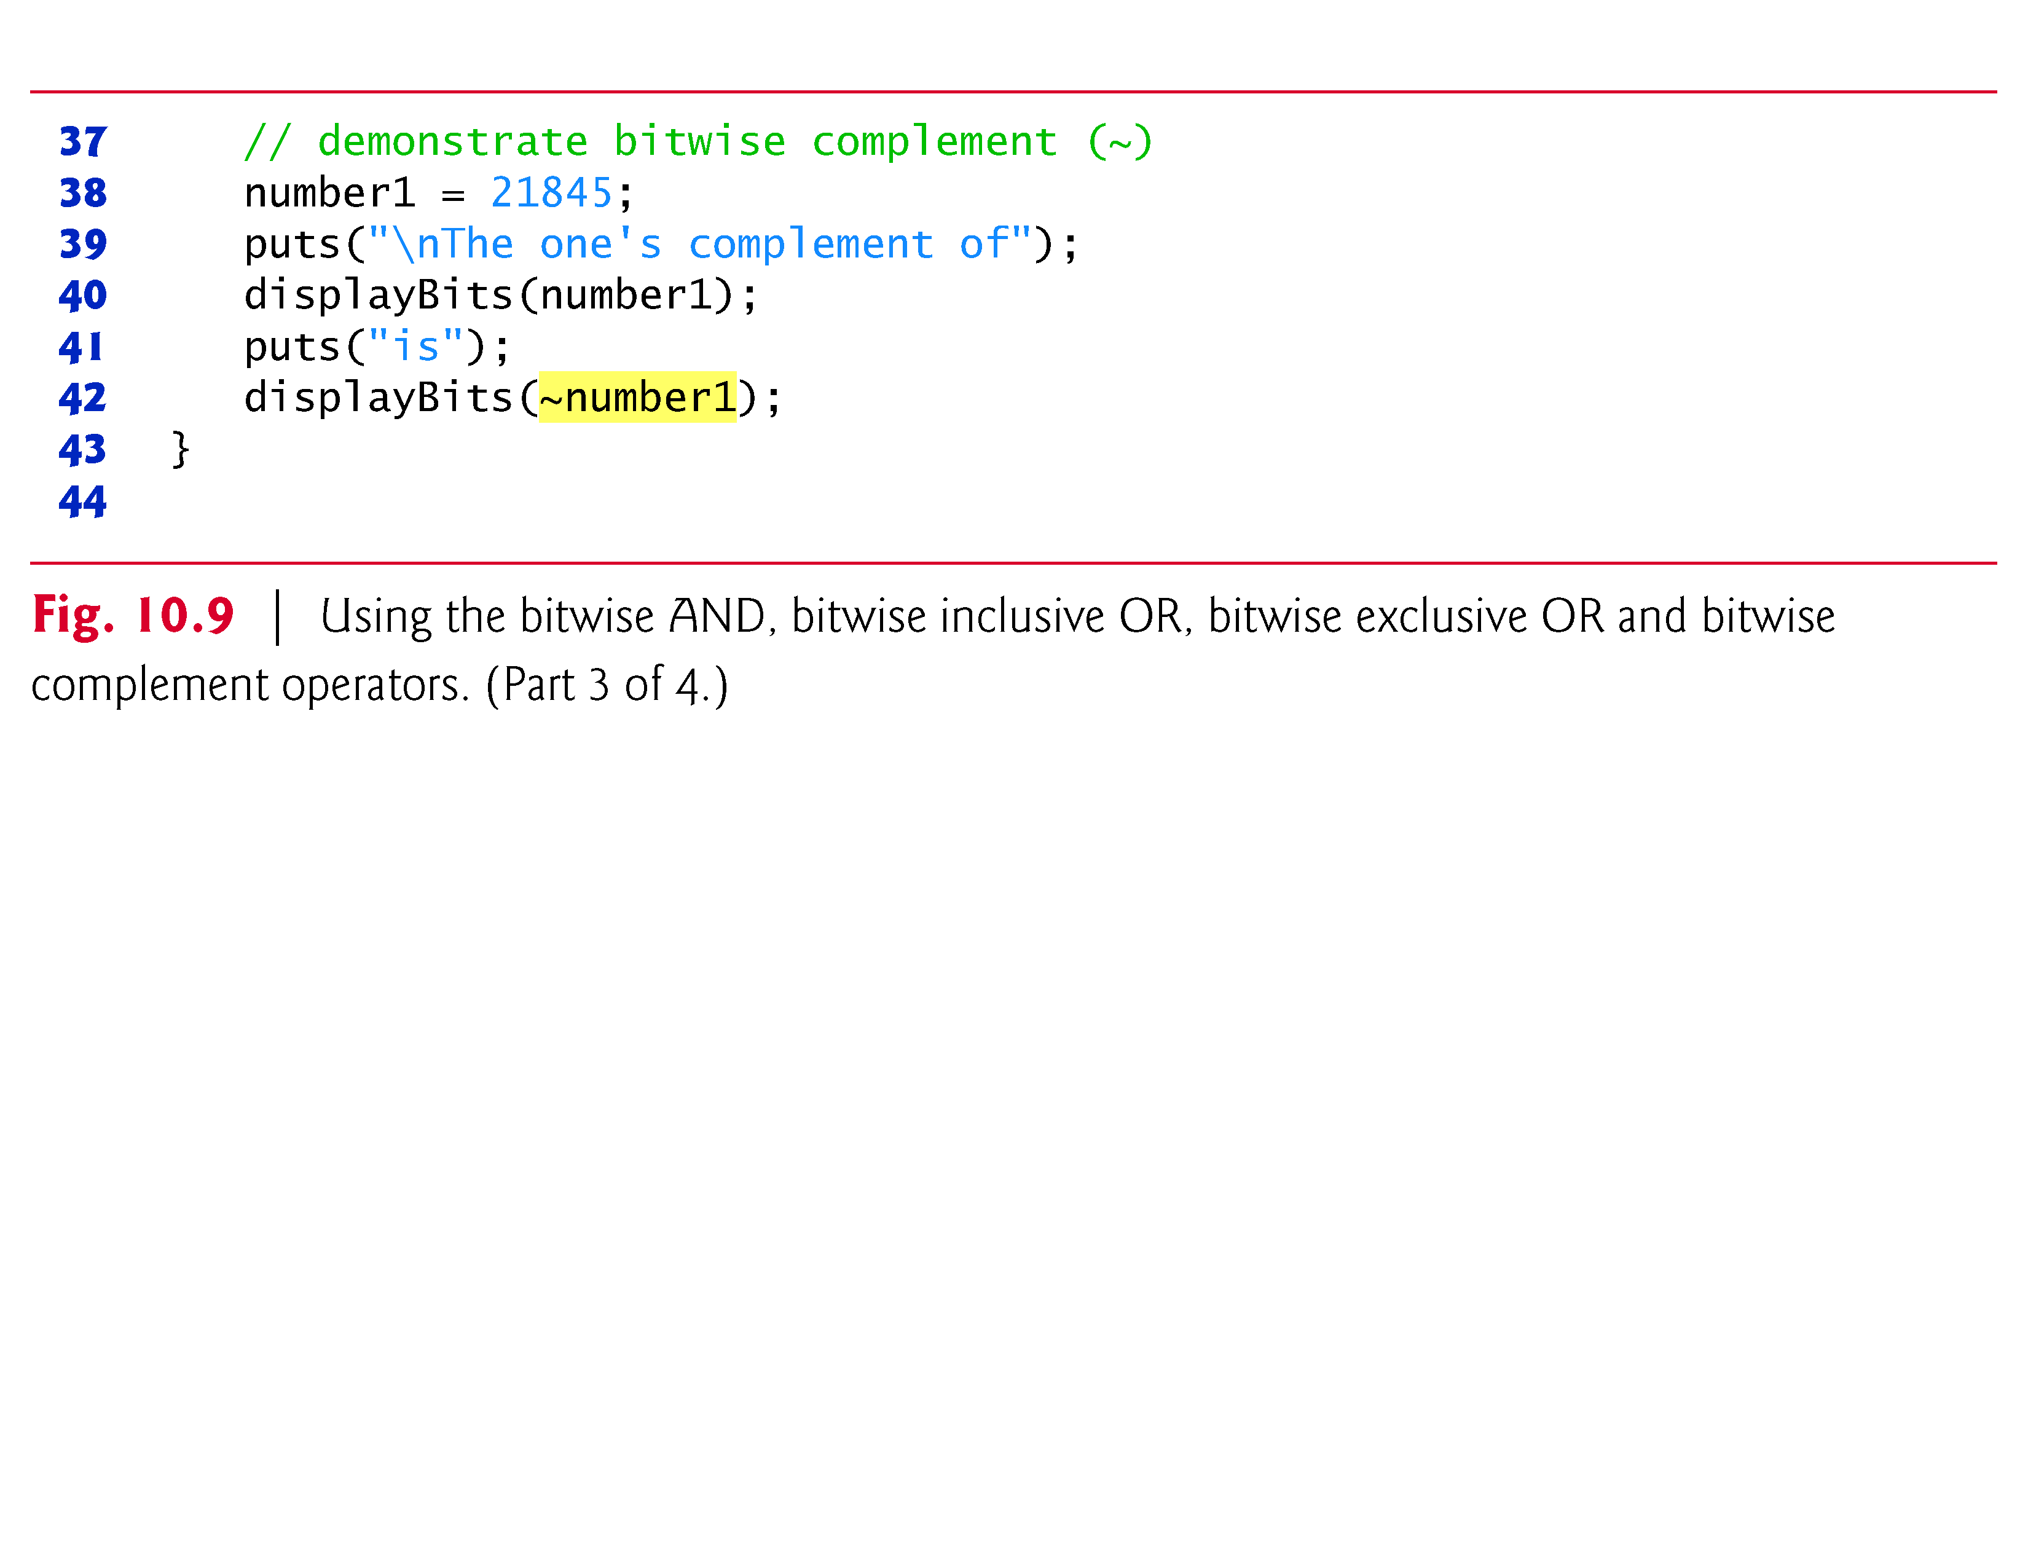

Slide 93
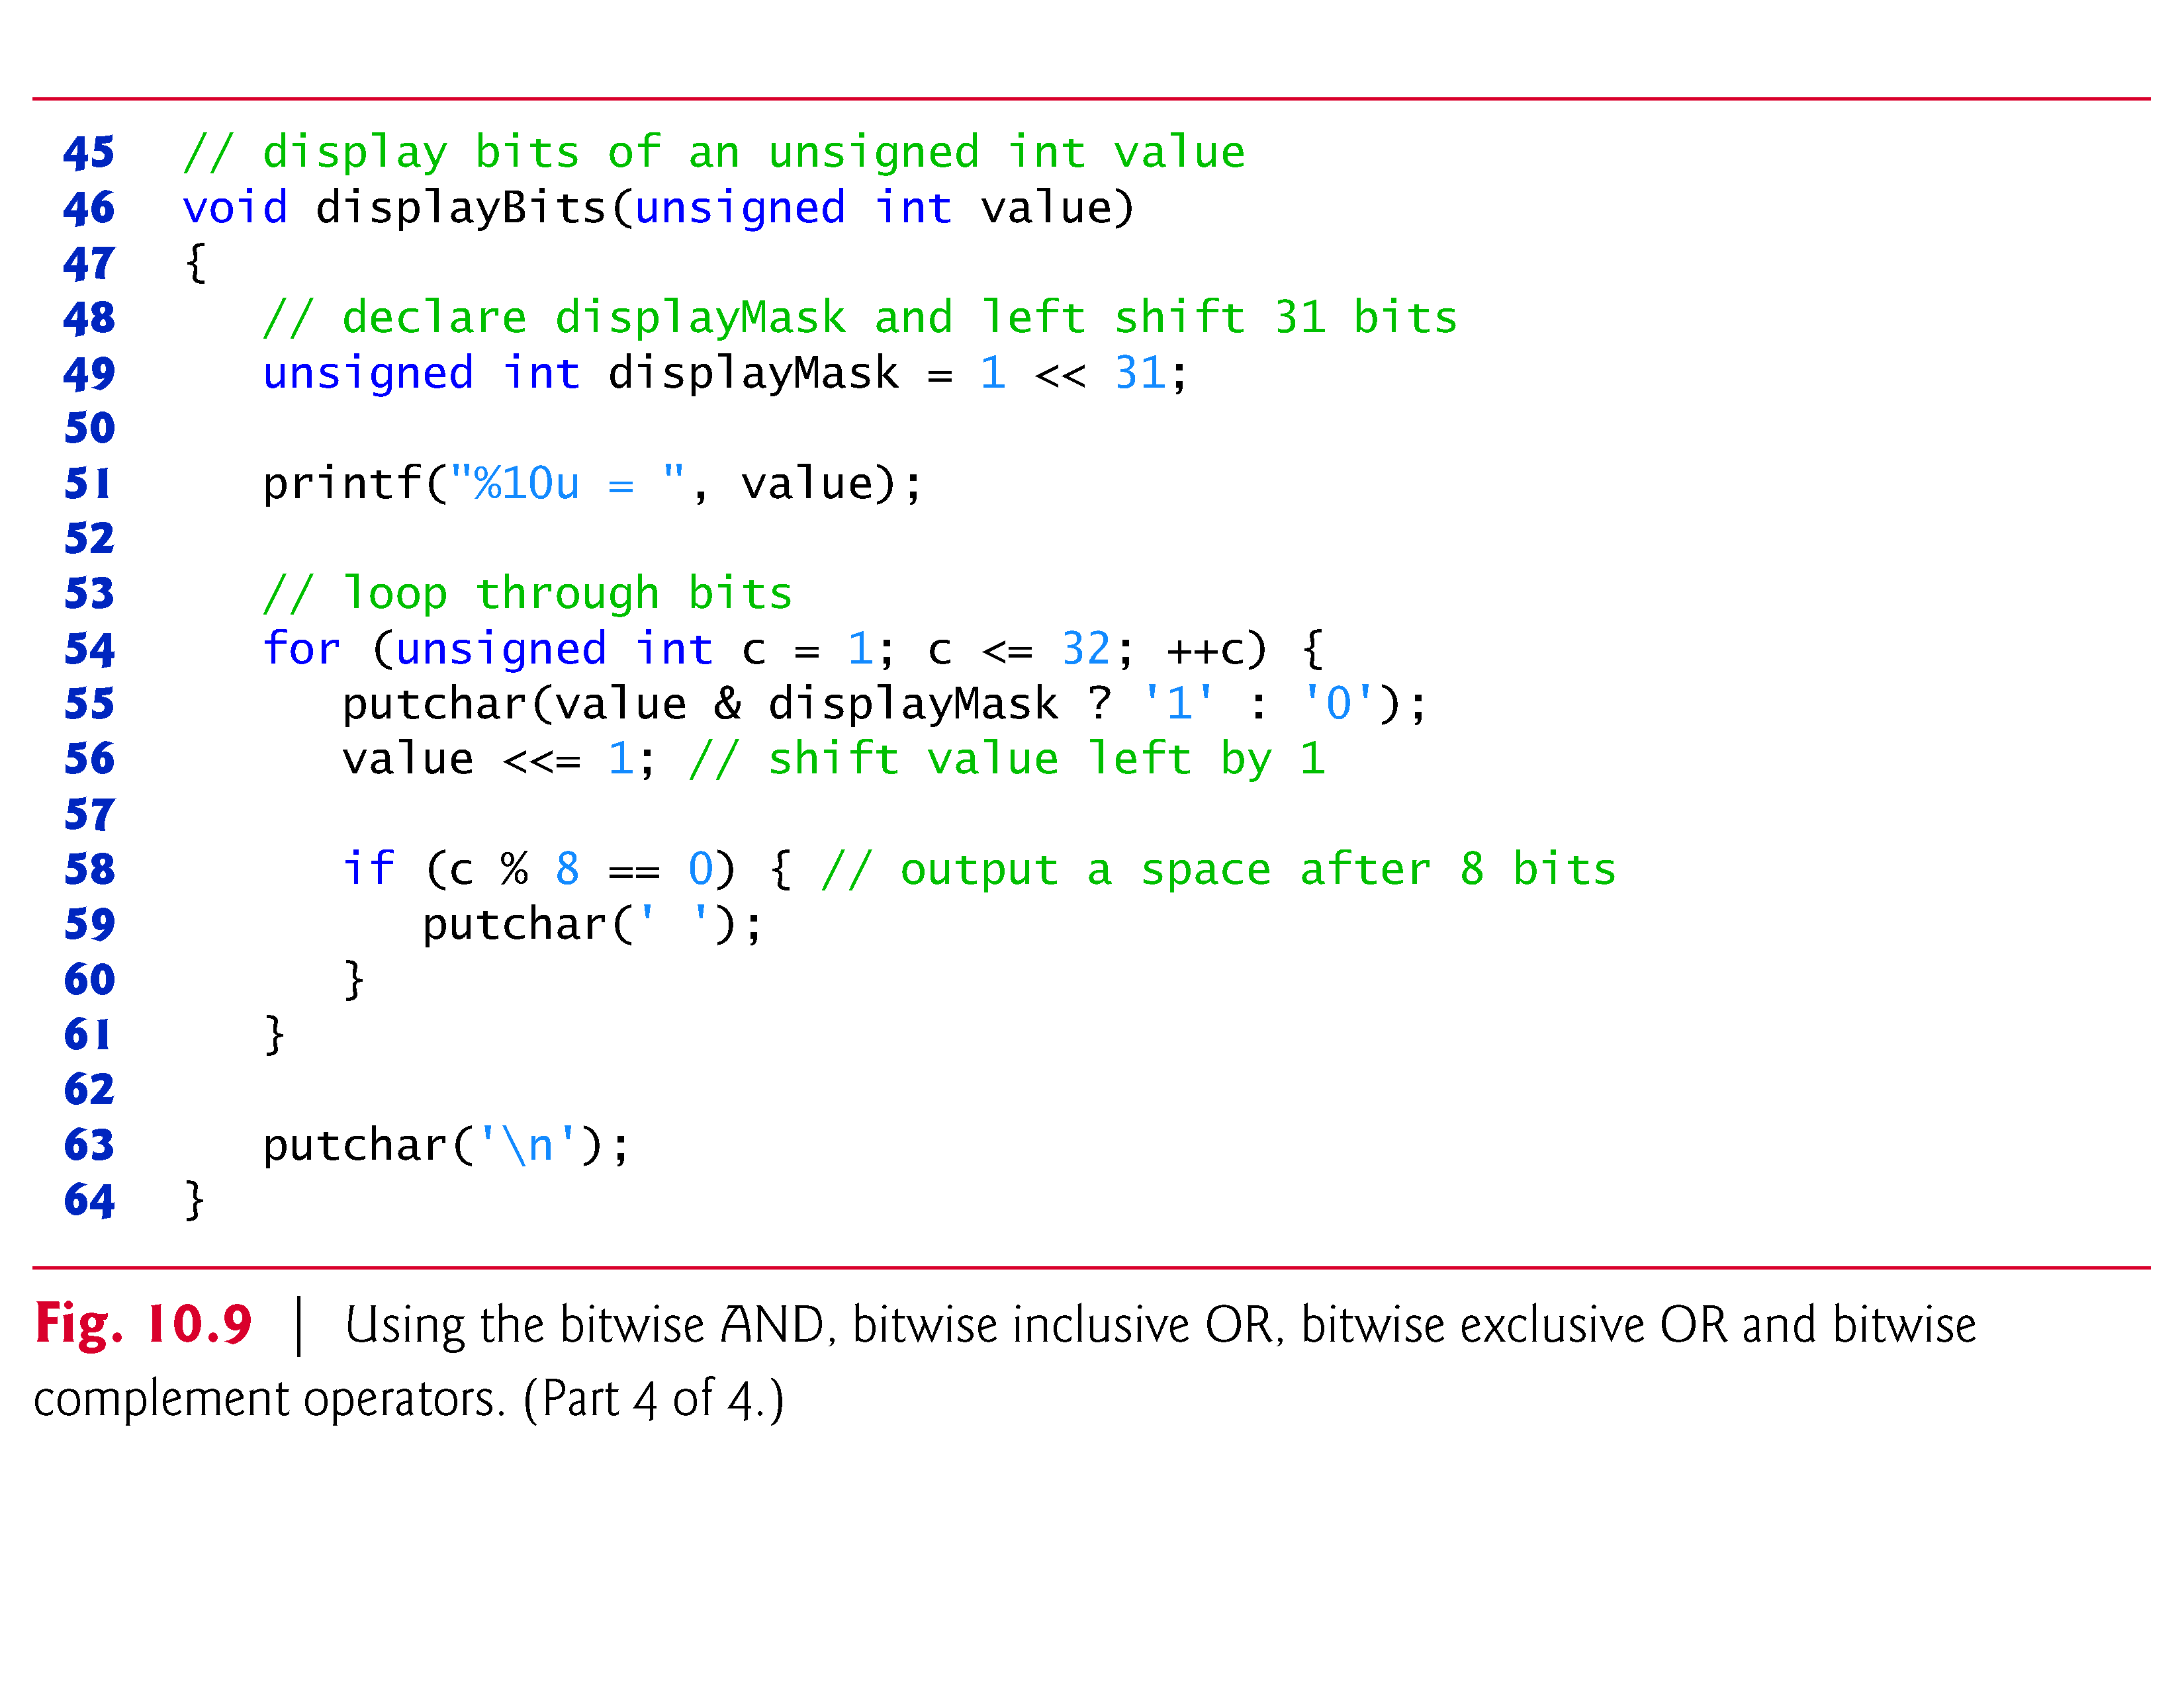

Slide 94
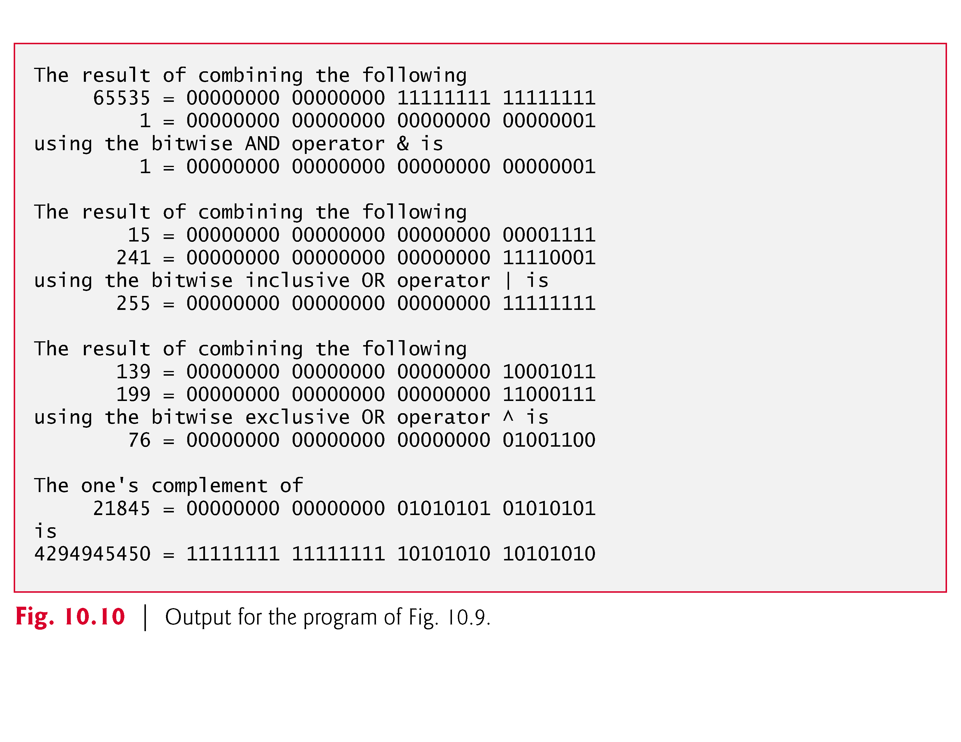

Slide 95
10.9.3 Using the Bitwise AND, Inclusive OR, Exclusive OR and Complement Operators (Cont.)
In Fig. 10.9, integer variable number1 is assigned value 65535 (00000000 00000000 11111111 11111111) and variable mask is assigned the value 1 (00000000 00000000 00000000 00000001).
When number1 and mask are combined using the bitwise AND operator (&) in the expression number1 & mask, the result is 00000000 00000000 00000000 00000001.
All the bits except the low-order bit in variable number1 are “masked off” (hidden) by “ANDing” with variable mask.
The bitwise inclusive OR operator is used to set specific bits to 1 in an operand.

Slide 96
10.9.3 Using the Bitwise AND, Inclusive OR, Exclusive OR and Complement Operators (Cont.)
In Fig. 10.9, variable number1 is assigned 15 (00000000 00000000 00000000 00001111), and variable setBits is assigned 241 (00000000 00000000 00000000 11110001)
When number1 and setBits are combined using the bitwise inclusive OR operator in the expression number1 | setBits, the result is 255 (00000000 00000000 00000000 11111111).
Figure 10.11 summarizes the results of combining two bits with the bitwise inclusive OR operator.

Slide 97
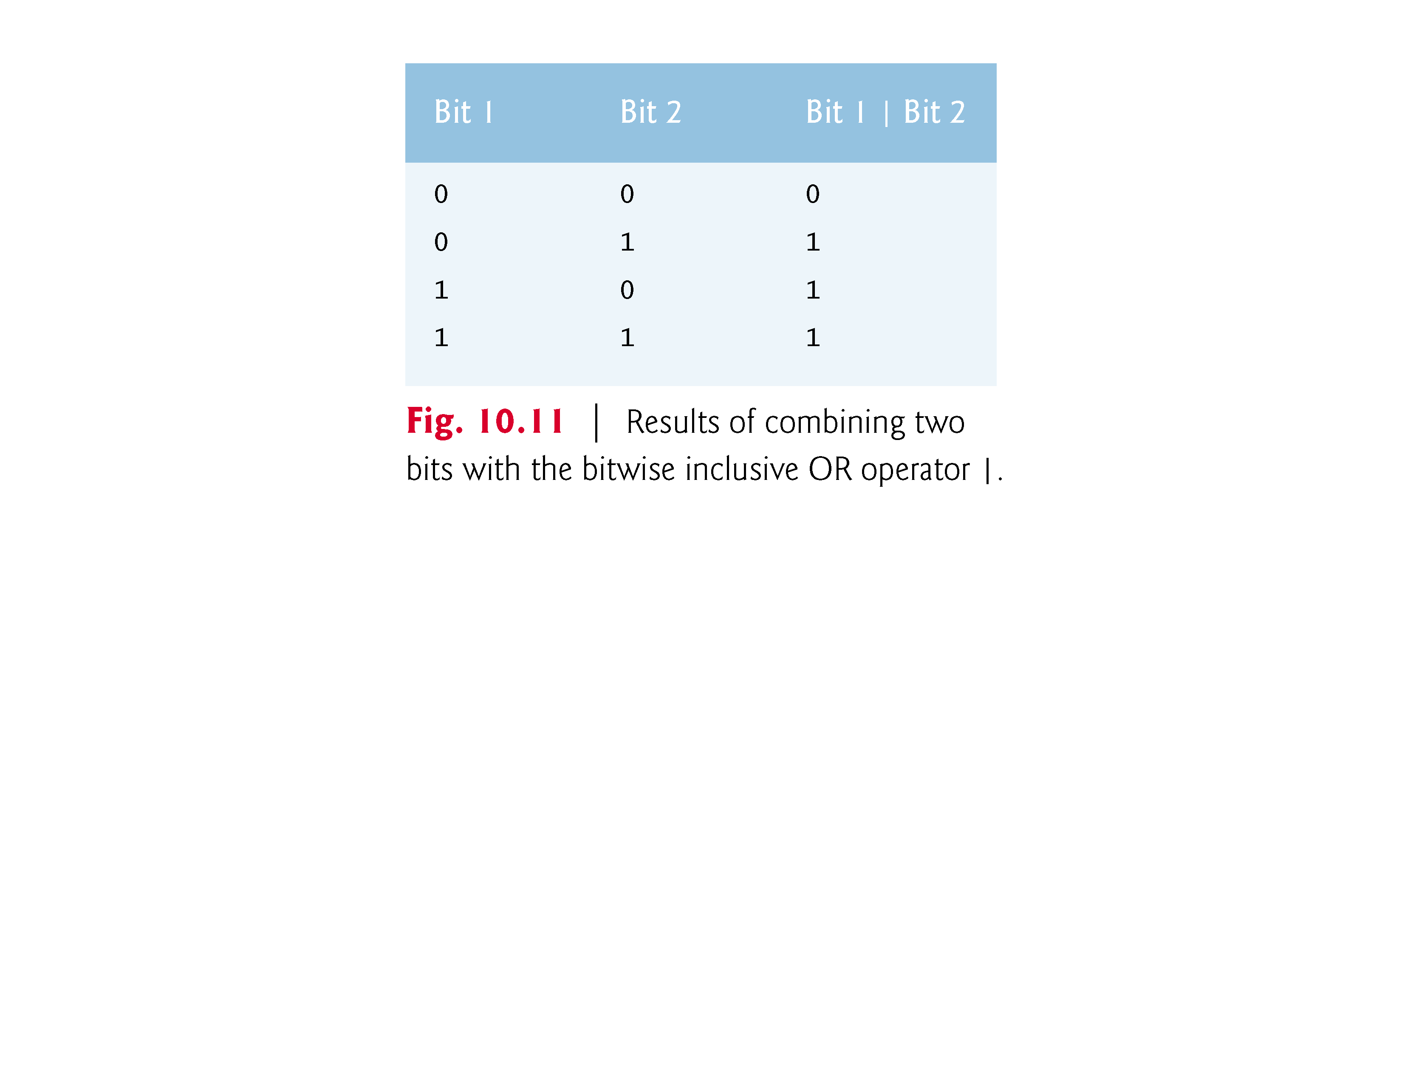

Slide 98
10.9.3 Using the Bitwise AND, Inclusive OR, Exclusive OR and Complement Operators (Cont.)
The bitwise exclusive OR operator (^) sets each bit in the result to 1 if exactly one of the corresponding bits in its two operands is 1.
In Fig. 10.9, variables number1 and number2 are assigned the values 139 (00000000 00000000 00000000 10001011) and 199 (00000000 00000000 00000000 11000111)
When these variables are combined with the bitwise exclusive OR operator in the expression number1 ^ number2, the result is 00000000 00000000 00000000 01001100.
Figure 10.12 summarizes the results of combining two bits with the bitwise exclusive OR operator.

Slide 99
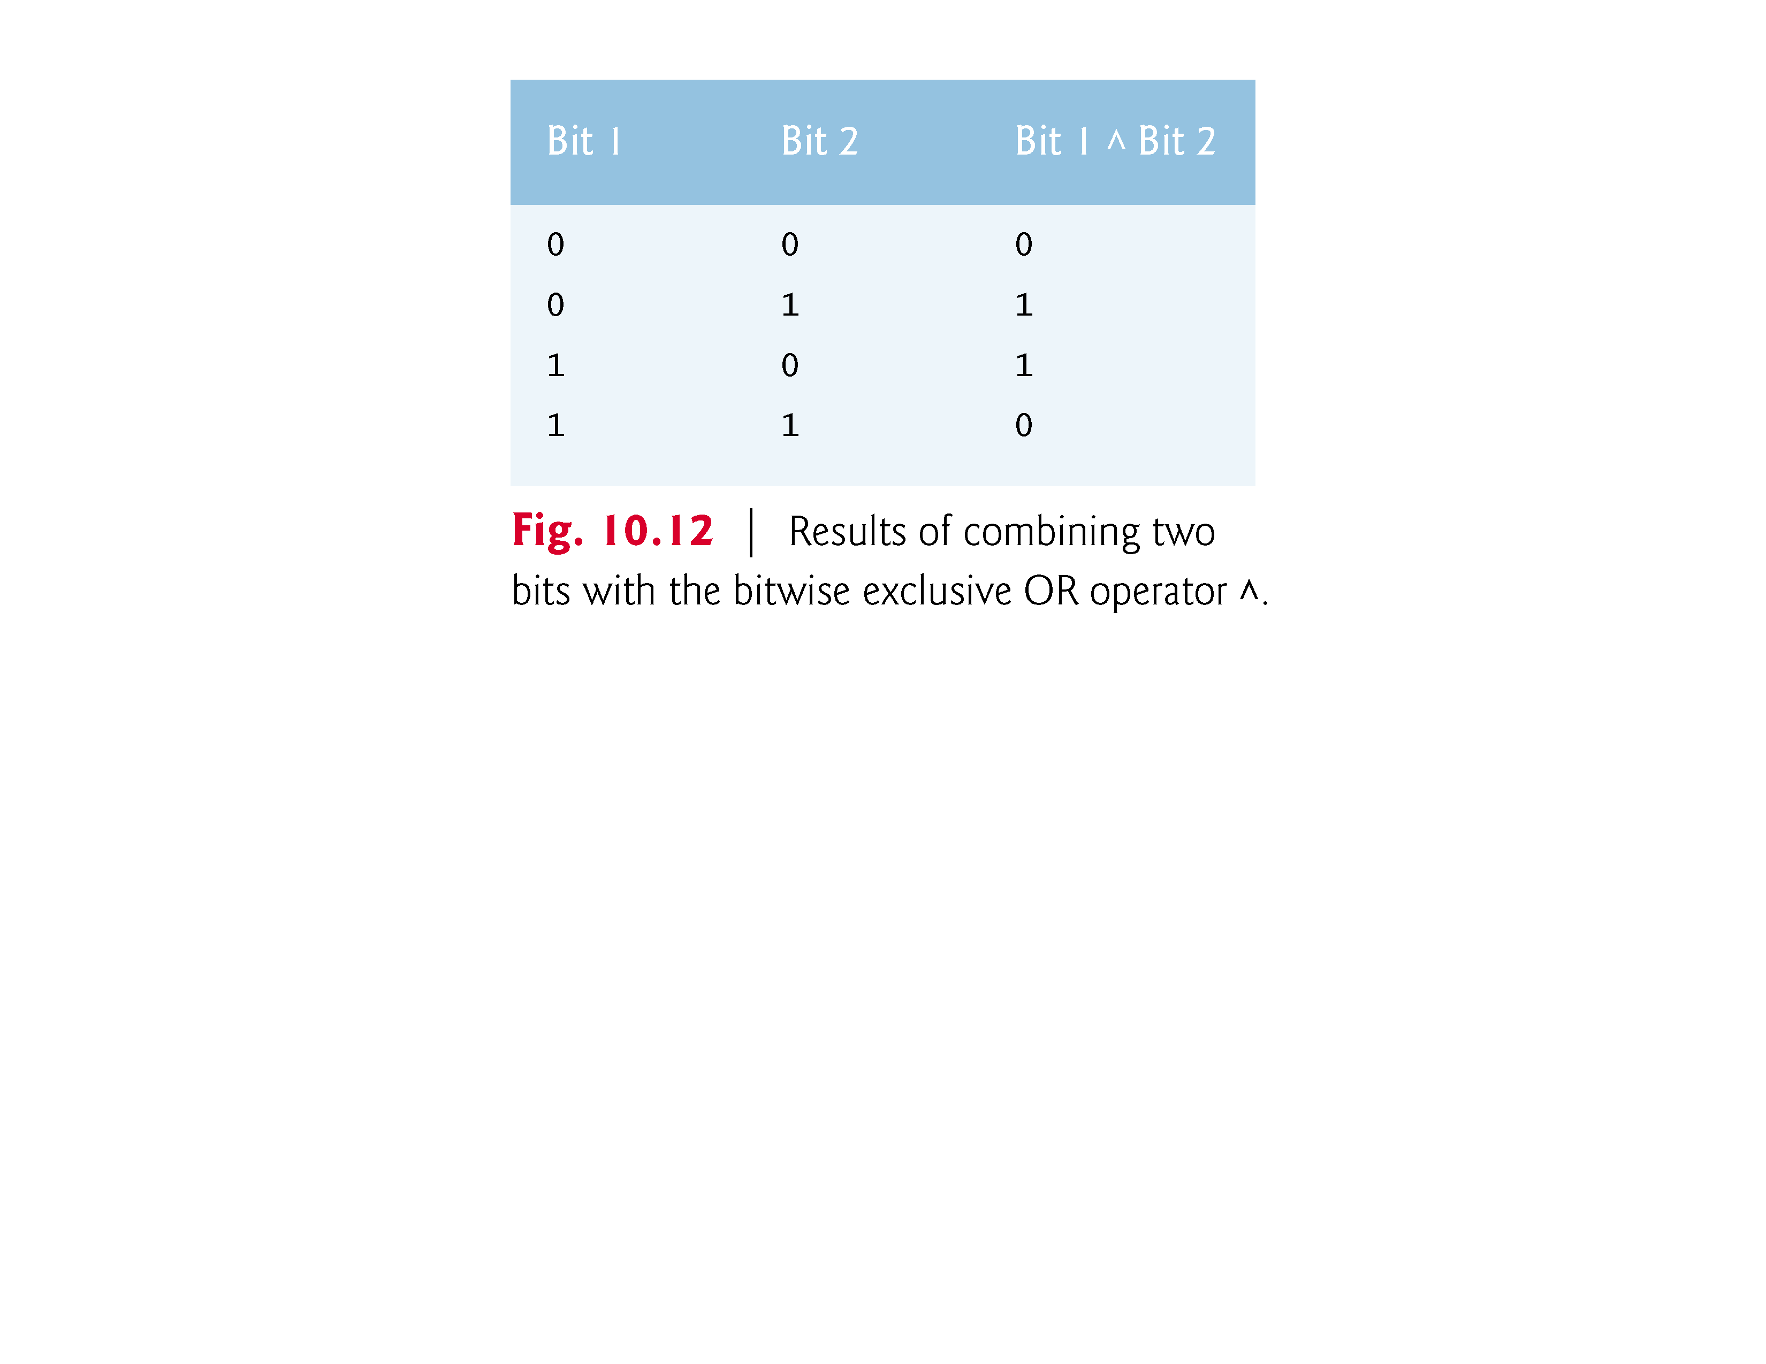

Slide 100
10.9.3 Using the Bitwise AND, Inclusive OR, Exclusive OR and Complement Operators (Cont.)
The bitwise complement operator (~) sets all 1 bits in its operand to 0 in the result and sets all 0 bits to 1 in the result—otherwise referred to as “taking the one’s complement of the value.”
In Fig. 10.9, variable number1 is assigned the value 21845 (00000000 00000000 01010101 01010101)
When the expression ~number1 is evaluated, the result is 11111111 11111111 10101010 10101010.

Slide 101
10.9.4 Using the Bitwise Left- and Right-Shift Operators
The program of Fig. 10.13 demonstrates the left-shift operator (<<) and the right-shift operator (>>).
Function displayBits is used to print the unsigned int values.

Slide 102
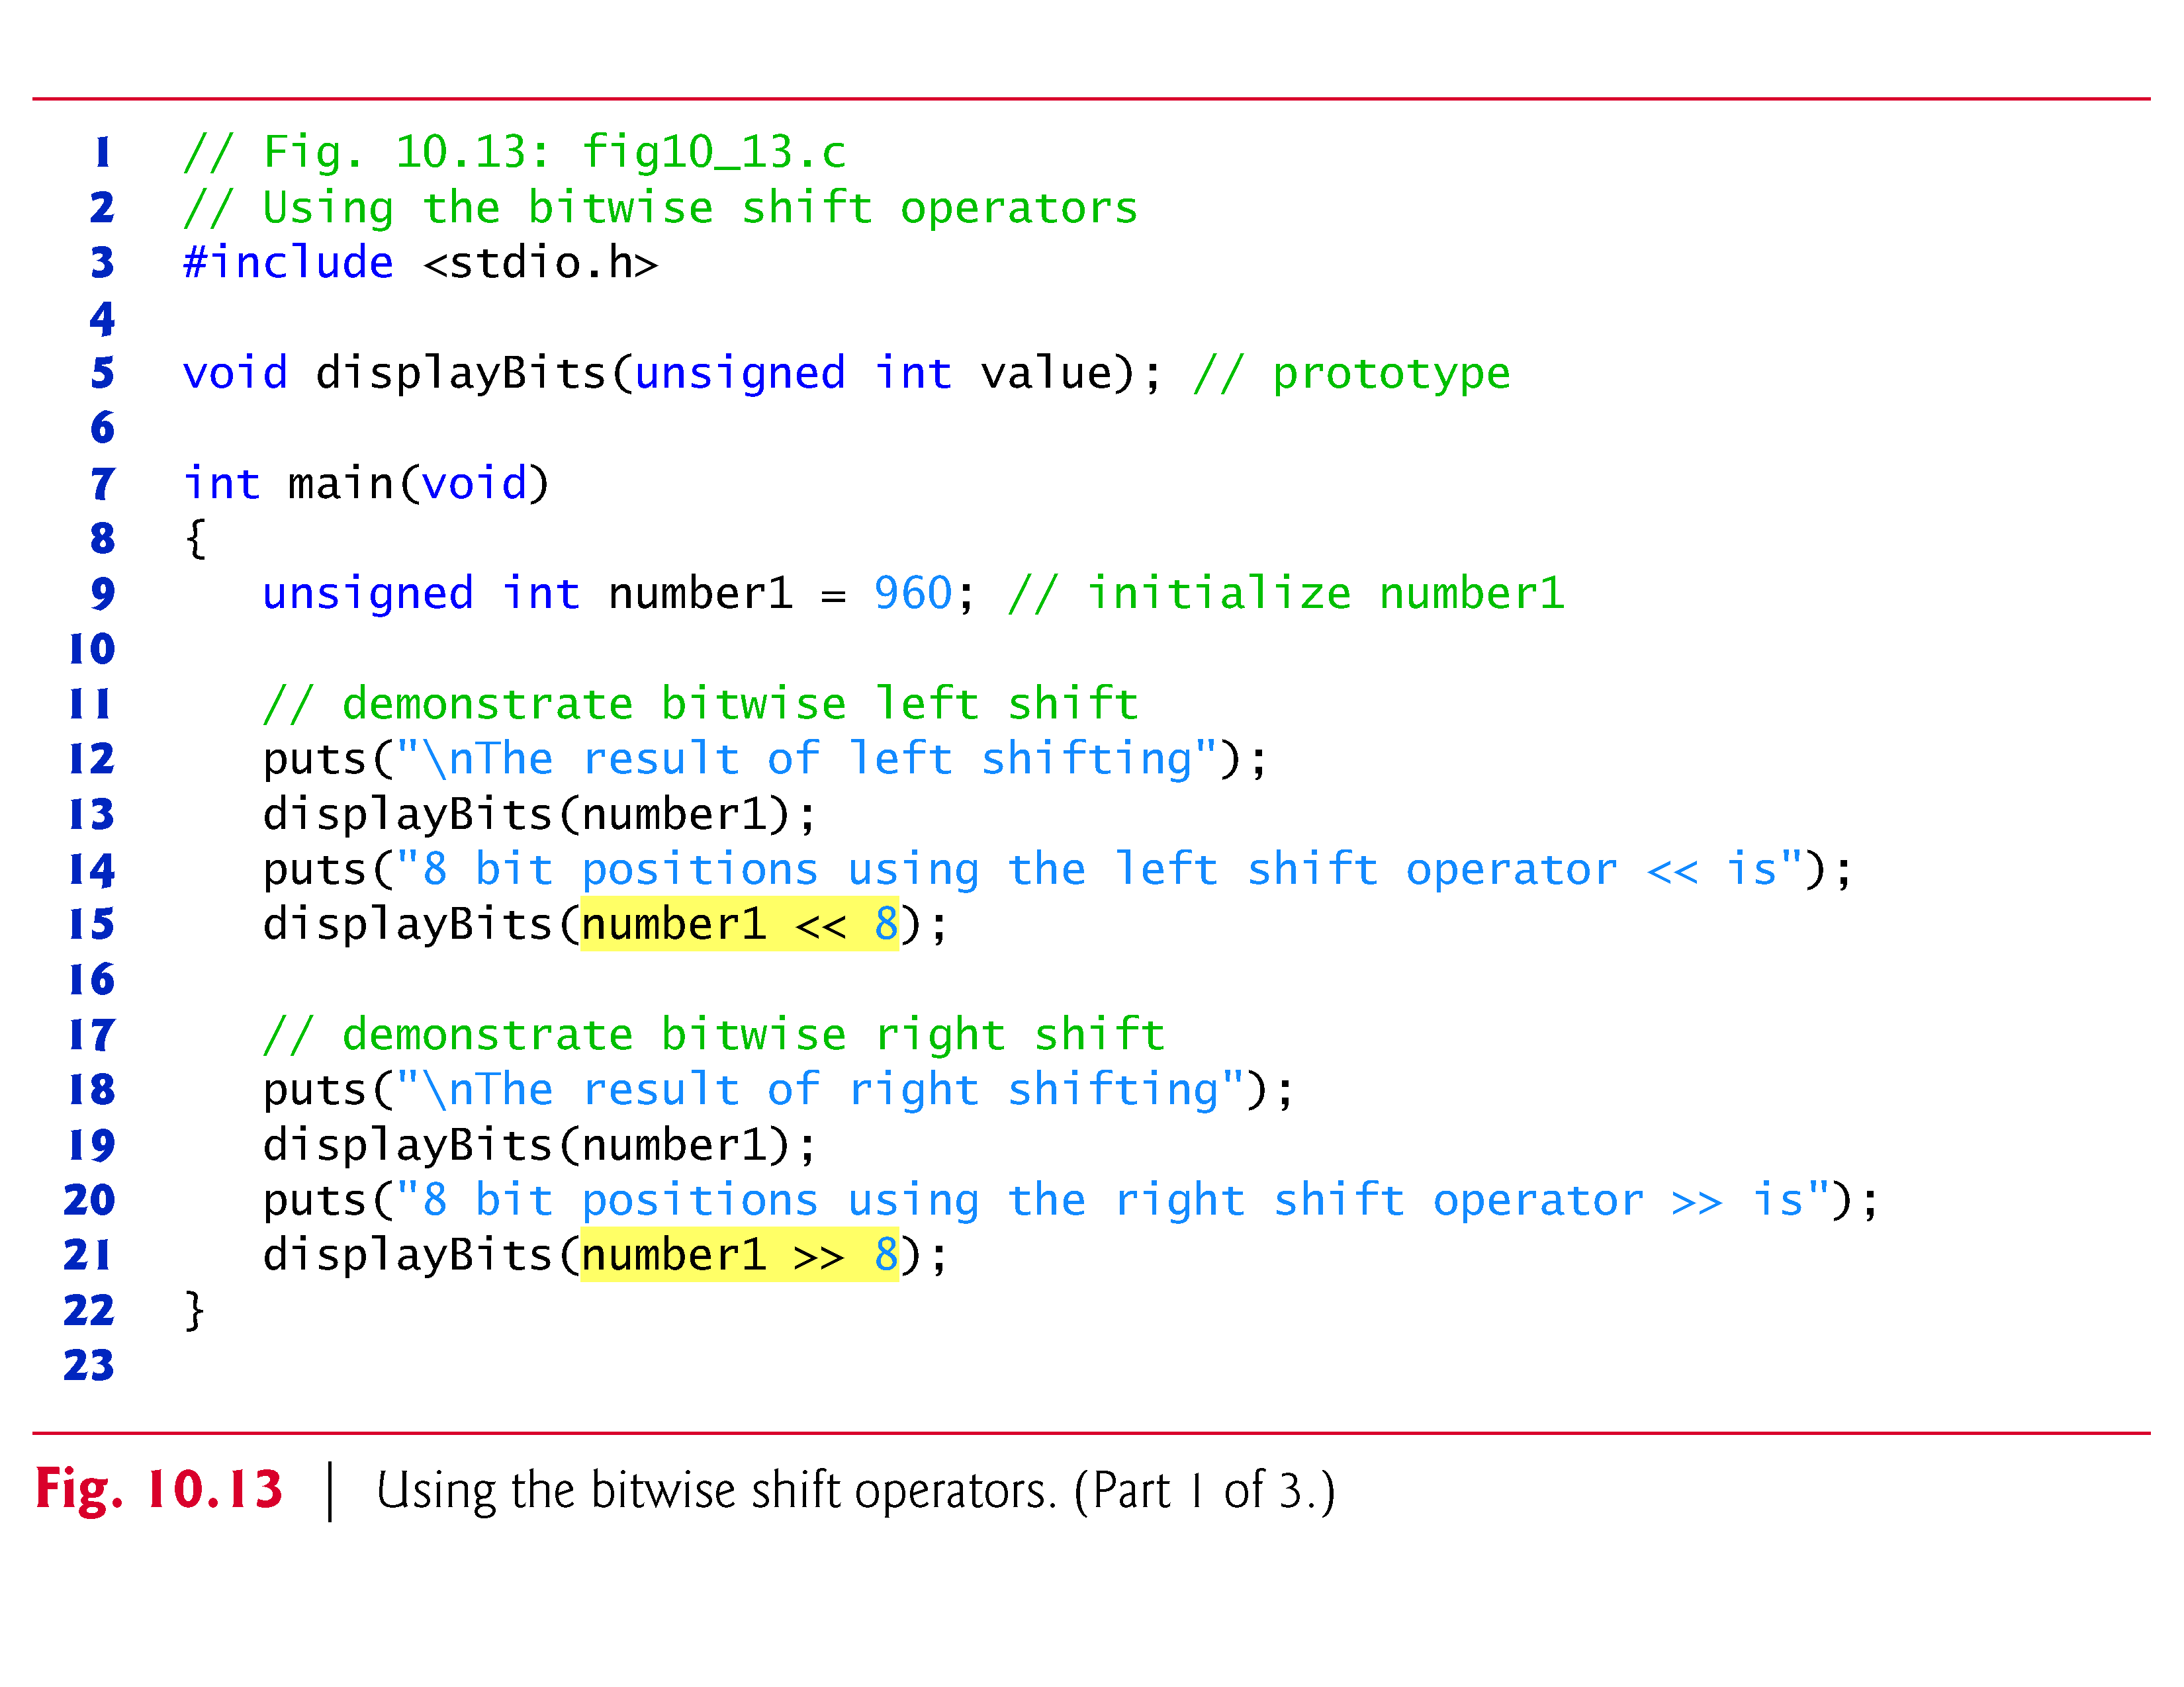

Slide 103
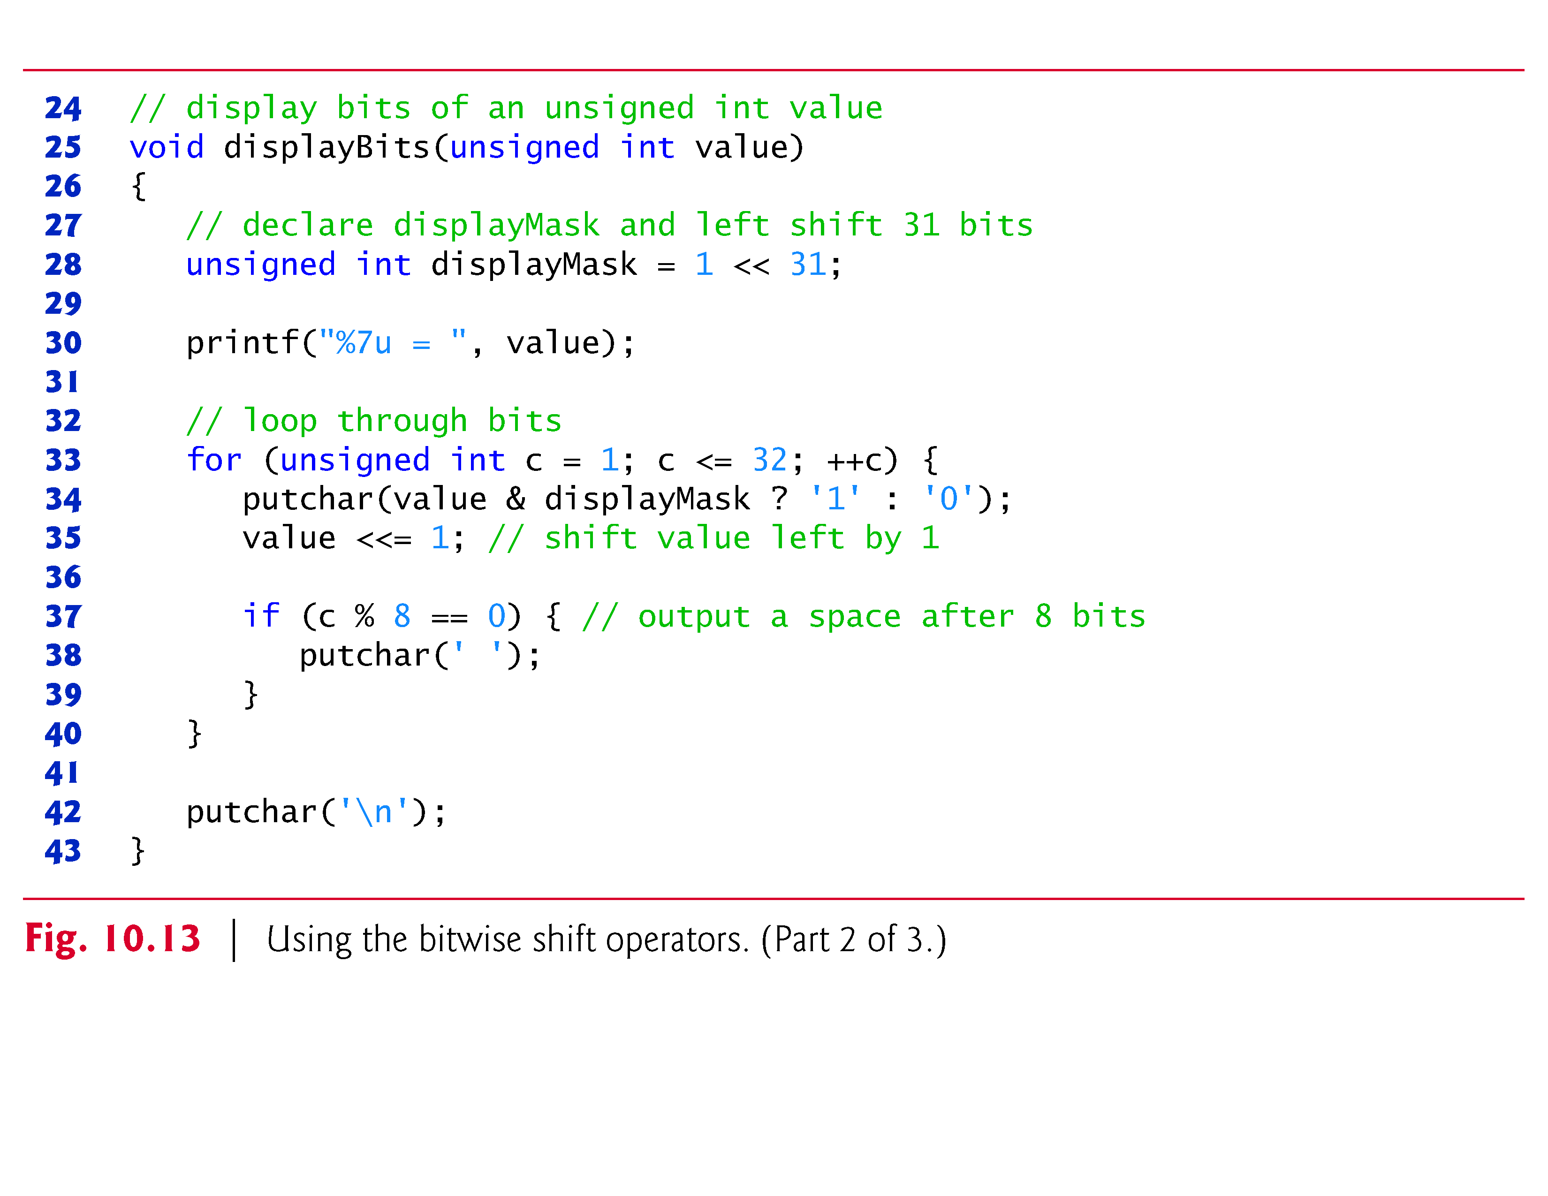

Slide 104
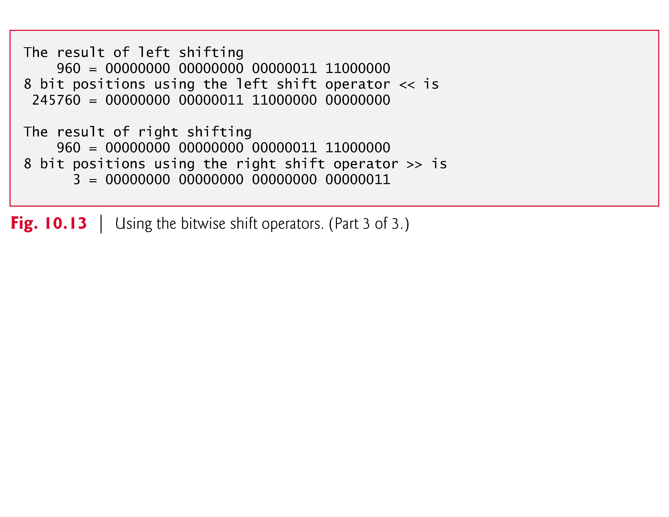

Slide 105
10.9.4 Using the Bitwise Left- and Right-Shift Operators (Cont.)
The left-shift operator (<<) shifts the bits of its left operand to the left by the number of bits specified in its right operand.
Bits vacated to the right are replaced with 0s; 1s shifted off the left are lost.
In Fig. 10.13, variable number1 is assigned the value 960 (00000000 00000000 00000011 11000000)
The result of left shifting variable number1 8 bits in the expression number1 << 8 is 49152 (00000000 00000011 11000000 00000000).

Slide 106
10.9.4 Using the Bitwise Left- and Right-Shift Operators (Cont.)
The right-shift operator (>>) shifts the bits of its left operand to the right by the number of bits specified in its right operand.
Performing a right shift on an unsigned int causes the vacated bits at the left to be replaced by 0s; 1s shifted off the right are lost.
In Fig. 10.13, the result of right shifting number1 in the expression number1 >> 8 is 3 (00000000 00000000 00000000 00000011).

Slide 107


Slide 108
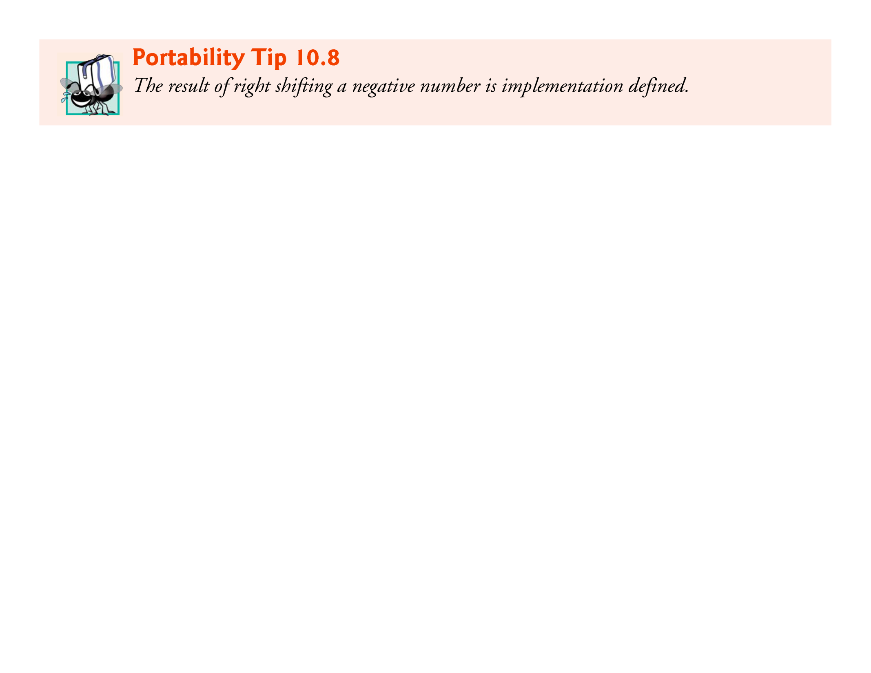

Slide 109
10.9.5 Bitwise Assignment Operators
Each binary bitwise operator has a corresponding assignment operator.
These bitwise assignment operators are shown in Fig. 10.14 and are used in a manner similar to the arithmetic assignment operators introduced in Chapter 3.

Slide 110
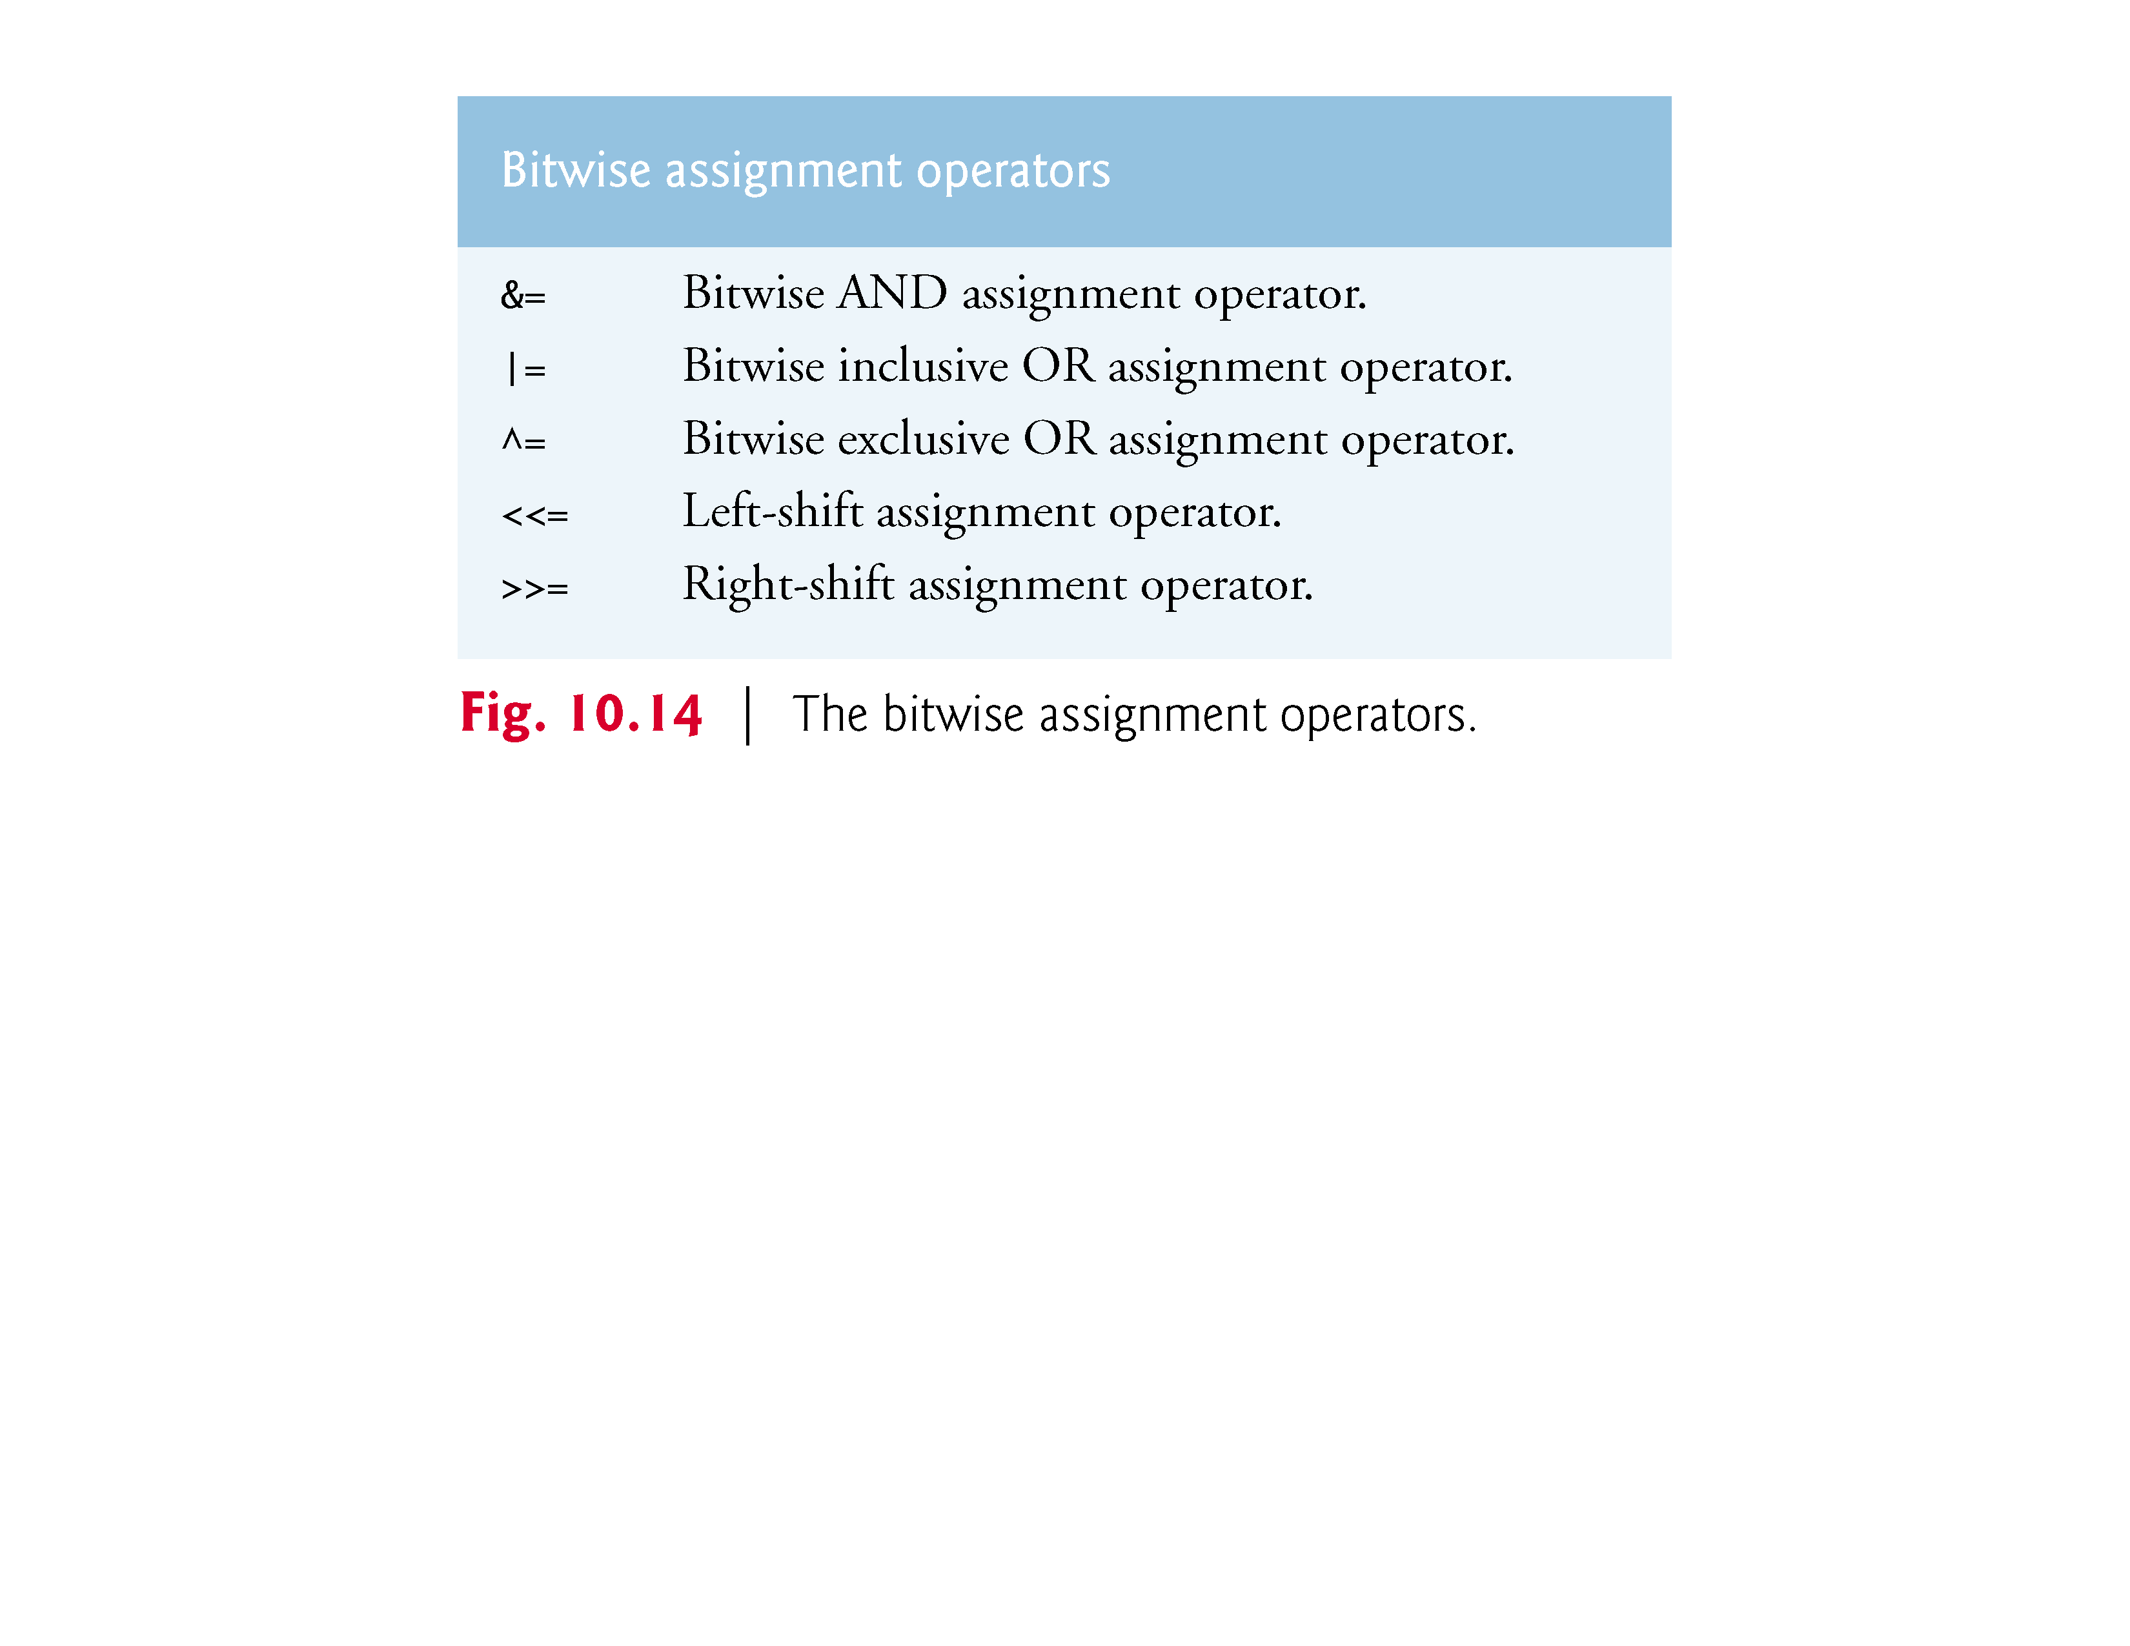

Slide 111
10.9 Bitwise Operators (Cont.)
Figure 10.15 shows the precedence and associativity of the various operators introduced to this point in the text.
They’re shown top to bottom in decreasing order of precedence.

Slide 112
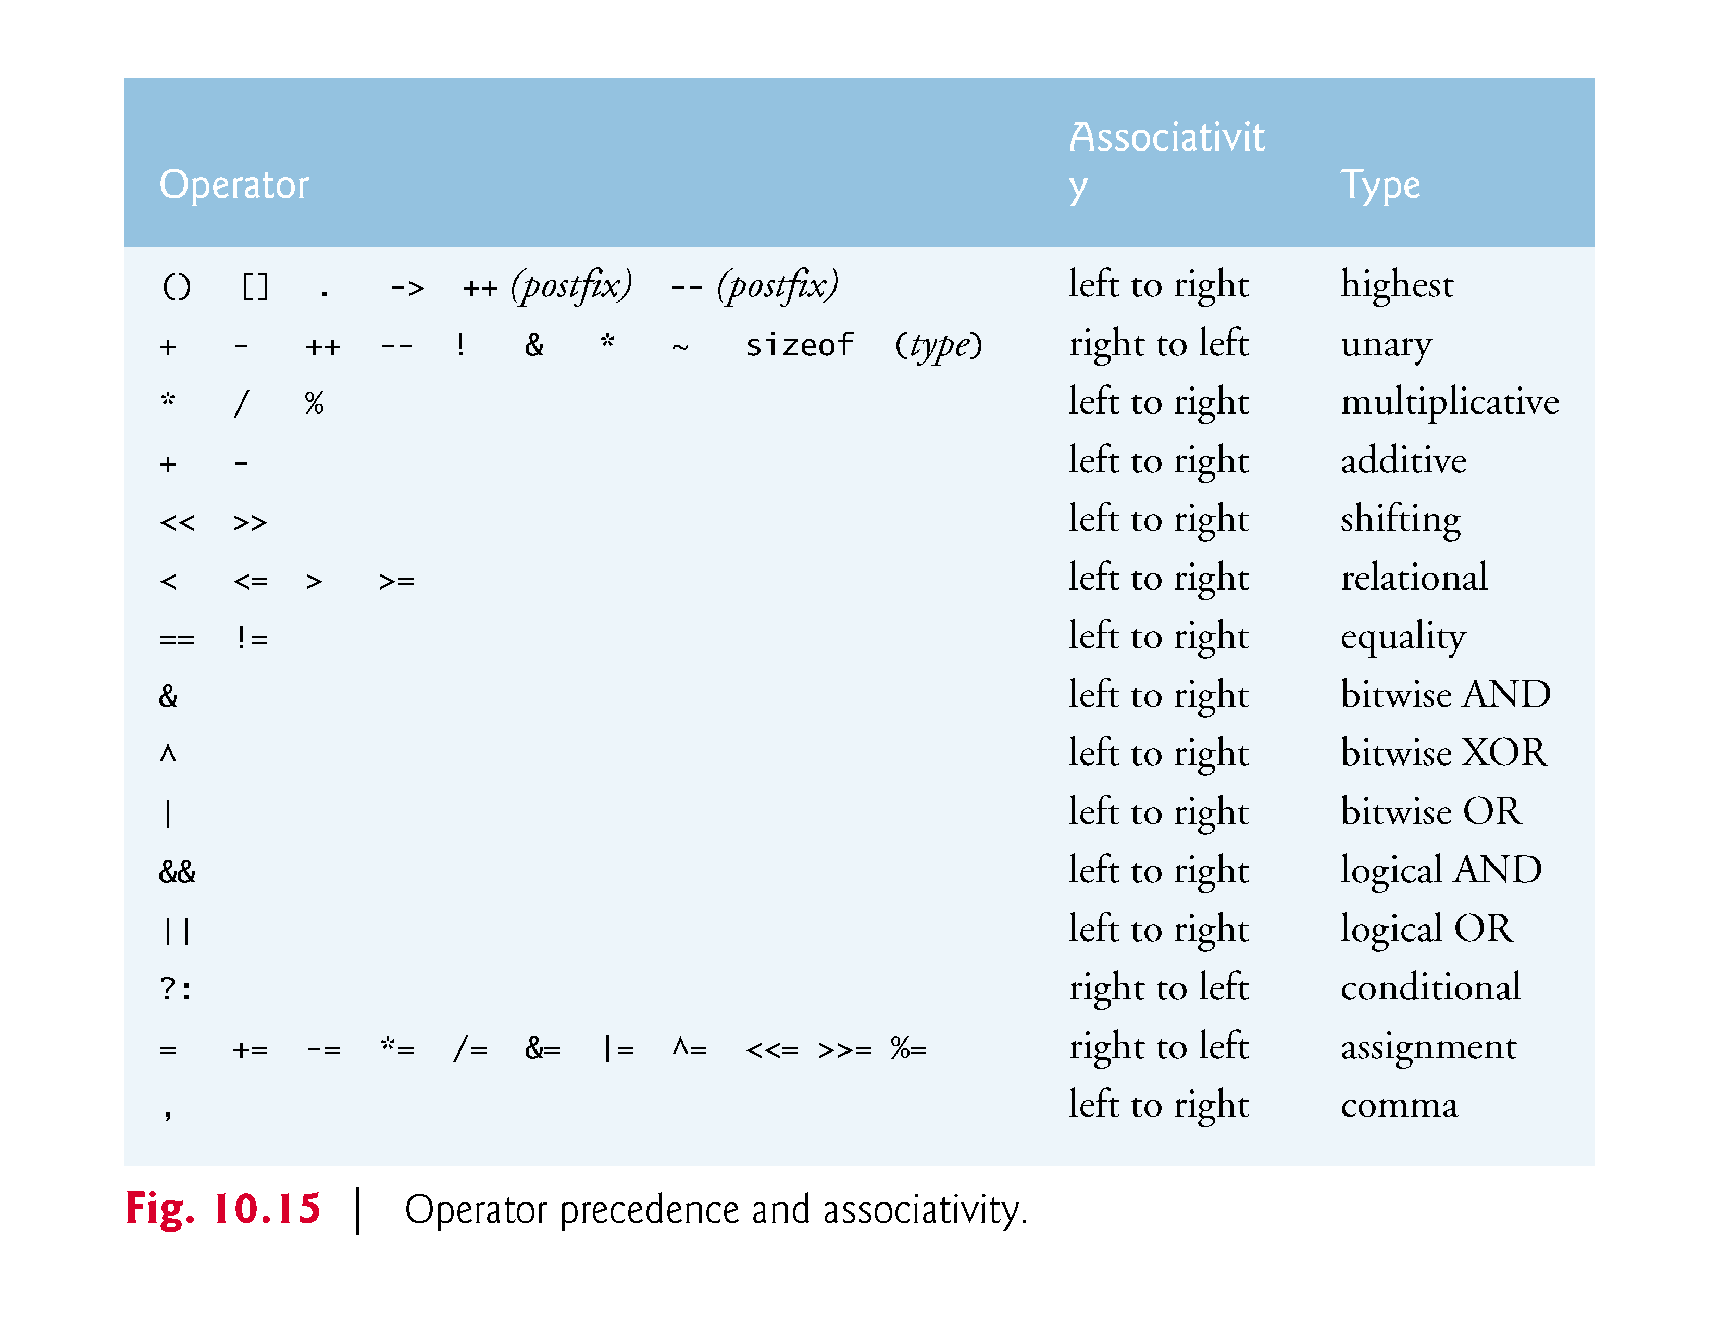

Slide 113
10.10 Bit Fields
C enables you to specify the number of bits in which an unsigned int or int member of a structure or union is stored.
This is referred to as a bit field.
Bit fields enable better memory utilization by storing data in the minimum number of bits required.
Bit field members must be declared as int or unsigned int.

Slide 114
10.10 Bit Fields (Cont.)
Consider the following structure definition:
struct bitCard { unsigned int face : 4; unsigned int suit : 2; unsigned int color : 1; };
which contains three unsigned int bit fields—face, suit and color—used to represent a card from a deck of 52 cards.

Slide 115
10.10 Bit Fields (Cont.)
A bit field is declared by following an unsigned int or int member name with a colon (:) and an integer constant representing the width of the field (i.e., the number of bits in which the member is stored).
The constant representing the width must be an integer between 0 and the total number of bits used to store an int on your system, inclusive.
Our examples were tested on a computer with 4-byte (32-bit) integers.
The preceding structure definition indicates that member face is stored in 4 bits, member suit is stored in 2 bits and member color is stored in 1 bit.

Slide 116
10.10 Bit Fields (Cont.)
The number of bits is based on the desired range of values for each structure member.
Member face stores values from 0 (Ace) through 12 (King)—4 bits can store values in the range 0–15.
Member suit stores values from 0 through 3 (0 = Diamonds, 1 = Hearts, 2 = Clubs, 3 = Spades)—2 bits can store values in the range 0–3.
Finally, member color stores either 0 (Red) or 1 (Black)—1 bit can store either 0 or 1.
Figure 10.16 (output shown in Fig. 10.17) creates array deck containing 52 struct bitCard structures

Slide 117
10.10 Bit Fields (Cont.)
Function fillDeck inserts the 52 cards in the deck array and function deal prints the 52 cards.
Notice that bit field members of structures are accessed exactly as any other structure member.
Member color is included as a means of indicating the card color on a system that allows color displays.
It’s possible to specify an unnamed bit field to be used as padding in the structure.

Slide 118
10.10 Bit Fields (Cont.)
For example, the structure definition
struct example { unsigned int a : 13; unsignedint : 19; unsigned int b : 4; };
uses an unnamed 19-bit field as padding—nothing can be stored in those 19 bits.
Member b (on our 4-byte-word computer) is stored in another storage unit.

Slide 119
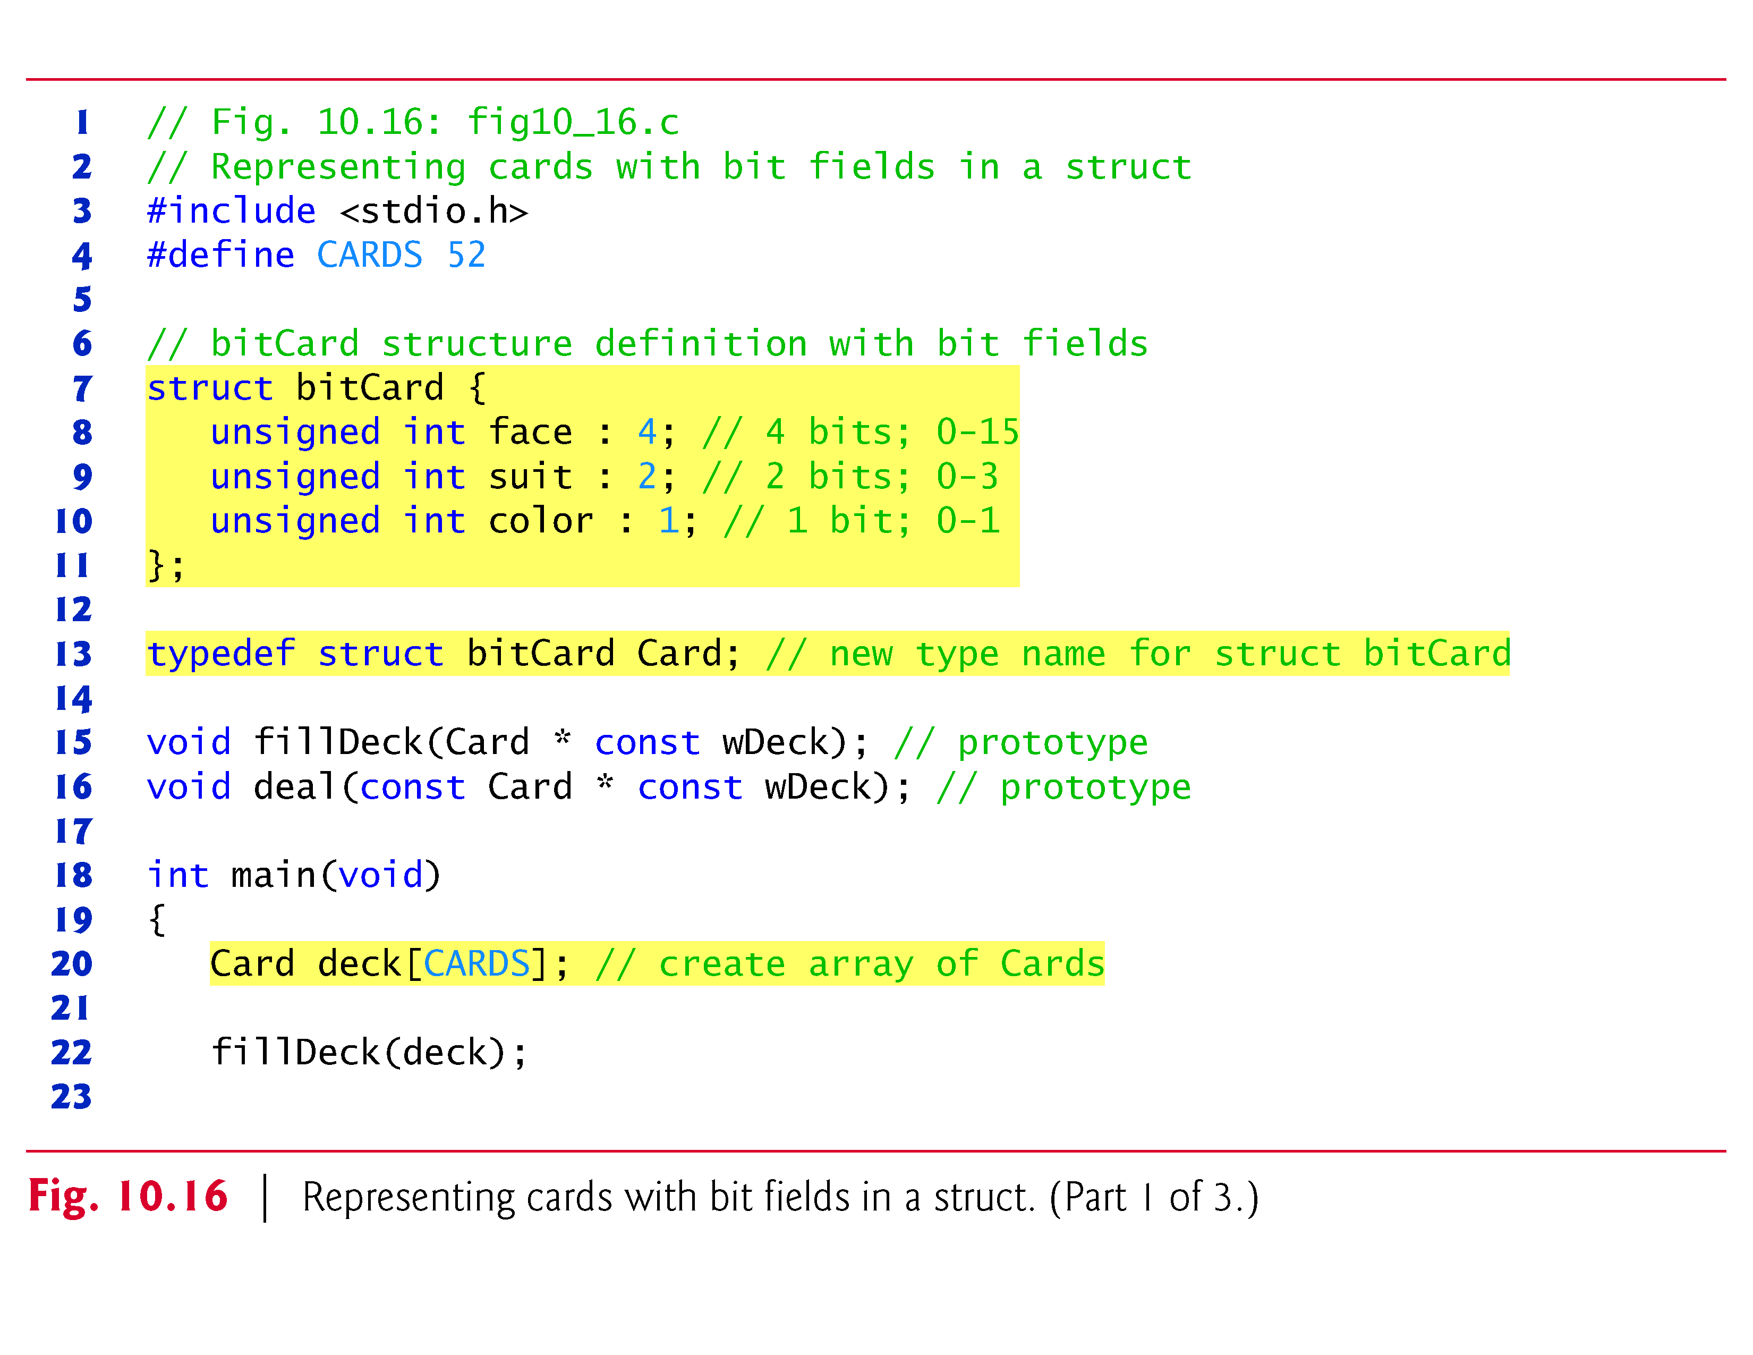

Slide 120


Slide 121


Slide 122


Slide 123
10.10 Bit Fields (Cont.)
An unnamed bit field with a zero width is used to align the next bit field on a new storage-unit boundary.
For example, the structure definition
struct example { unsigned int a : 13; unsigned int : 0; unsigned int b : 4; };
uses an unnamed 0-bit field to skip the remaining bits (as many as there are) of the storage unit in which a is stored and to align b on the next storage-unit boundary.

Slide 124


Slide 125


Slide 126


Slide 127


Slide 128


Slide 129
10.11 Enumeration Constants
An enumeration (discussed briefly in Section 5.11), introduced by the keyword enum, is a set of integer enumeration constants represented by identifiers.
Values in an enum start with 0, unless specified otherwise, and are incremented by 1.
For example, the enumeration
enum months { JAN, FEB, MAR, APR, MAY, JUN, JUL, AUG, SEP, OCT, NOV, DEC};
creates a new type, enum months, in which the identifiers are set to the integers 0 to 11, respectively.

Slide 130
10.11 Enumeration Constants (Cont.)
To number the months 1 to 12, use the following enumeration:
enum months { JAN = 1, FEB, MAR, APR, MAY, JUN, JUL, AUG, SEP, OCT, NOV, DEC};
Because the first value in the preceding enumeration is explicitly set to 1, the remaining values are incremented from 1, resulting in the values 1 through 12.
The identifiers in an enumeration must be unique.
The value of each enumeration constant of an enumeration can be set explicitly in the definition by assigning a value to the identifier.

Slide 131
10.11 Enumeration Constants (Cont.)
Multiple members of an enumeration can have the same constant value.
In the program of Fig. 10.18, the enumeration variable month is used in a for statement to print the months of the year from the array monthName.
We’ve made monthName[0] the empty string "".
You could set monthName[0] to a value such as ***ERROR*** to indicate that a logic error occurred.

Slide 132


Slide 133


Slide 134


Slide 135


Slide 136
10.12 Anonymous Structures and Unions
C11 supports anonymous structs and unions that can be nested in named structs and unions
Members in a nested anonymous struct and union are considered to be members of the enclosing type and can be accessed directly through an object of the enclosing type
Example
struct MyStruct { int member1; int member2; struct { int nestedMember1; int nestedMember2; }; };
For a variable myStruct of type struct MyStruct, you can access the members as:
myStruct.member1 myStruct.member2 myStruct.nestedMember1 myStruct.nestedMember2

Slide 137
10.13 Secure C Programming
Various CERT guidelines and rules apply to this chapter’s topics. For more information on each, visit www.securecoding.cert.org.
struct
The boundary alignment requirements for struct members may result in extra bytes containing undefined data for each struct variable you create. Each of the following guidelines is related to this issue:

Slide 138
10.13 Secure C Programming (Cont.)
EXP03-C: Because of boundary alignment requirements, the size of a struct variable is not necessarily the sum of its members’ sizes. Always use sizeof to determine the number of bytes in a struct variable. As you’ll see, we use this technique to manipulate fixed-length records that are written to and read from files in Chapter 11, and to create so-called dynamic data structures in Chapter 12.
EXP04-C: struct variables cannot be compared for equality or inequality, because they might contain bytes of undefined data. Therefore, you must compare their individual members.

Slide 139
10.13 Secure C Programming (Cont.)
DCL39-C: In a struct variable, the undefined extra bytes could contain secure data—left over from prior use of those memory locations—that should not be accessible. This CERT guideline discusses compiler-specific mechanisms for packing the data to eliminate these extra bytes.
typedef
DCL05-C: Complex type declarations, such as those for function pointers can be difficult to read. You should use typedef to create self-documenting type names that make your programs more readable.

Slide 140
10.13 Secure C Programming (Cont.)
Bit Manipulation
INT02-C: As a result of the integer promotion rules (discussed in Section 5.6), performing bitwise operations on integer types smaller than int can lead to unexpected results. Explicit casts are required to ensure correct results.
INT13-C: Some bitwise operations on signed integer types are implementation defined—this means that the operations may have different results across C compilers. For this reason, unsigned integer types should be used with the bitwise operators.

Slide 141
10.13 Secure C Programming (Cont.)
EXP17-C: The logical operators && and || are frequently confused with the bitwise operators & and |, respectively. Using & and | in the condition of a conditional expression (?:) can lead to unexpected behavior, because the & and | operators do not use short-circuit evaluation.
enum
INT09-C: Allowing multiple enumeration constants to have the same value can result in difficult-to-find logic errors. In most cases, an enum’s enumeration constants should each have unique values to help prevent such logic errors

